Slide 1
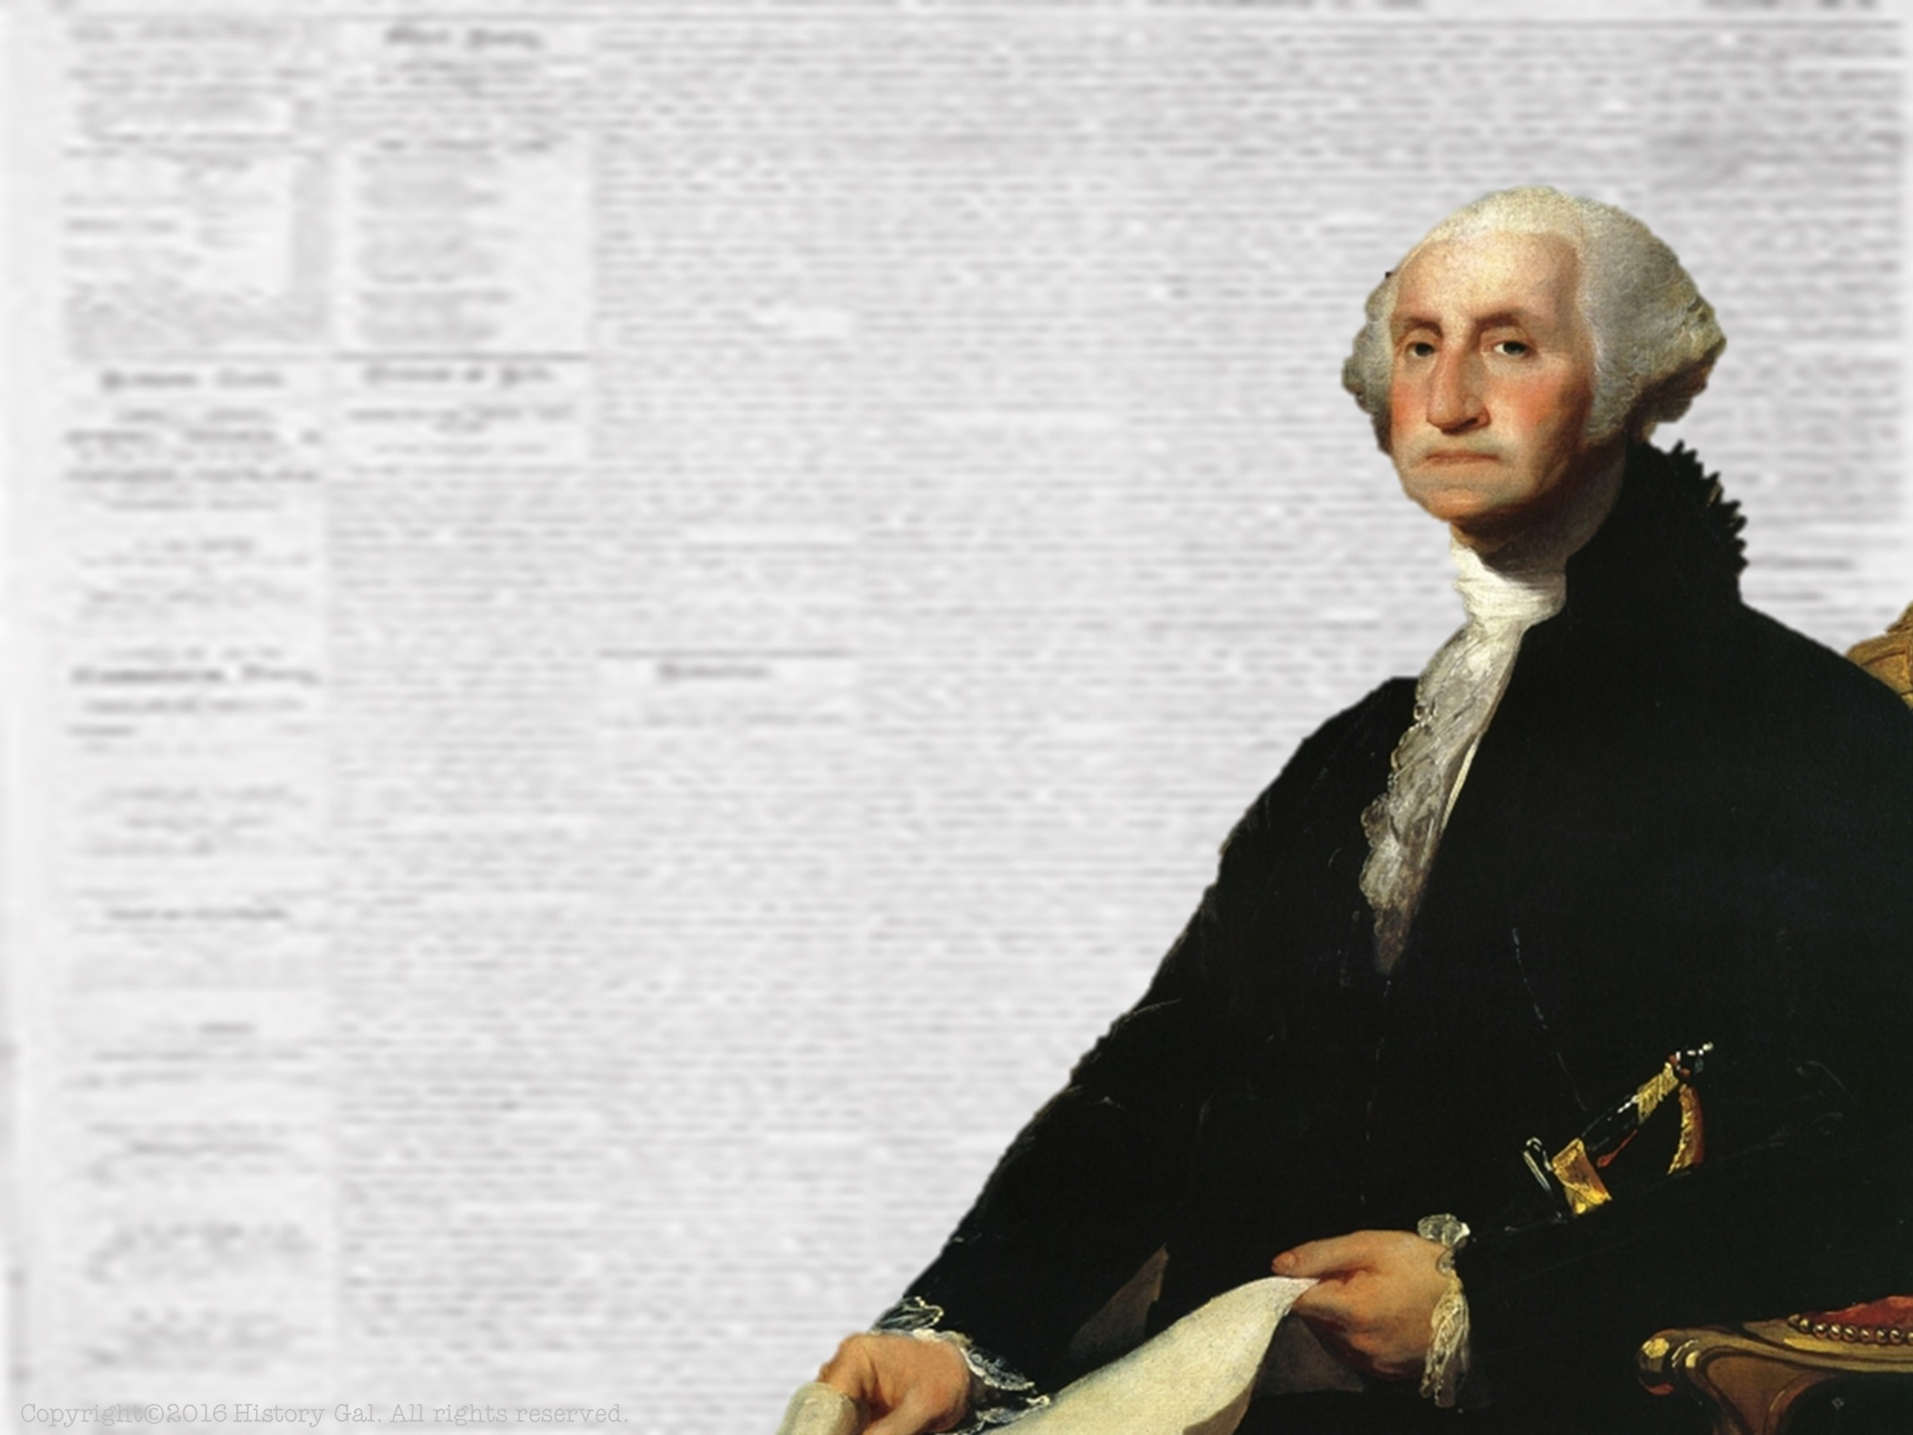
PRESIDENCY OF
GEORGE
WASHINGTON
1789-1797
George Washington in 60 Seconds

Slide 2
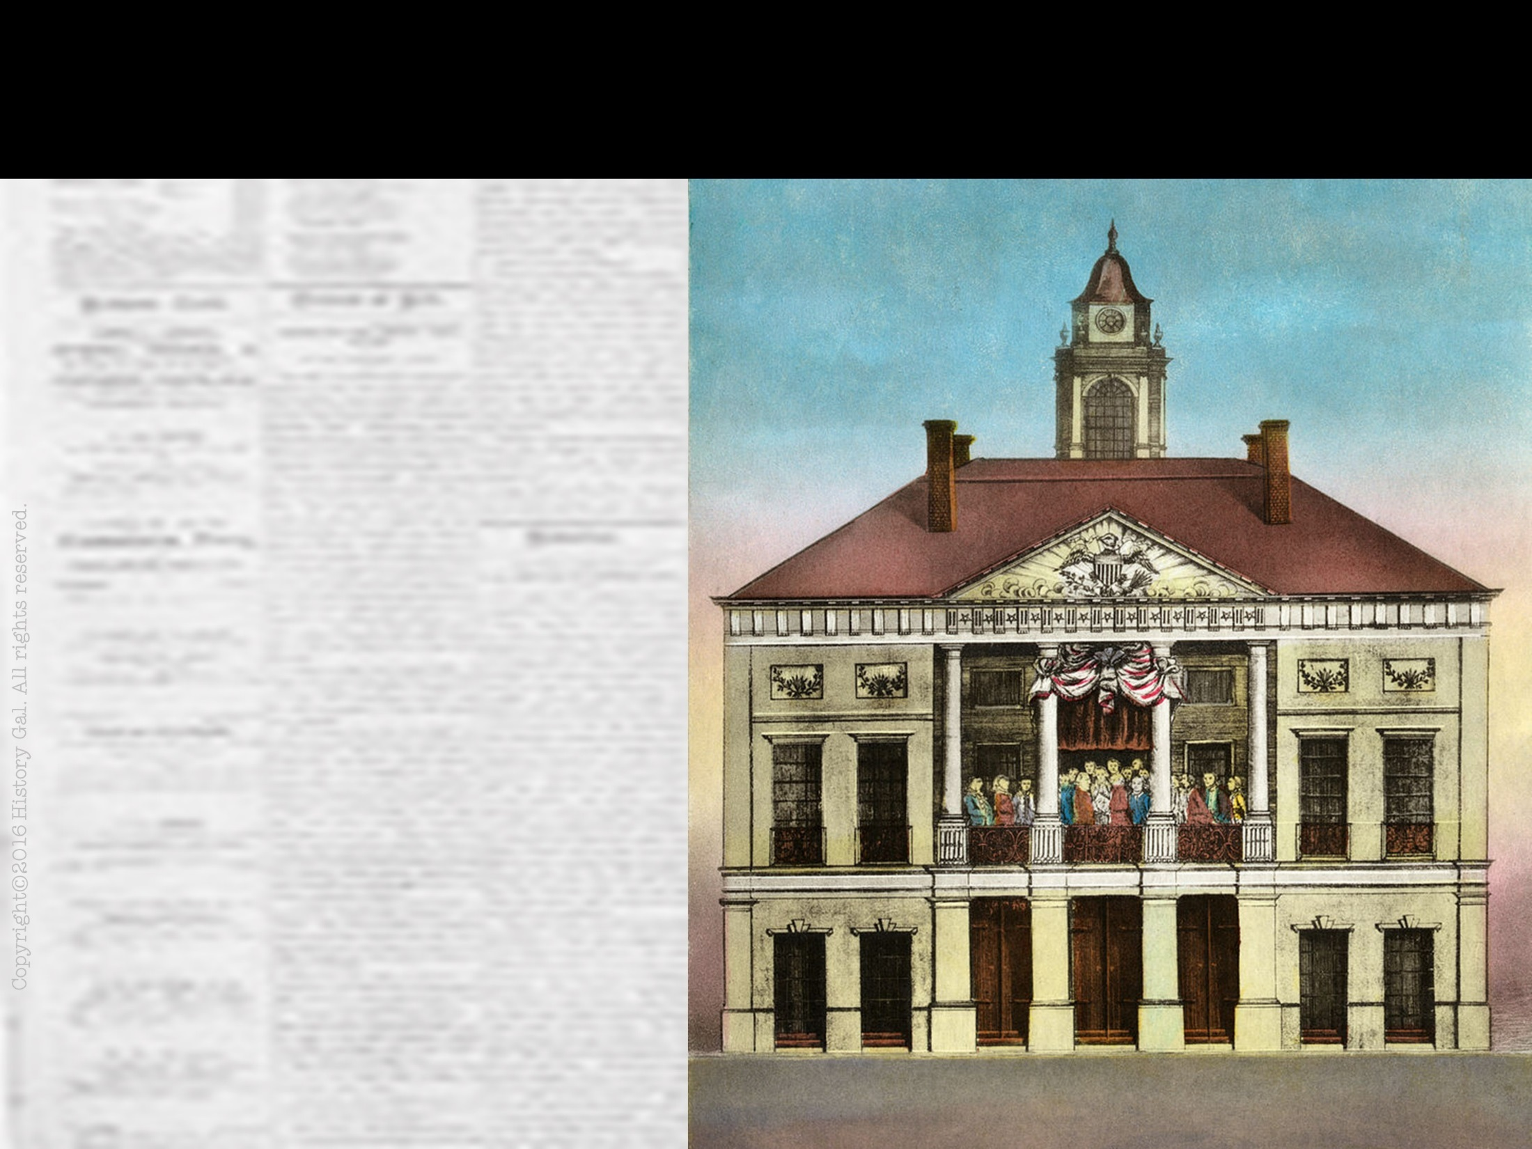
A NEW GOVERNMENT
First Congress under the Constitution was elected in 1788 and began their first session in March 1789 in New York City (the nation’s temporary capital)
Where Was the First U.S. Capital?

Slide 3
A NEW GOVERNMENT
George Washington was the electoral college’s unanimous choice for President and he took his oath of office on April 30, 1789
John Adams became the 1st Vice President

Slide 4
A NEW GOVERNMENT
At the time of Washington’s election, 11 out of the 13 states had ratified the Constitution (North Carolina and Rhode Island had not ratified it yet)

Slide 5
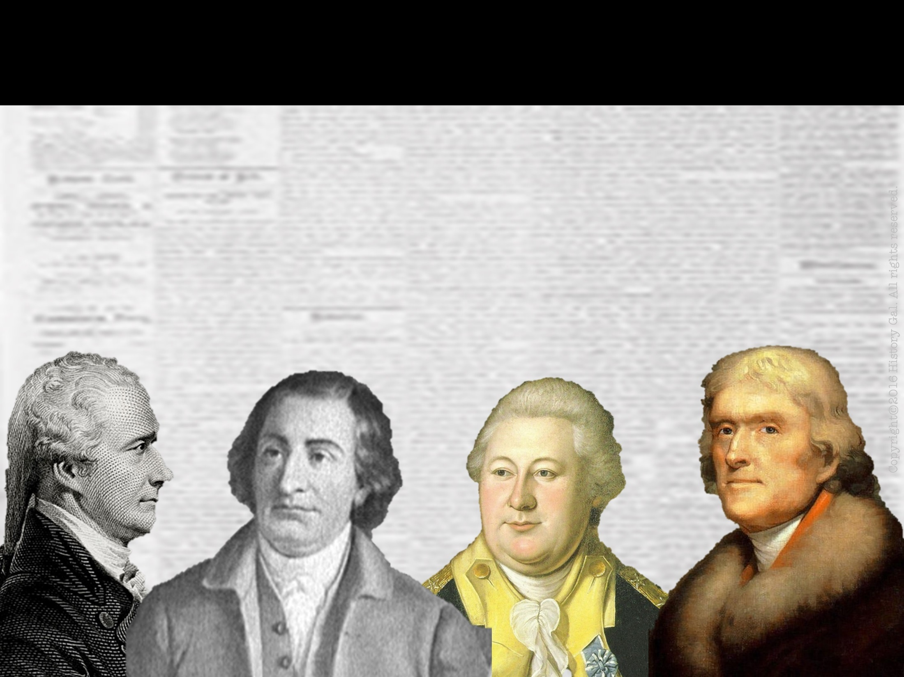
ORGANIZING THE NEW FEDERAL GOVERNMENT
Washington appointed 4 department heads and created a CABINET of advisors that he met with regularly to discuss issues (this practice continues today)
How Presidents Govern

Slide 6
ORGANIZING THE NEW FEDERAL GOVERNMENT
Thomas Jefferson - Secretary of State
Alexander Hamilton - Secretary of Treasury
Henry Knox - Secretary of War
Edmund Randolph - Attorney General
Alexander Hamilton

Slide 7
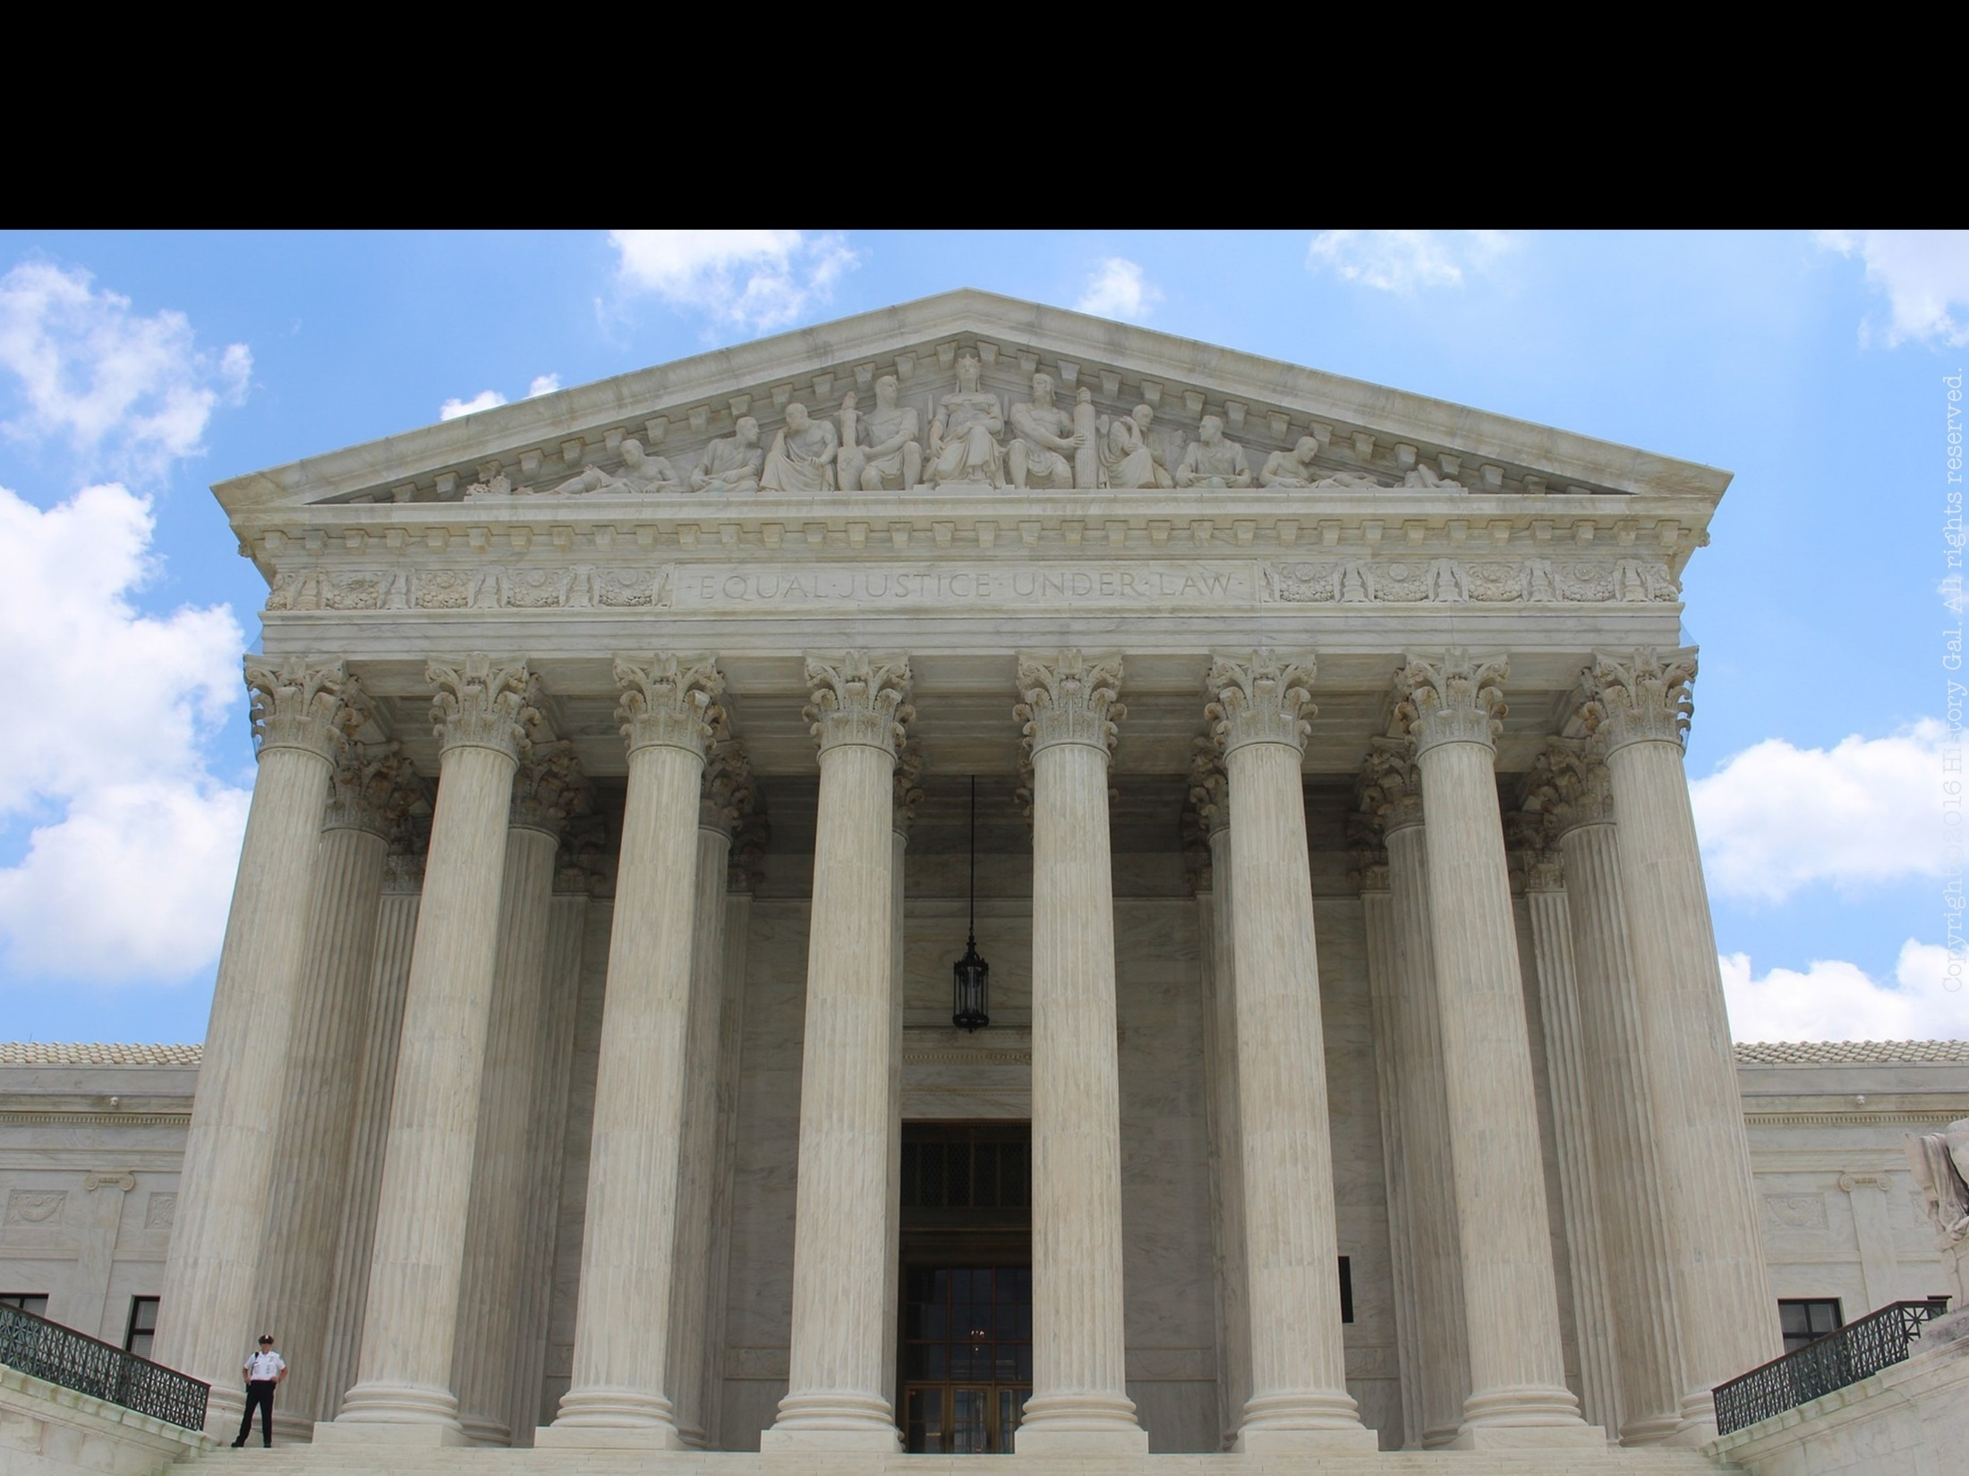
JUDICIARY ACT OF 1789
Established the Supreme Court with one Chief Justice and 5 Associate Justices, created 13 district courts and 3 circuit courts of appeal

Slide 8
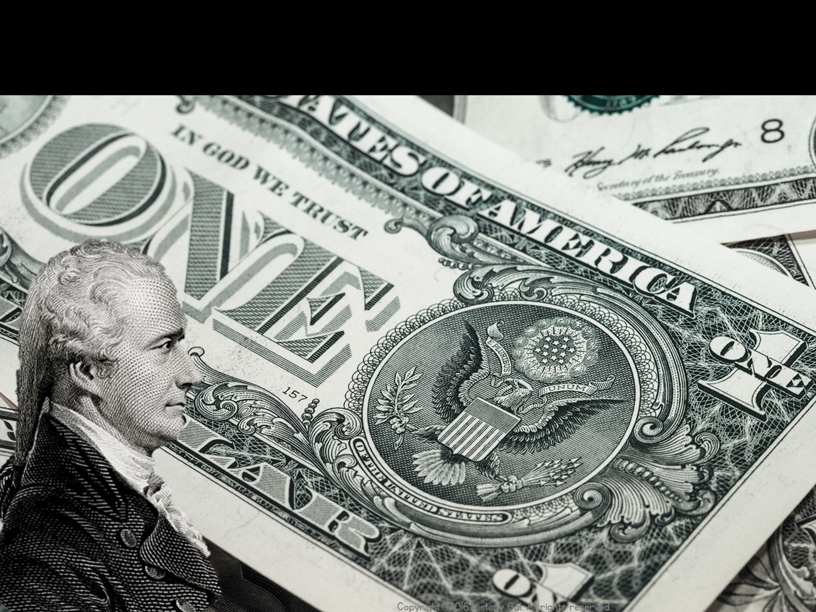
HAMILTON’S FINANCIAL PROGRAM
Assume the debts of the states and the federal government
Create protective tariffs
Create a Bank of the United States
Hamilton Explained

Slide 9
HAMILTON’S FINANCIAL PROGRAM
SUPPORTERS: Northern merchants who would gain from high tariffs and a stable U.S. currency
OPPONENTS: Anti-federalists and Thomas Jefferson believed it only benefited the rich

Slide 10
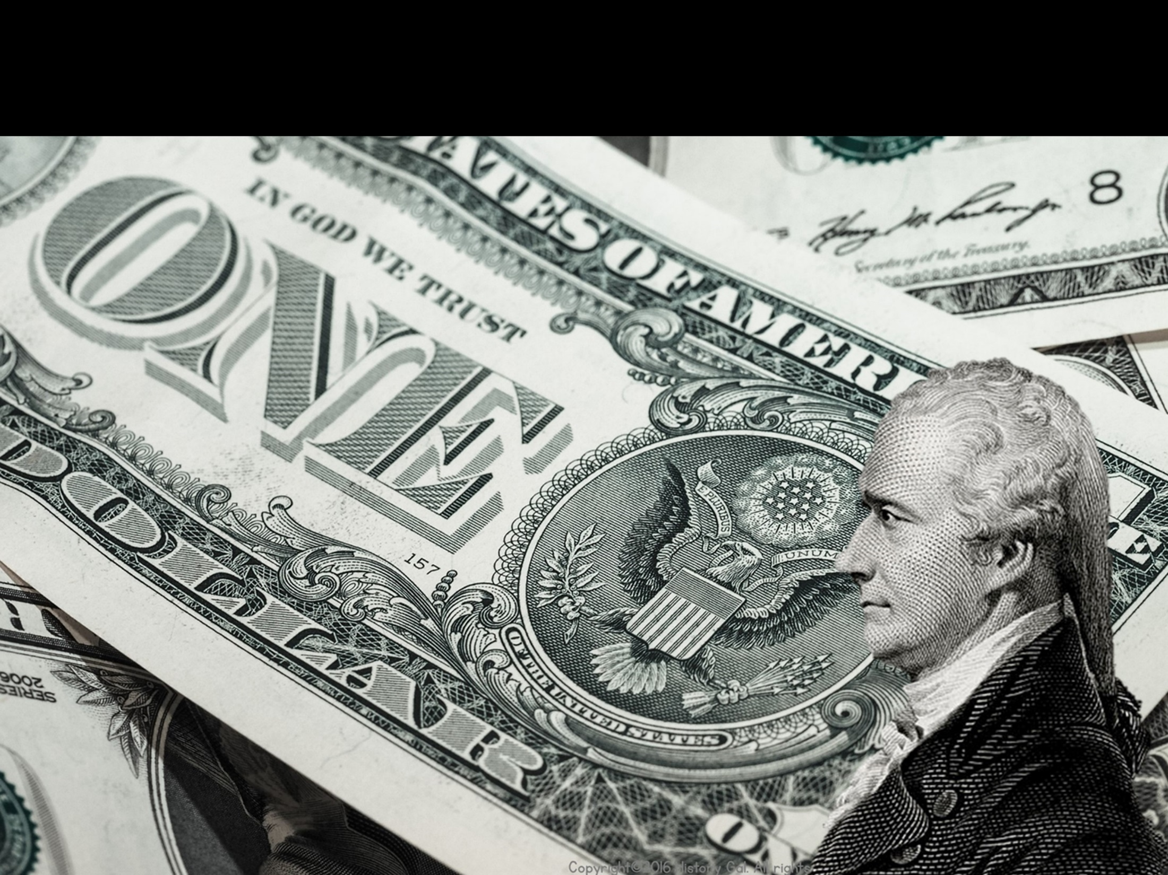
HAMILTON’S FINANCIAL PROGRAM
WHAT PASSED THROUGH CONGRESS:
Pay off national debt
Assume the debts of the states
A compromise with Jefferson established the nation’s capital in the South along the Potomac River (will be named Washington after his death)

Slide 11
HAMILTON’S FINANCIAL PROGRAM
WHAT PASSED THROUGH CONGRESS:
Tariff rates were lower than what Hamilton wanted, but he persuaded Congress to pass excise taxes, particularly one on whiskey
Established a National Bank (argument whether or not this was constitutional)

Slide 12
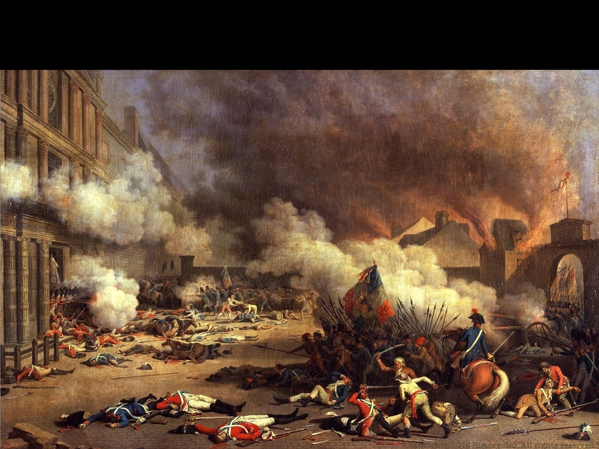
FRENCH REVOLUTION
Americans generally supported the cause of the French people, but were horrified by the mass executions and mob hysteria
PROCLAMATION OF NEUTRALITY 1793 – proclaimed U.S. neutrality in the French Revolution and the European wars (Thomas Jefferson resigned over this proclamation)
French Revolution in 9 Minutes
Proclamation of Neutrality

Slide 13
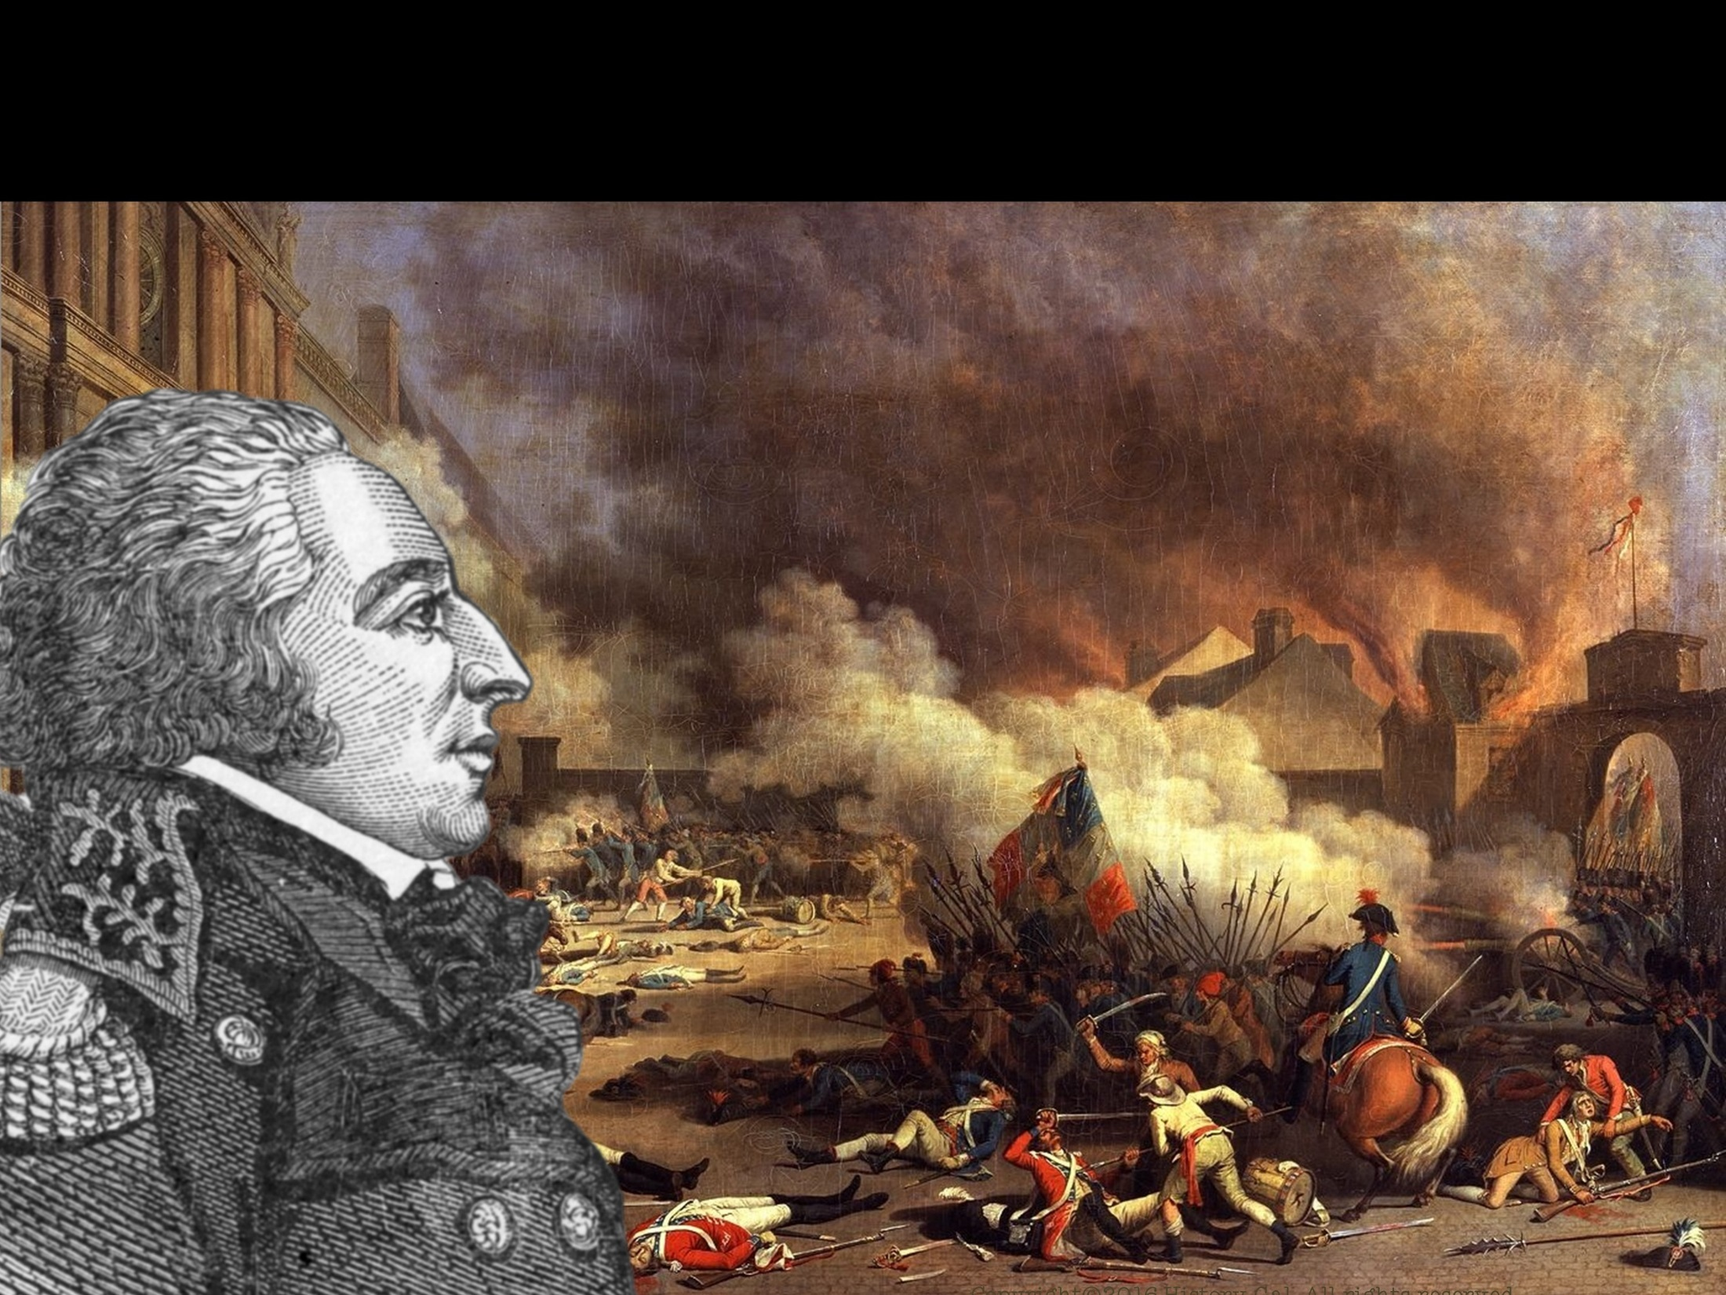
FRENCH REVOLUTION
CITIZEN GENET
French minister to the U.S. appealed directly to the American people to support the French cause
Washington requested that France remove the diplomat
France recalled him but Genet chose to stay in the U.S. (later married and became U.S. citizen)

Slide 14
JAY TREATY 1794
Chief Justice John Jay was sent to England to stop the British from searching and seizing American ships and impressing American seamen into the British navy
Britain agreed to evacuate military posts on the U.S. western frontier and pay damages to American shipping
SIGNIFICANCE – kept U.S. and Britain at peace
Jay’s Treaty Explained

Slide 15
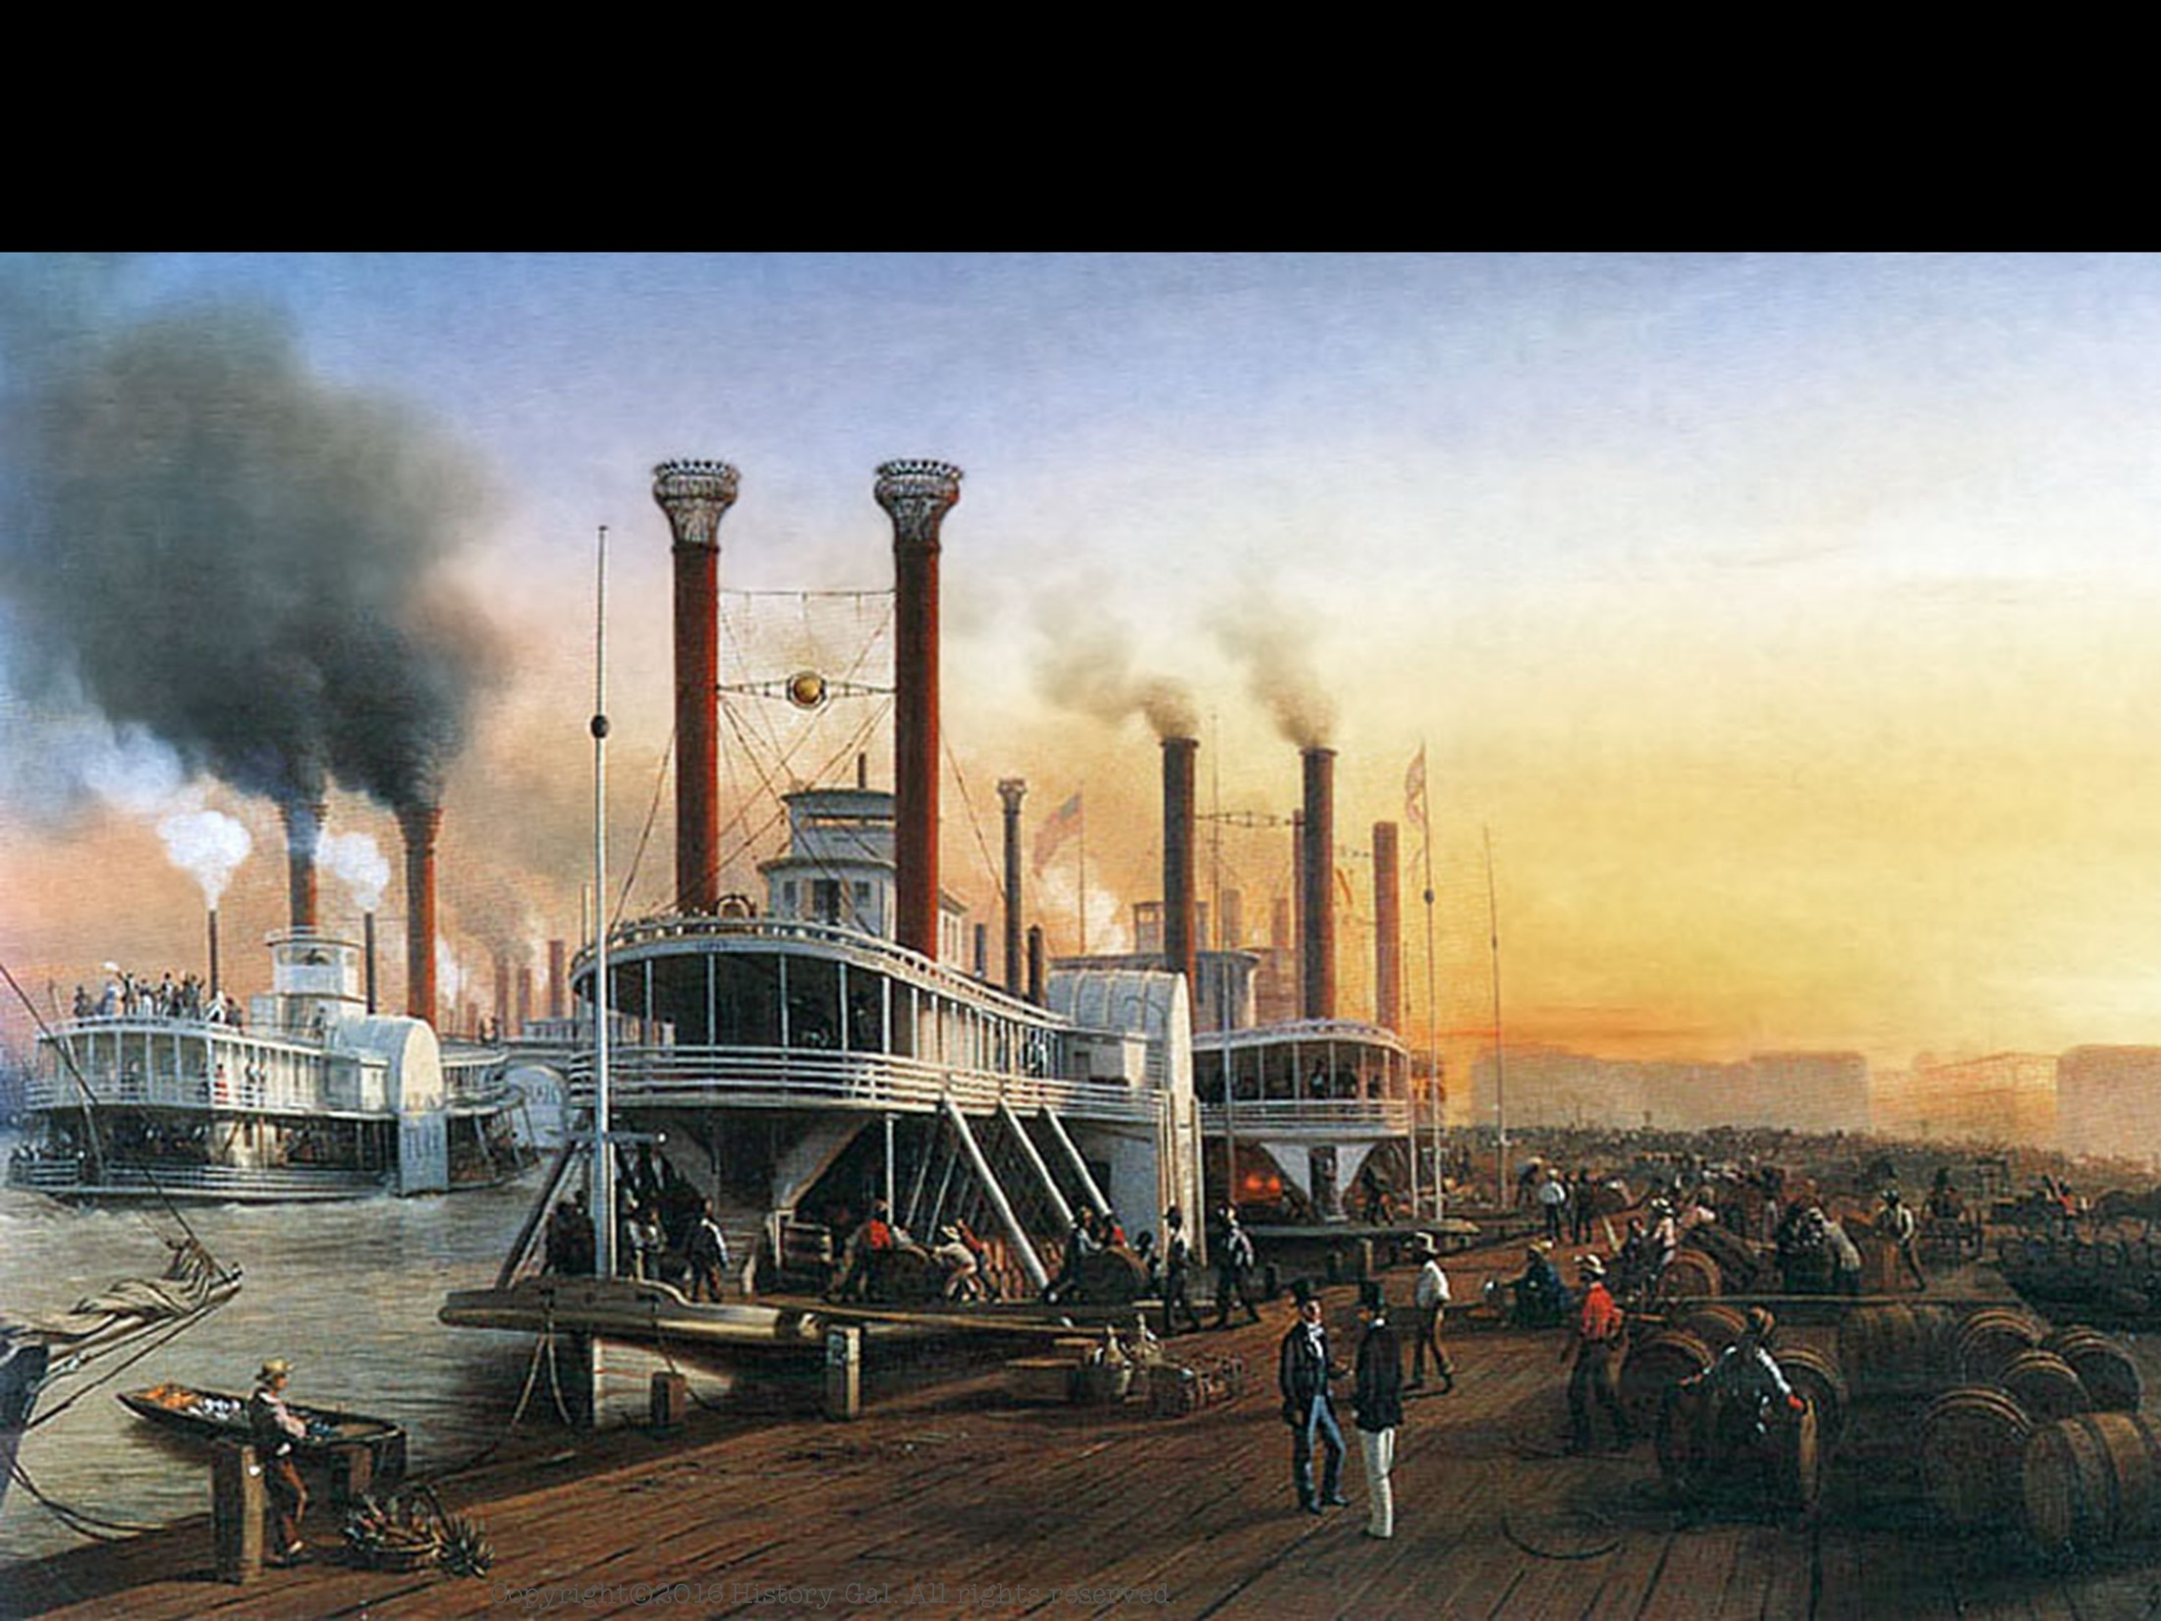
PINCKNEY TREATY 1795
Between U.S. and Spain
Spain agreed to open the lower Mississippi River and New Orleans to U.S. trade
U.S. could transfer cargo in New Orleans without paying duties to the Spanish government
Set the northern border of Spanish Florida at the 31st parallel
Pinckney’s Treaty

Slide 16
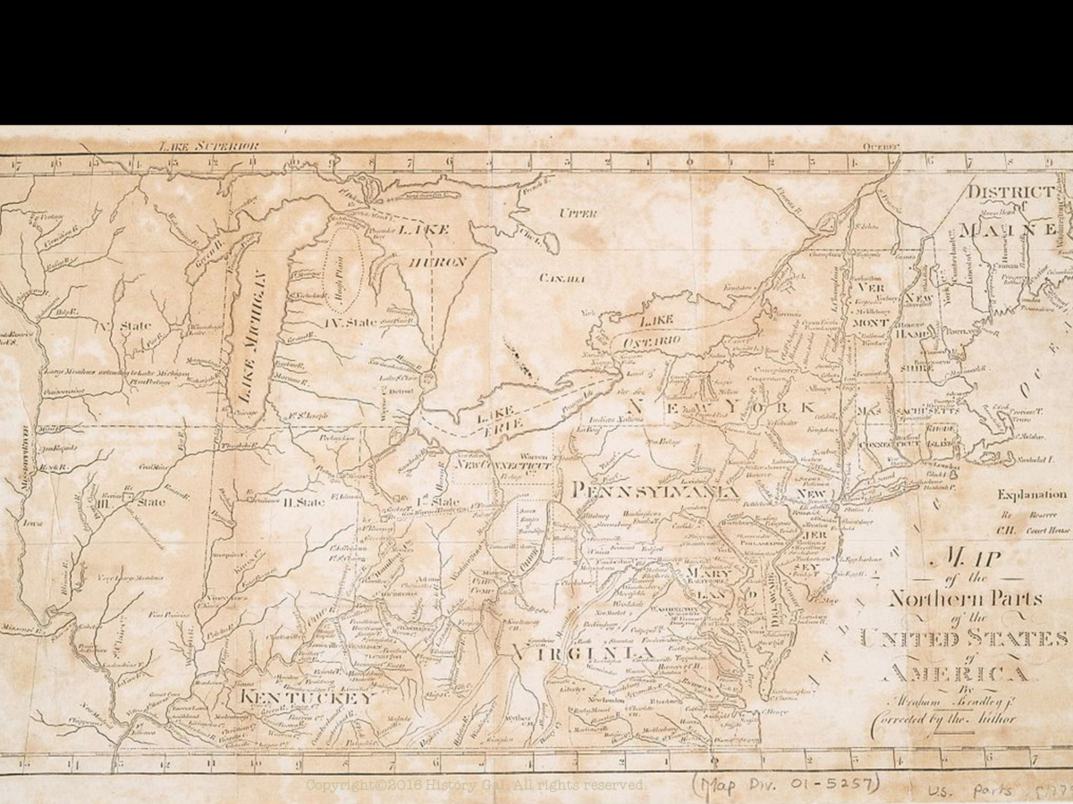
NATIVE AMERICANS
American settlers moved steadily westward into Ohio and beyond
Settlers encroached on Native American lands
The British supplied weapons to the Native Americans and encouraged them to attack the settlers
U.S. army and Native Americans fought for control of the Northwest Territory

Slide 17
NATIVE AMERICANS
1795 TREATY OF GREENVILLE – the Native Americans who lost to the U.S. Army surrendered claims in the Ohio territory and promised to open it up to settlement

Slide 18
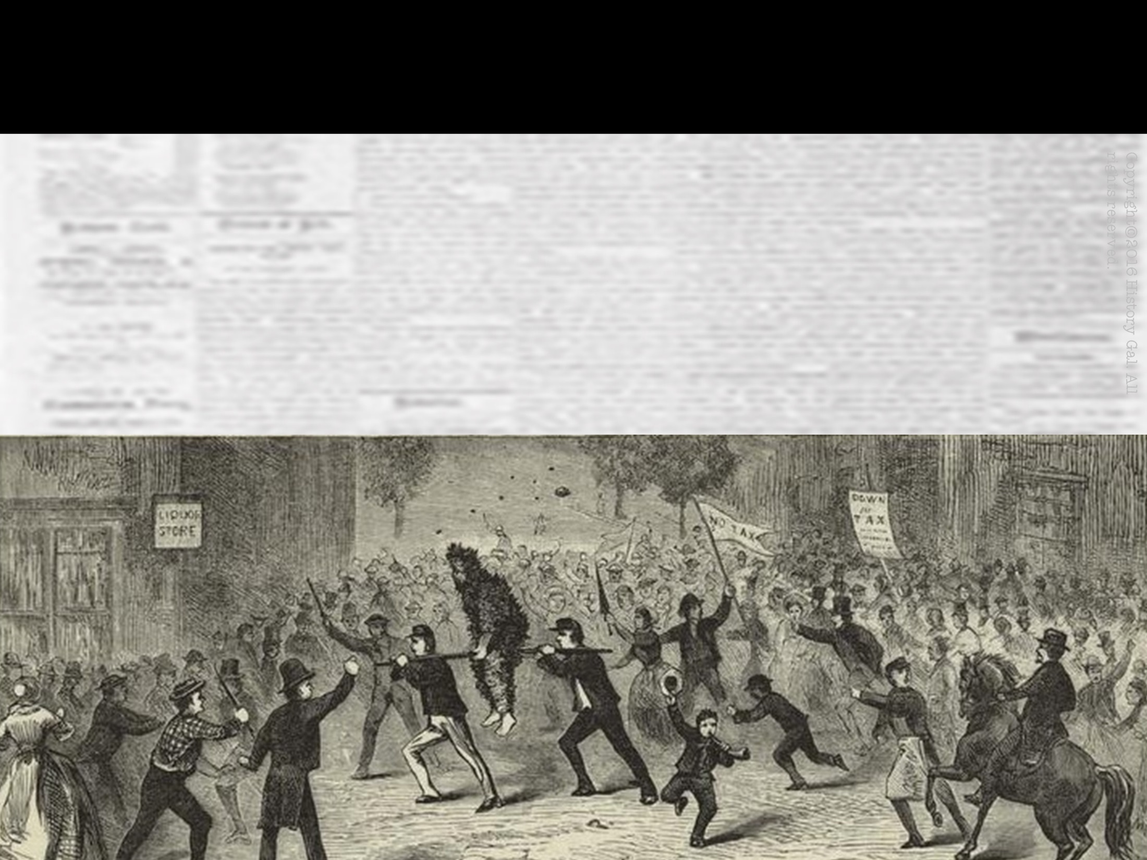
WHISKEY REBELLION 1794
Farmers in western Pennsylvania refused to pay the federal excise tax on whiskey because they could not afford to pay it
They defended their “liberties” by attacking the revenue (tax) collectors
Illustrated Whiskey Rebellion

Slide 19
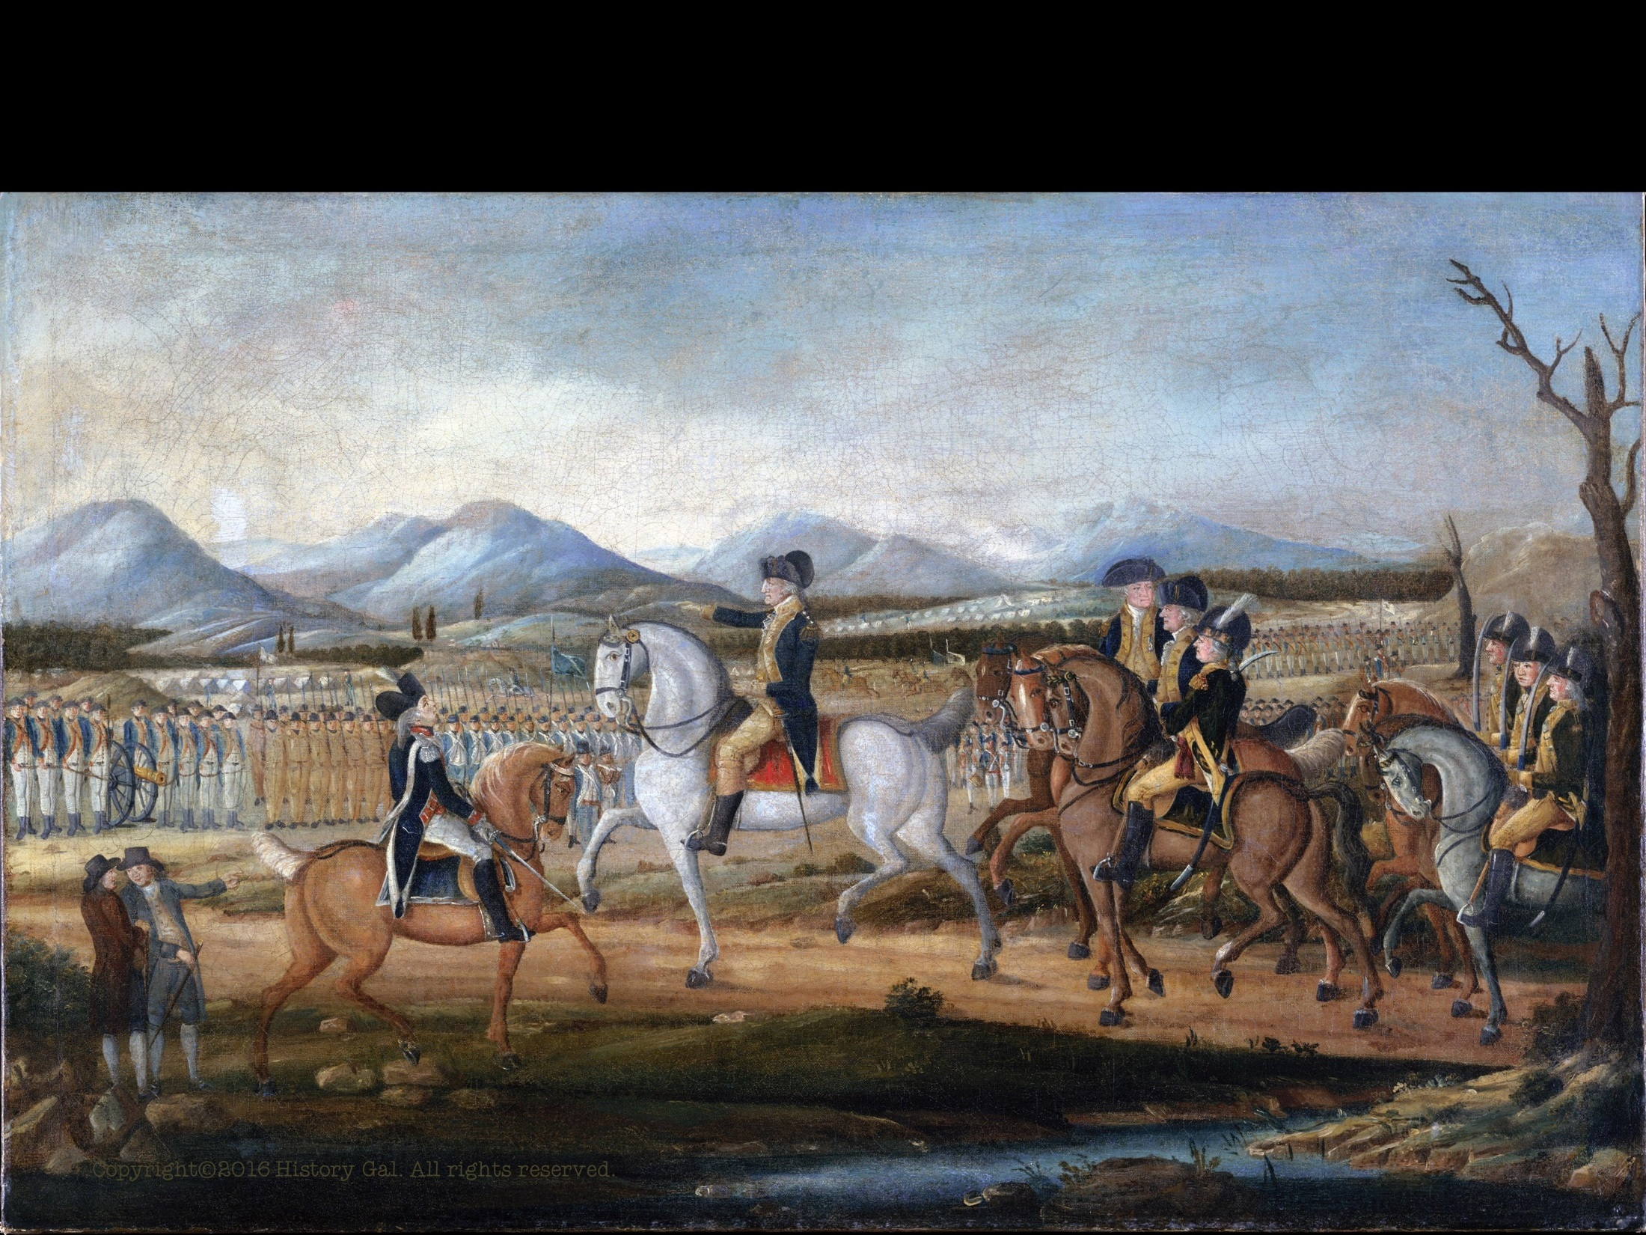
WHISKEY REBELLION 1794
Washington federalized 15,000 state militiamen
the show of force caused the Whiskey Rebellion to collapse without bloodshed
SIGNIFICANCE – demonstrated that the new Federal government was strong enough to deal successfully with rebellion against its laws
Whiskey Rebellion in One Minute

Slide 20
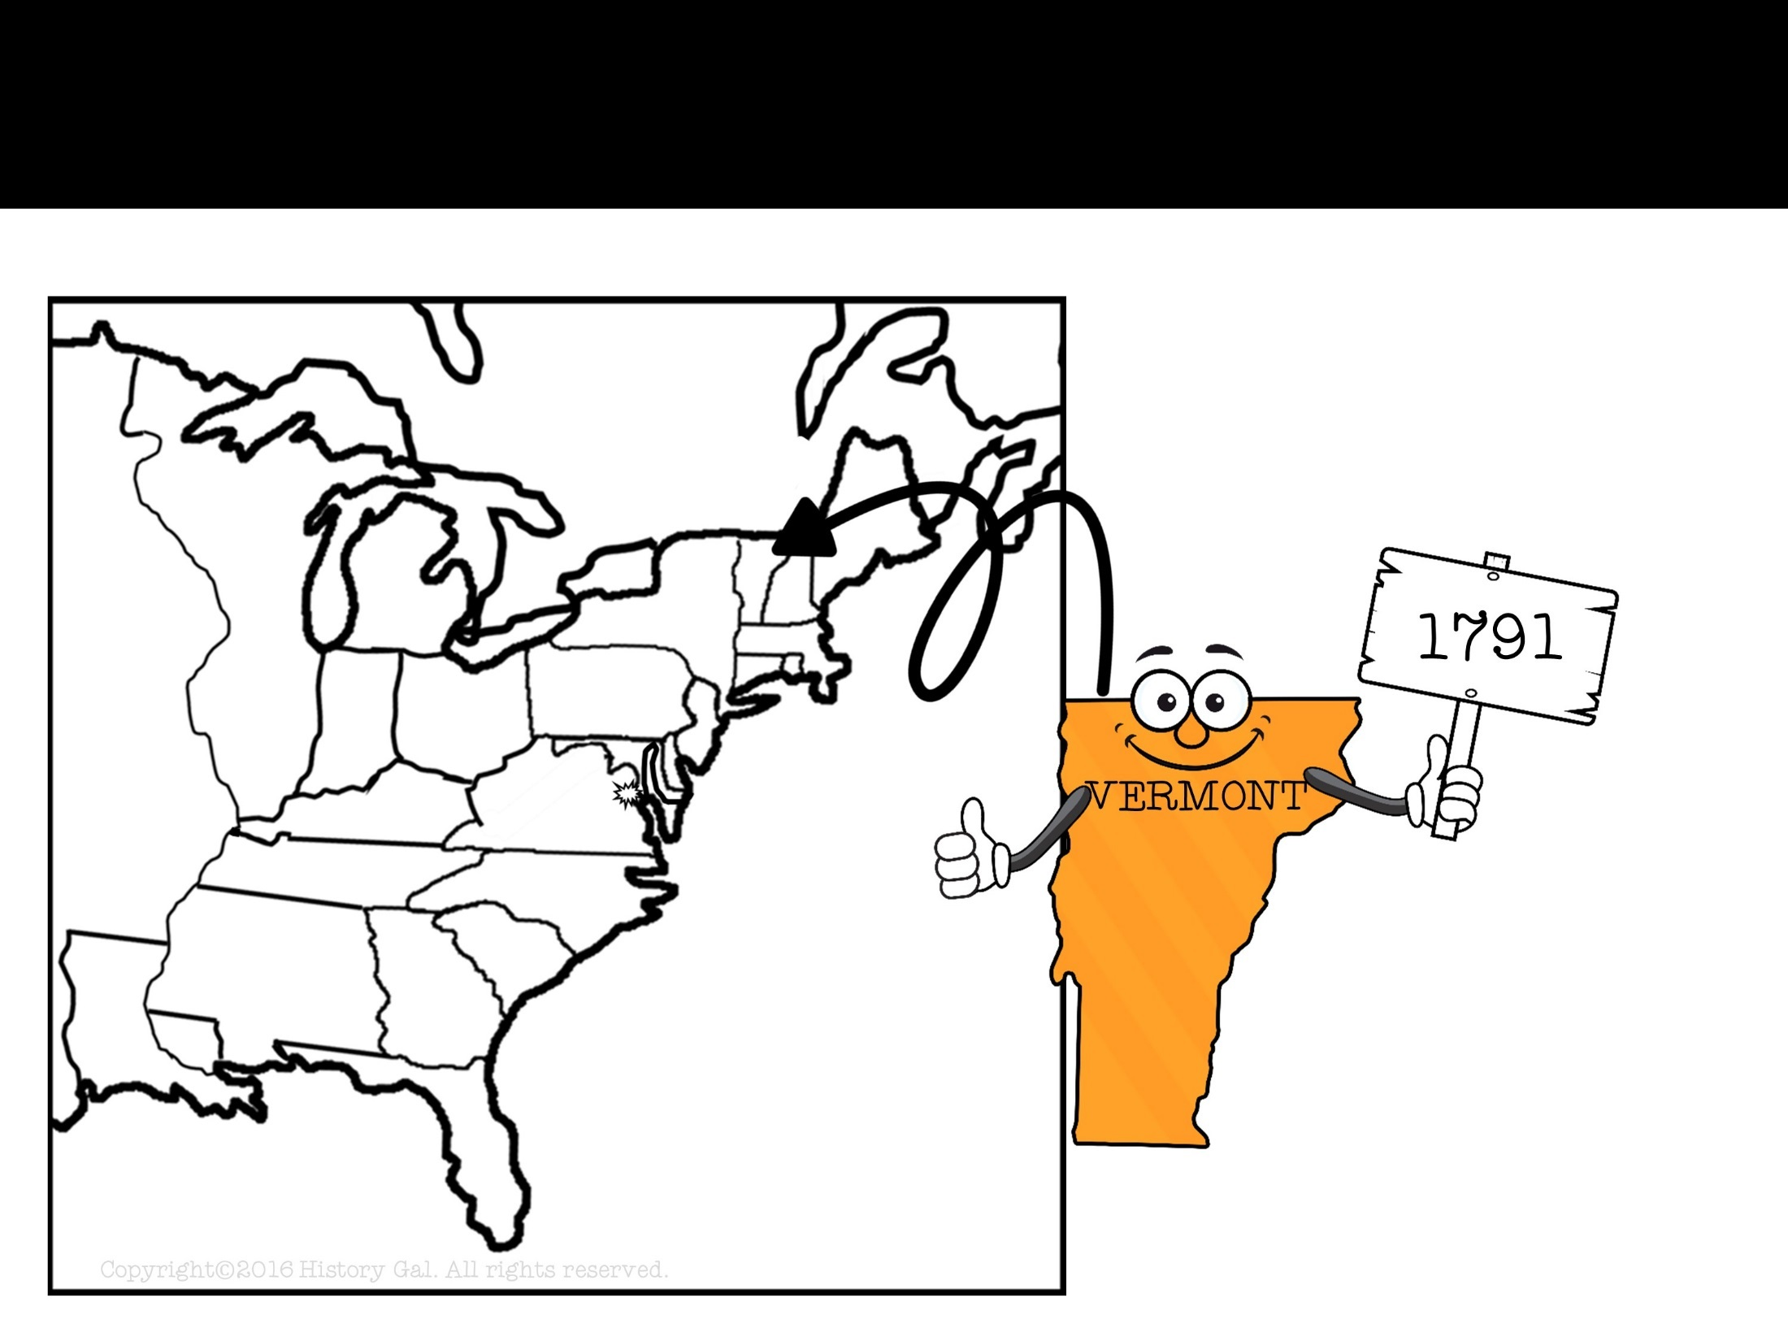
NEW STATES

Slide 21
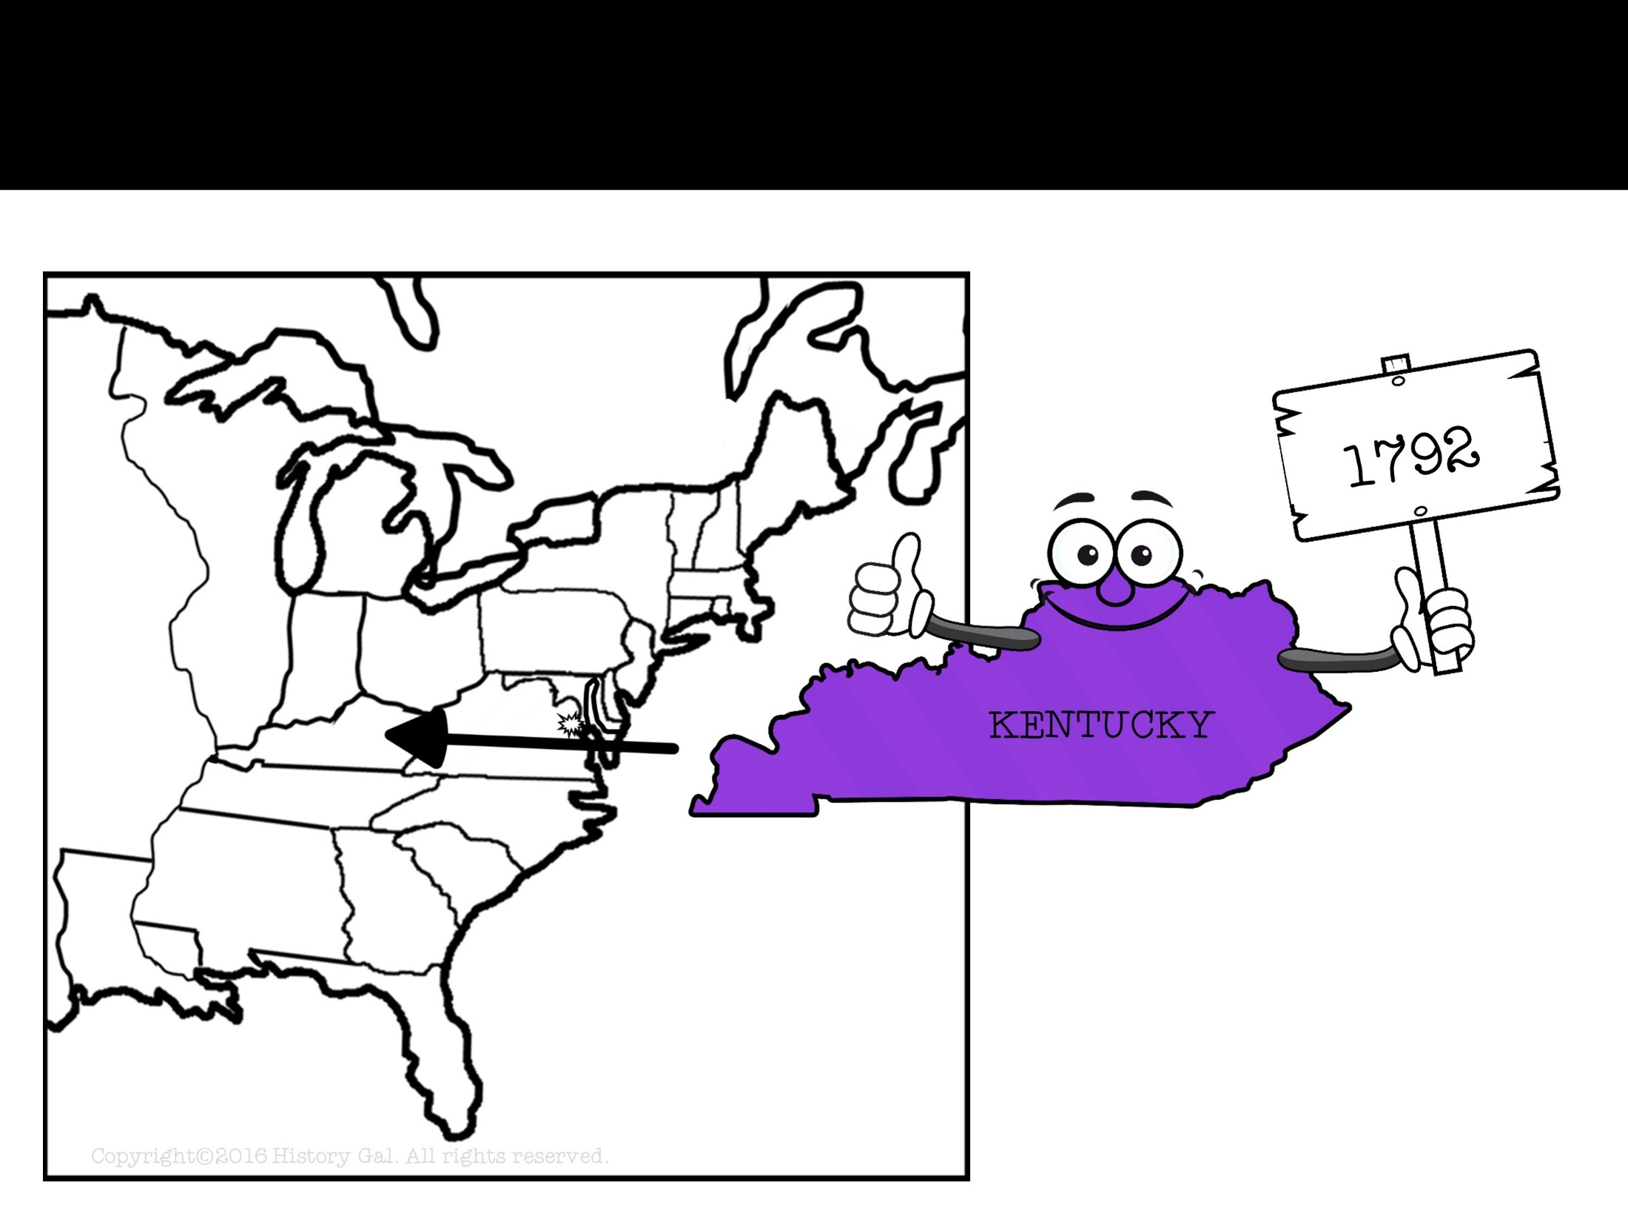
NEW STATES

Slide 22
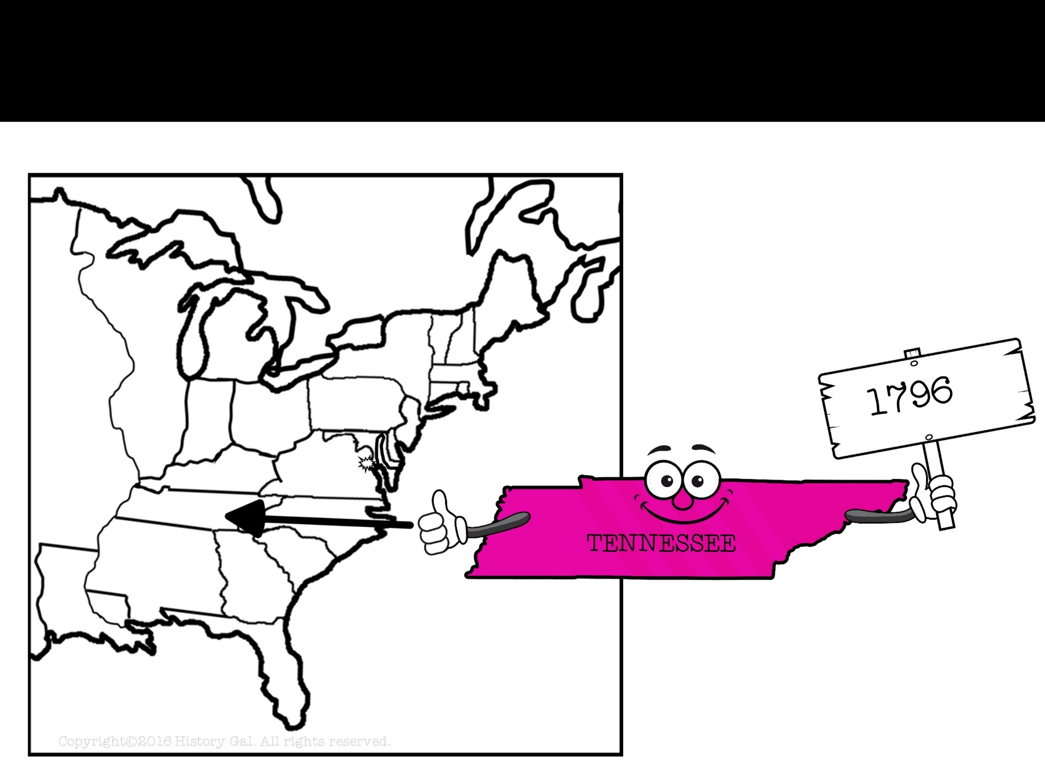
NEW STATES

Slide 23
A TWO TERM PRECEDENT
1796 – Washington announced he would not run for a 3rd term (set a precedent, or example)

Slide 24
WASHINGTON’S FAREWELL ADDRESS
WASHINGTON’S FAREWELL ADDRESS:
Avoid sectionalism
Do not get involved in European affairs
Avoid permanent military alliances
Do not form political parties
George Washington’s Farewell Address

Slide 25
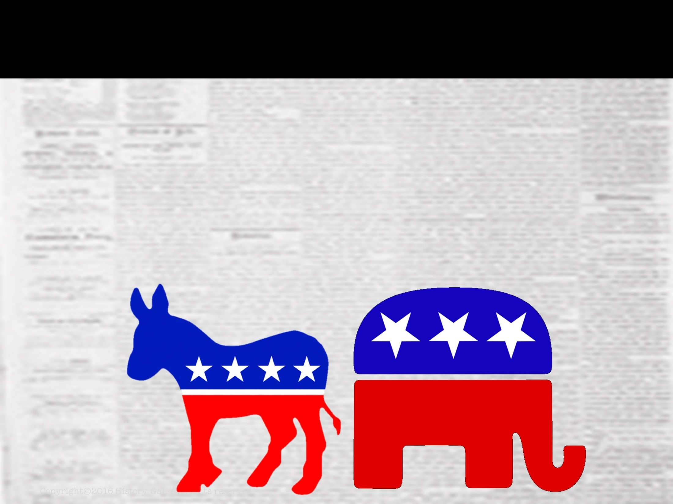
POLITICAL PARTIES
Washington’s election by unanimous vote of the Electoral College led people to believe that political parties were not needed and therefore would not arise.
THEY WERE WRONG

Slide 26
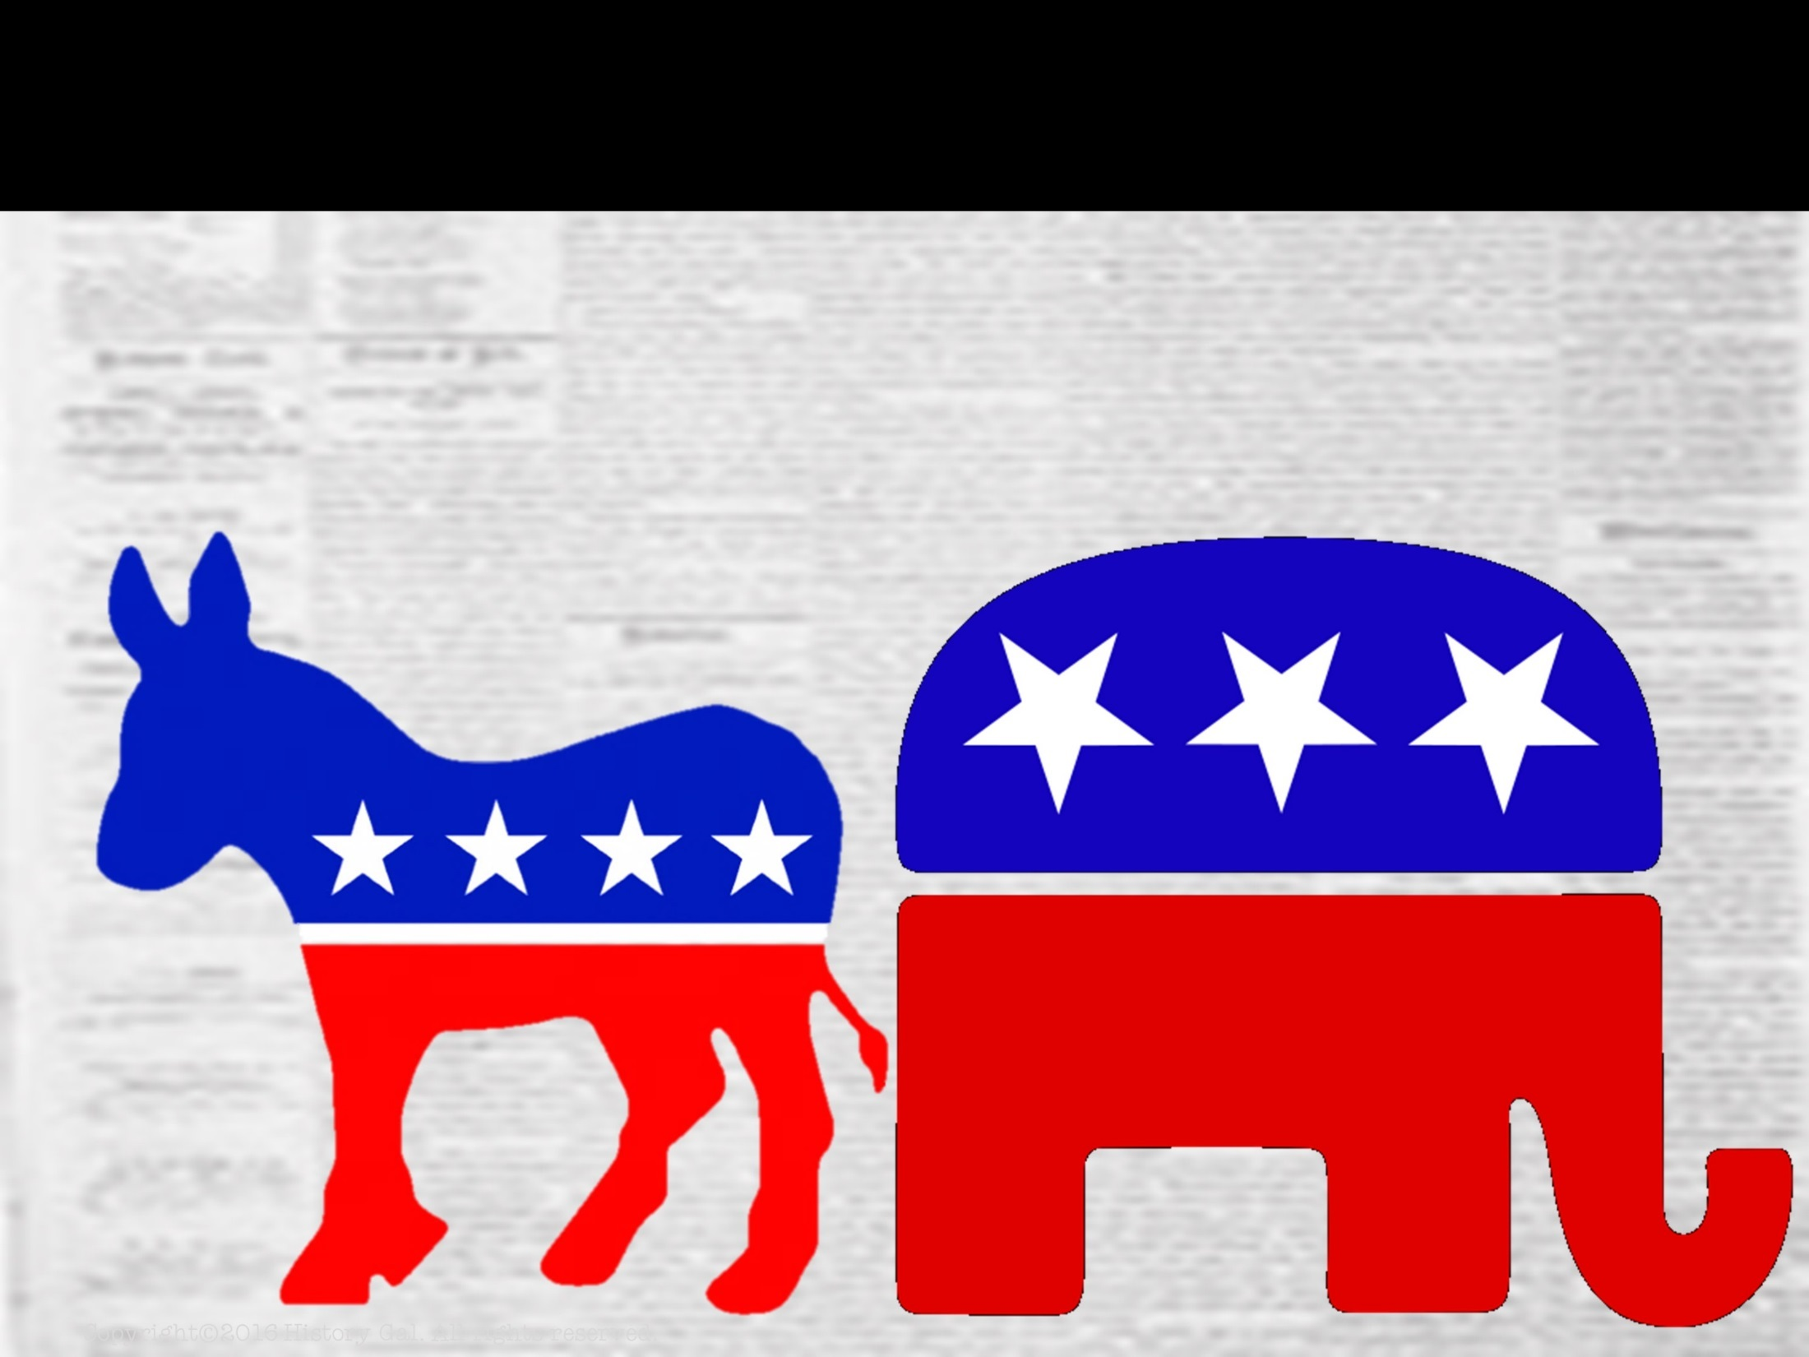
POLITICAL PARTIES
FEDERALISTS
supported Hamilton’s financial reform
favored growth of Federal power
mostly from Northern states
favored loose interpretation of the Constitution

Slide 27
POLITICAL PARTIES
DEMOCRATIC-REPUBLICANS (D-R)
supported Thomas Jefferson
favored states’ rights and containment of Federal power
mostly from Southern and western states
favored strict interpretation of the Constitution
History of Political Parties in the U.S.

Slide 28
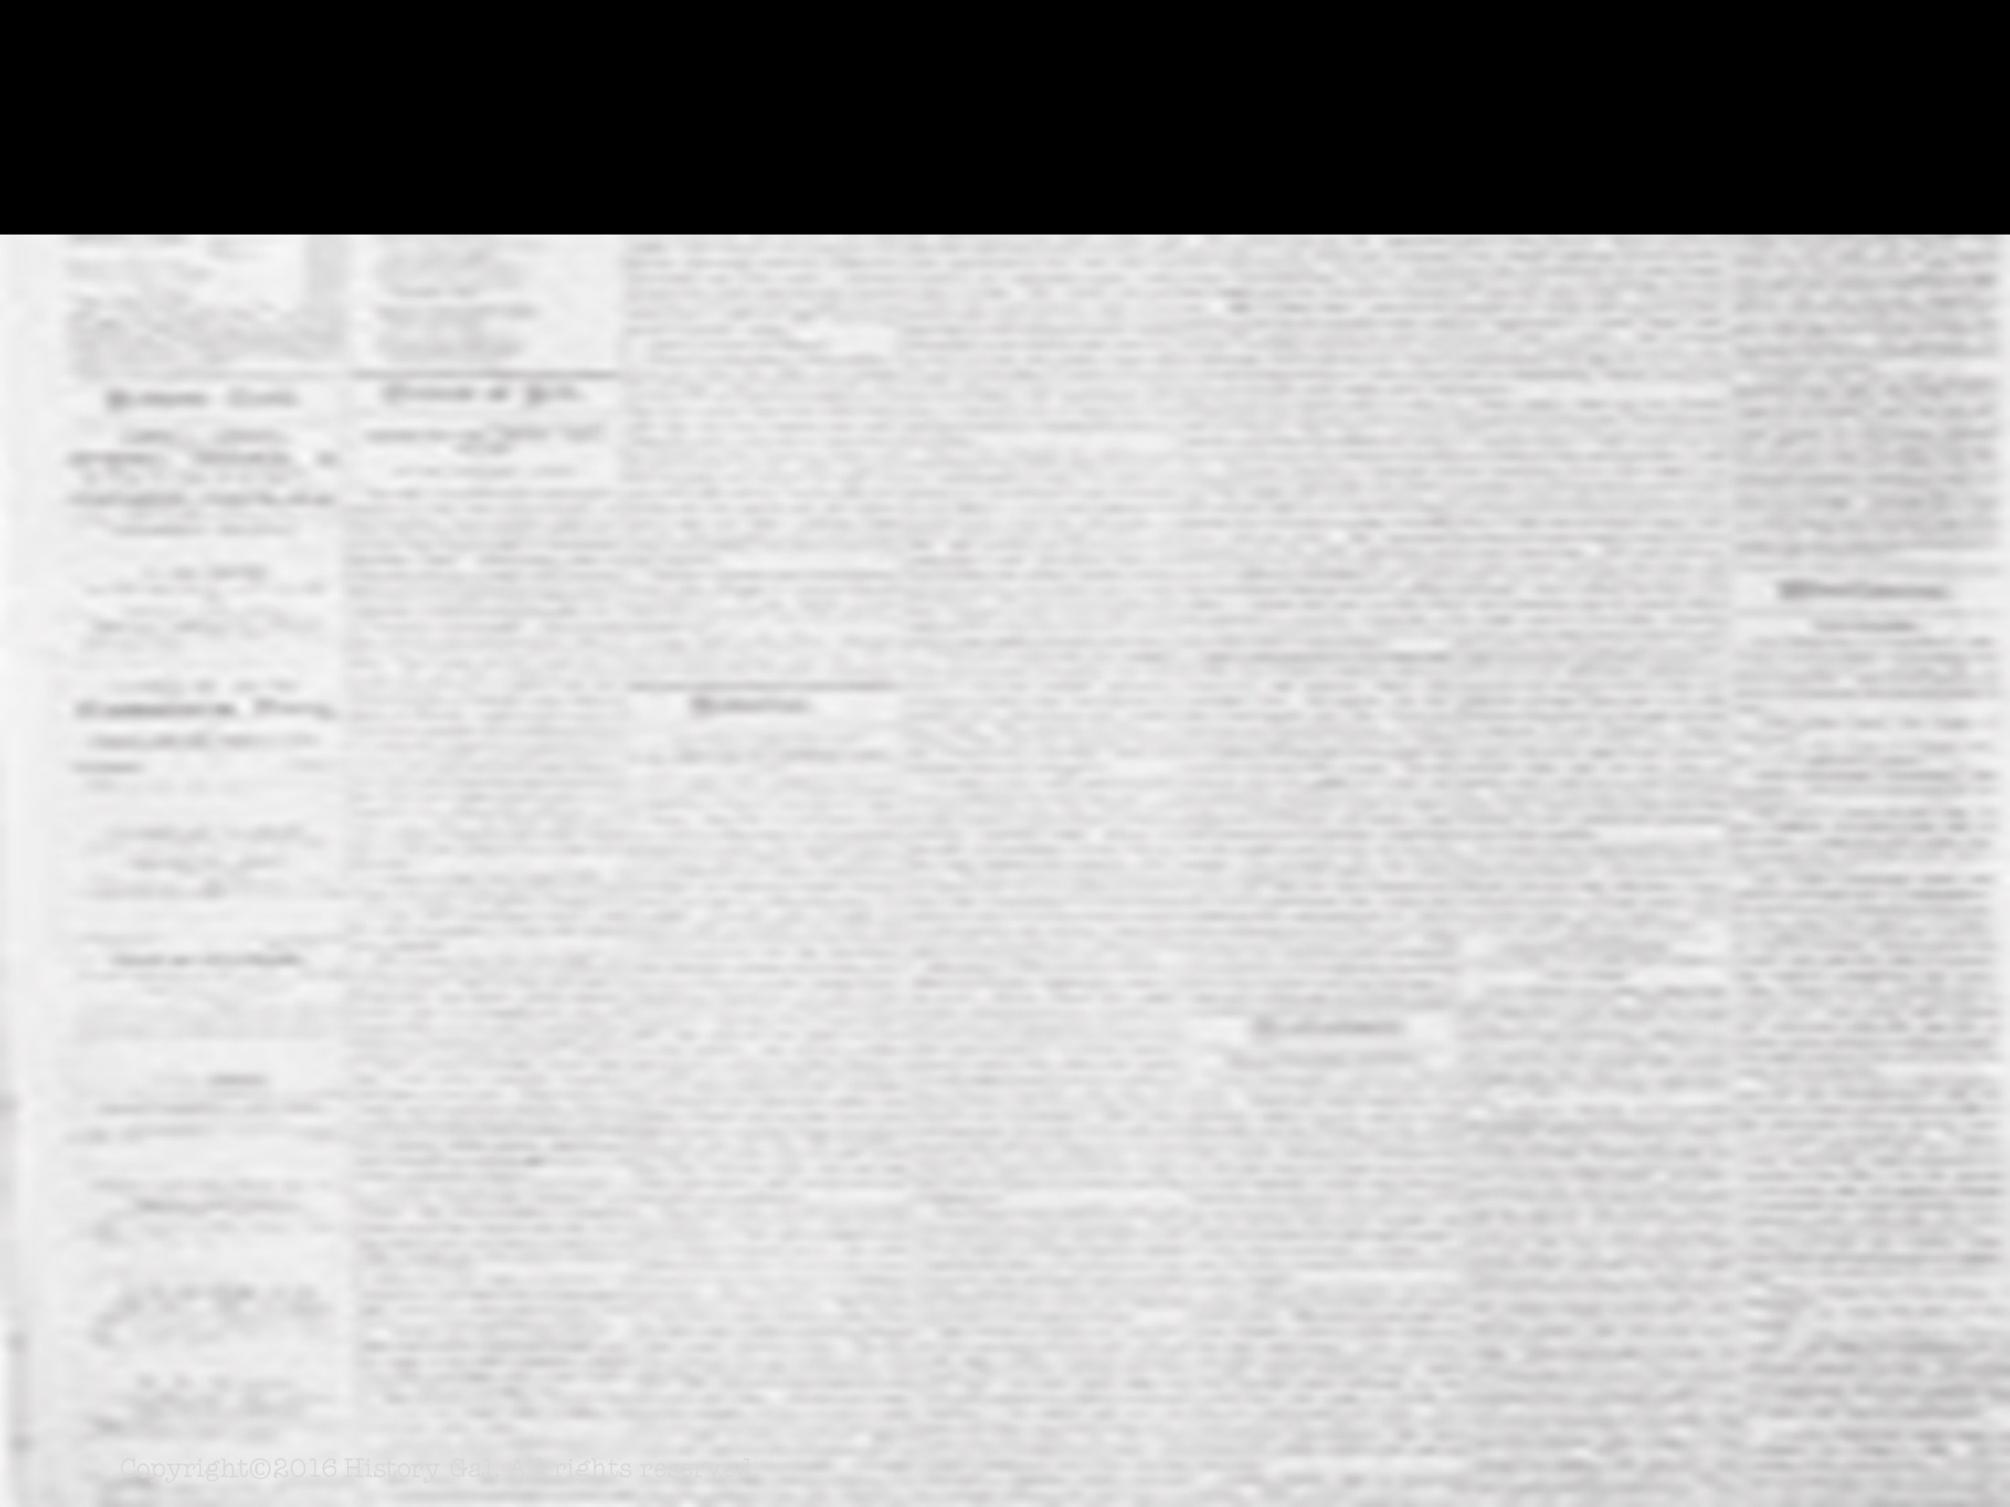
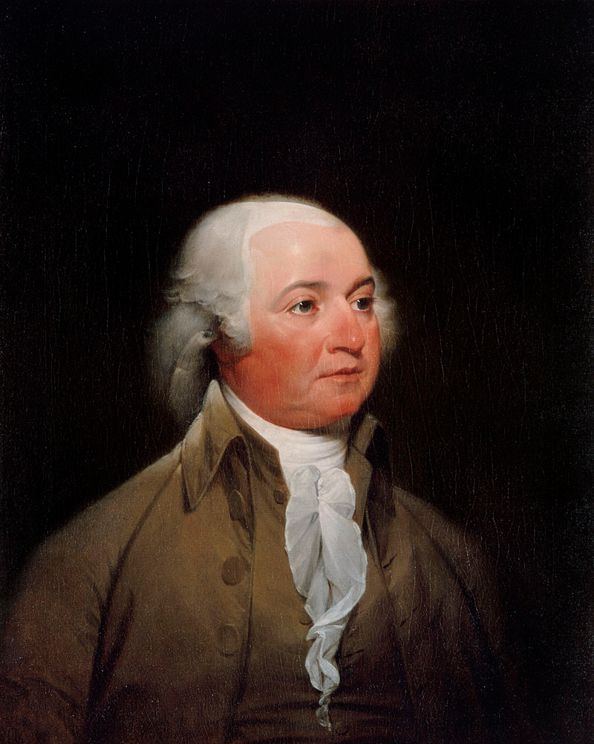
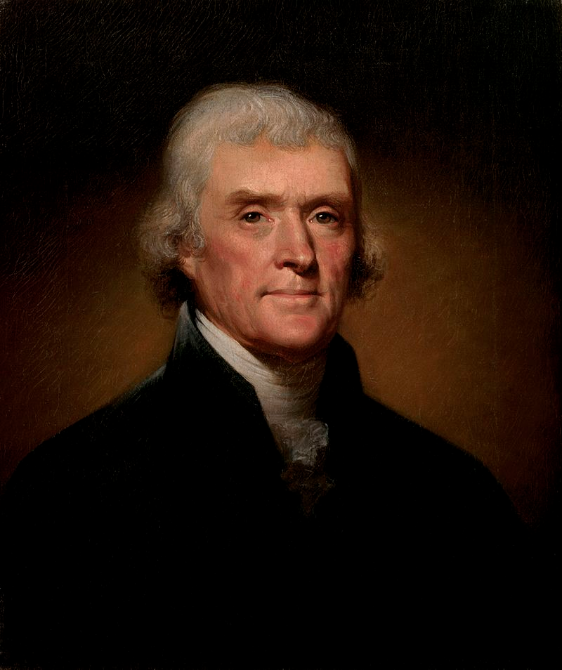
ELECTION OF 1796
Federalist
John Adams
VS.
WINNER!
Thomas Jefferson became Vice-President (method will be changed in 1804 with the 12th Amendment)
Adams won by 3 electoral votes
Democratic-Republican
Thomas Jefferson
Election of 1796 Explained

Slide 29
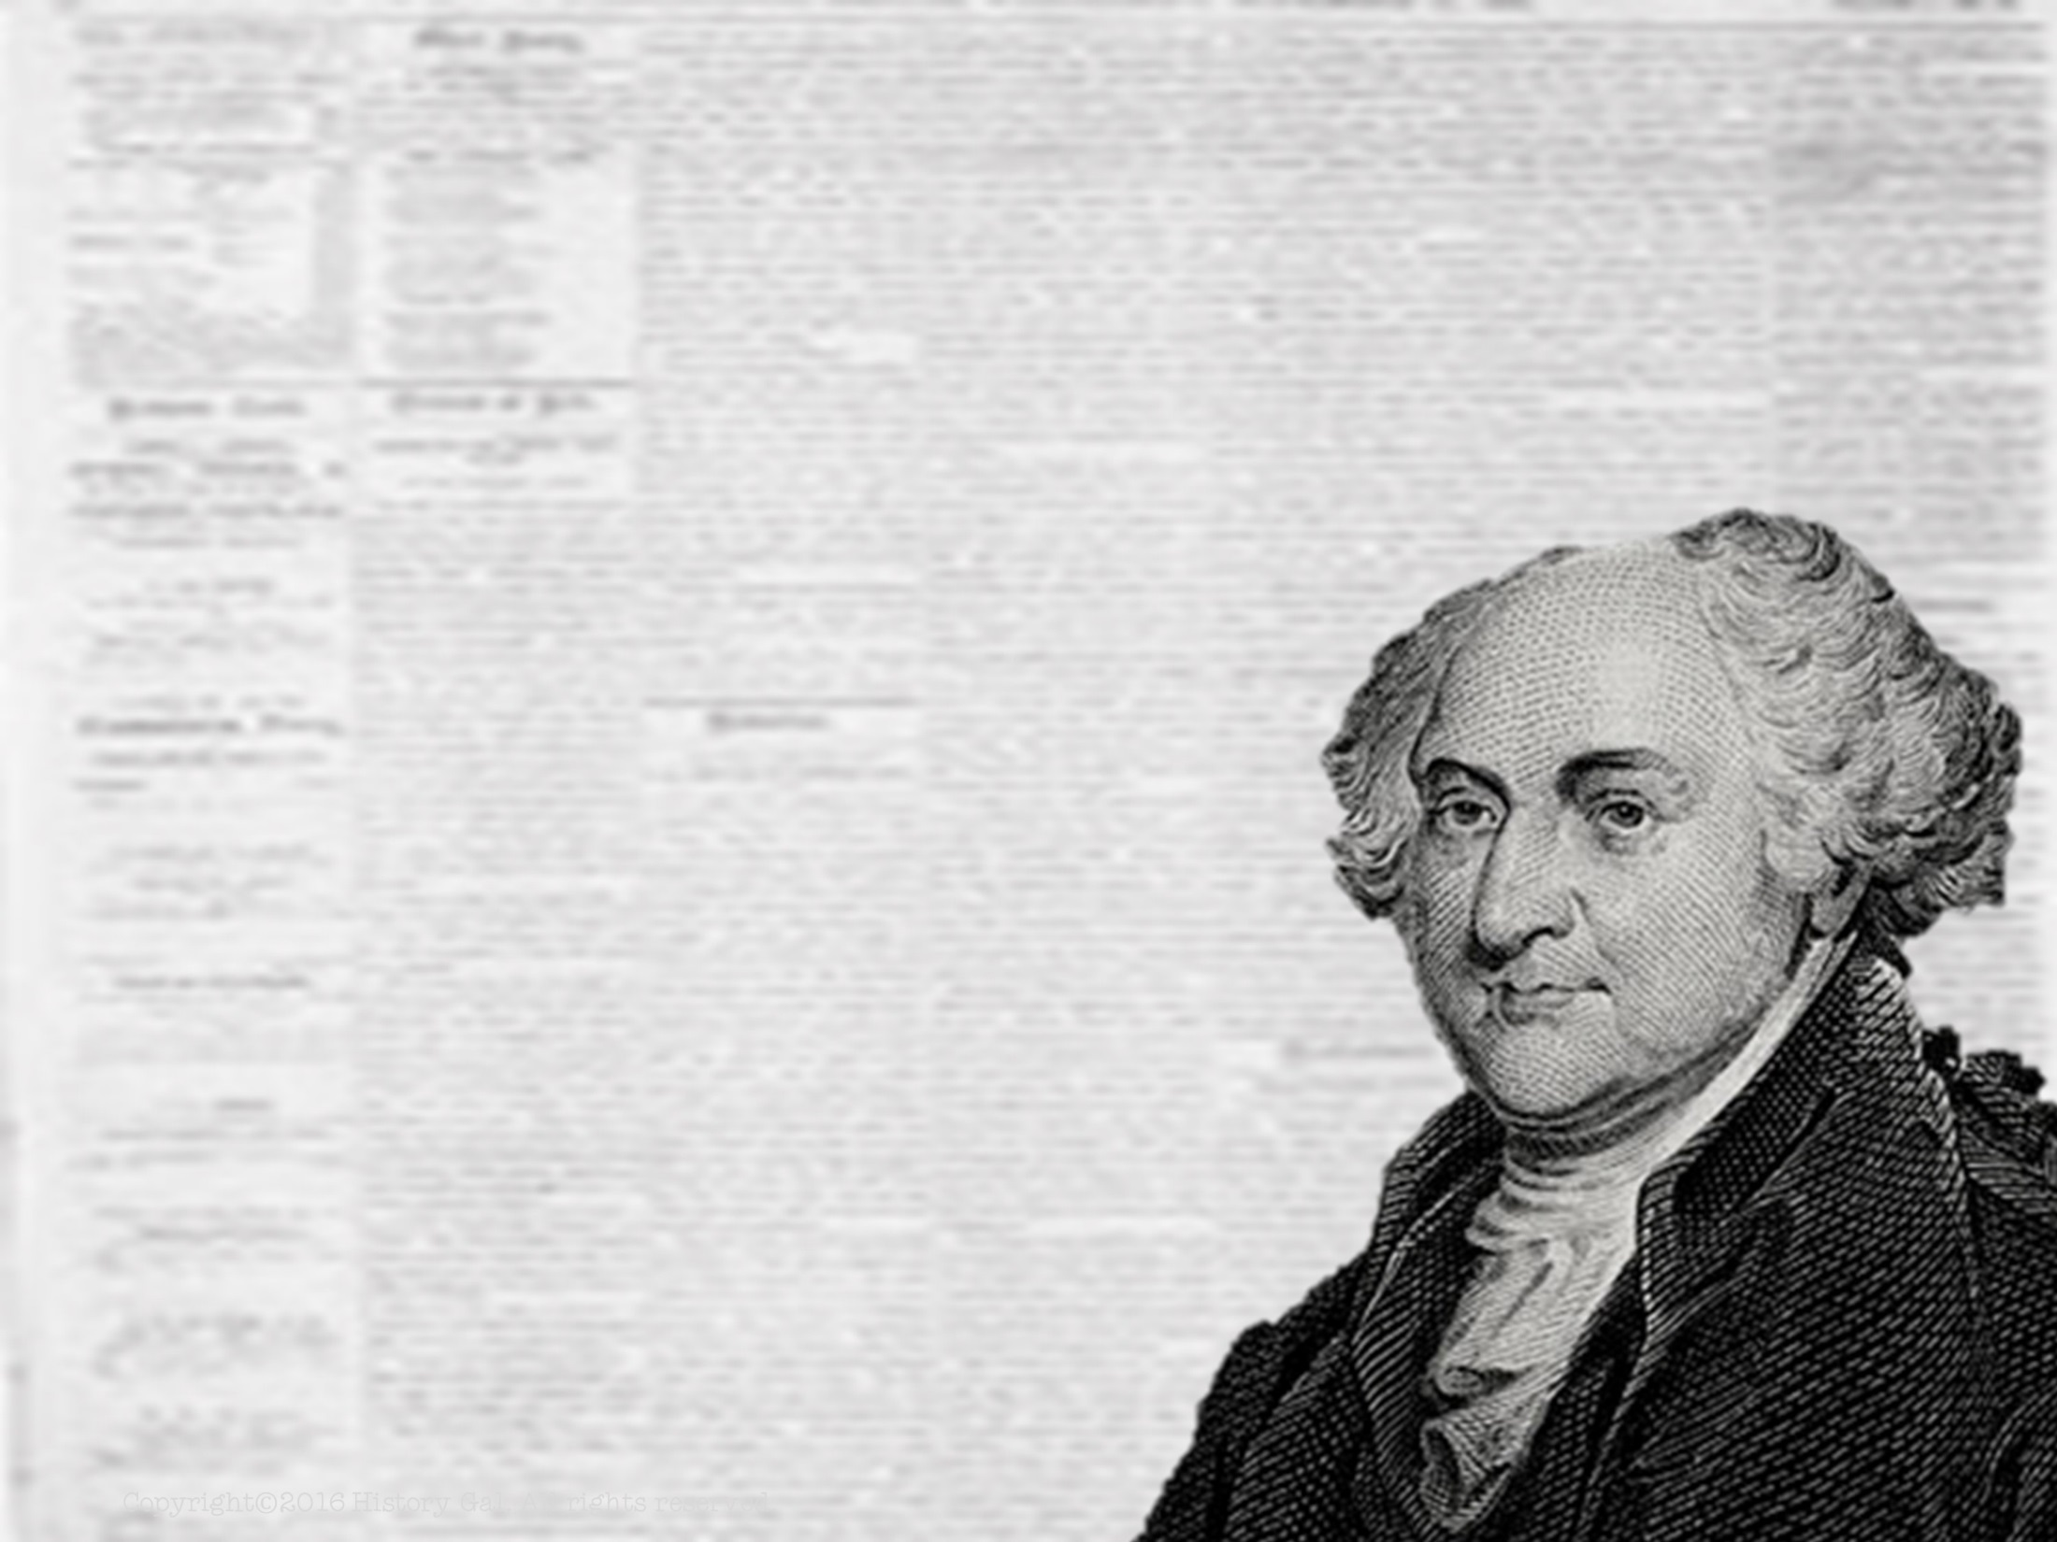
PRESIDENCY OF
JOHN
ADAMS
1797-1801
John Adams in 60 Seconds

Slide 30
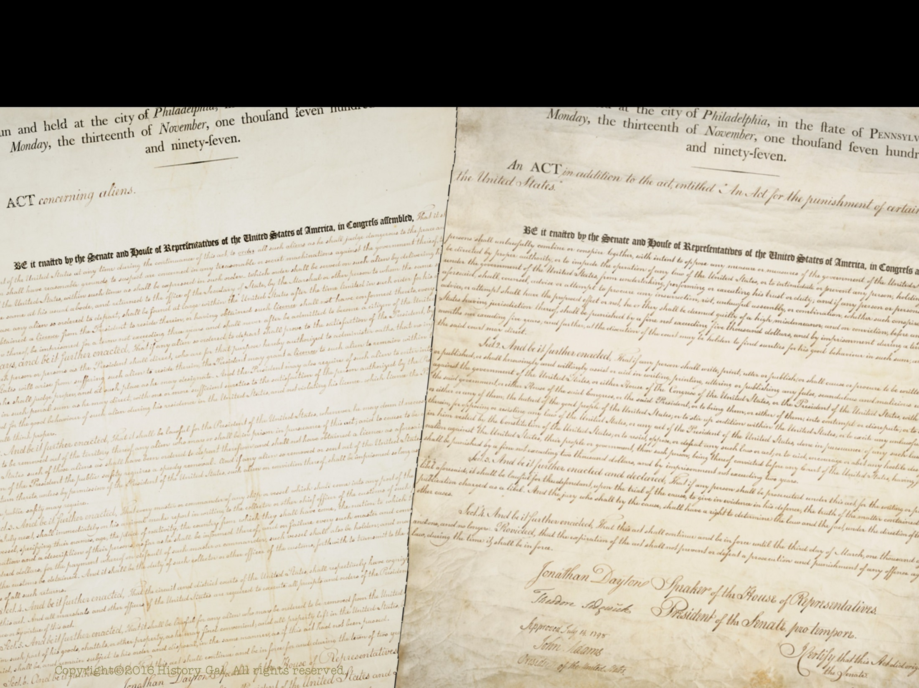
IMPORTANT ACTS
NATURALIZATION ACT – increased number of years to qualify for U.S. citizenship from 5 to 14 (this act hurt the D-R because immigrants tended to vote for D-R candidates)

Slide 31
IMPORTANT ACTS
ALIEN ACT – authorized the President to deport any aliens considered dangerous and to detain enemy citizens in time of war
SEDITION ACT – made it illegal for newspaper editors to criticize either the President or Congress and imposed heavy penalties (fined or imprisoned) for editors who violated the laws
Alien and Sedition Acts

Slide 32
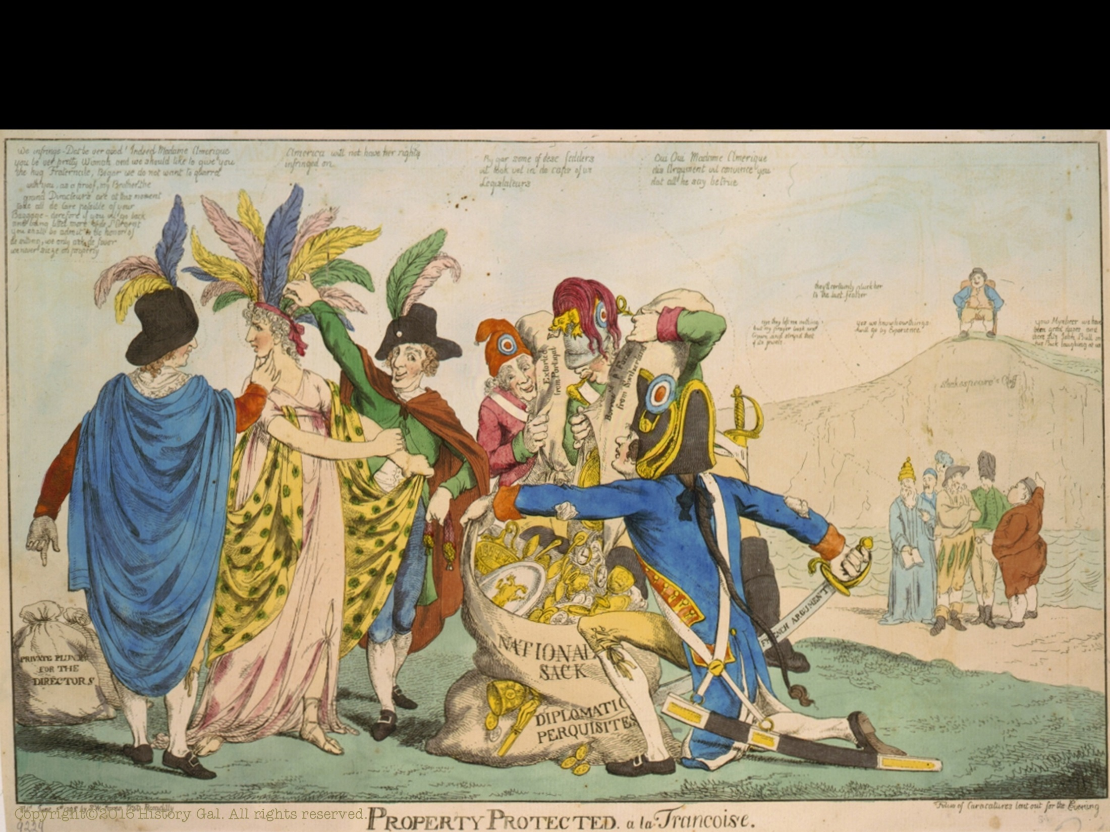
XYZ AFFAIR
U.S. merchant ships were being seized by French warships and privateers
Seeking peace, Adams sent a delegation to Paris to negotiate a treaty
French ministers known only as X, Y, Z (their names were never revealed) requested bribes before they would enter into negotiations

Slide 33
XYZ AFFAIR
U.S. delegates refused and went home
Americans wanted to go to war with France because of this insult
Adams opposed going to war with France and kept the U.S. out of the European wars
XYZ Affair

Slide 34
KENTUCKY & VIRGINIA RESOLUTIONS
Written by Thomas Jefferson and James Madison
States had entered into a compact and if any act of the Federal government broke this compact, a state could nullify the Federal law

Slide 35
KENTUCKY & VIRGINIA RESOLUTIONS
Written because D-R believed the Alien and Sedition Acts violated rights guaranteed by the 1st Amendment
At this time, the Supreme Court did not have power to declare laws unconstitutional
Crisis will soon fade because Federalists lose majority in Congress and the Supreme Court will gain the power to declare a law unconstitutional

Slide 36
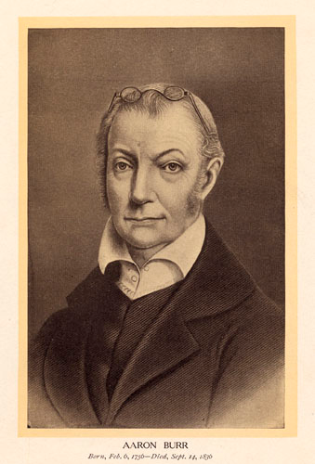
ELECTION OF 1800
Democratic-Republican
Aaron Burr
Federalist
John Adams
VS.
Democratic-Republican
Thomas Jefferson

Slide 37
ELECTION OF 1800
Electoral College split between Jefferson and Burr so the vote went to the House of Representatives
Aaron Burr
Thomas Jefferson

Slide 38
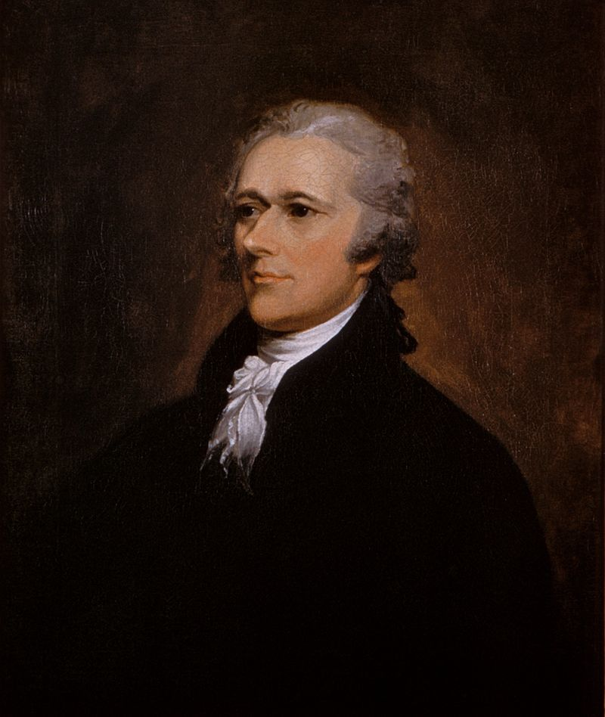
ELECTION OF 1800
Thomas Jefferson
Alexander Hamilton convinced his supporters in the House to vote for Jefferson not Burr
Aaron Burr
WINNER!
VICE PRESIDENT
Alexander
Hamilton

Slide 39
REVOLUTION OF 1800
The Election of 1800 is called the REVOLUTION OF 1800 because it was a peaceful transfer of power from the Federalists to the Democratic-Republicans
Indicated the U.S. Constitutional system would endure
Election of 1800

Slide 40
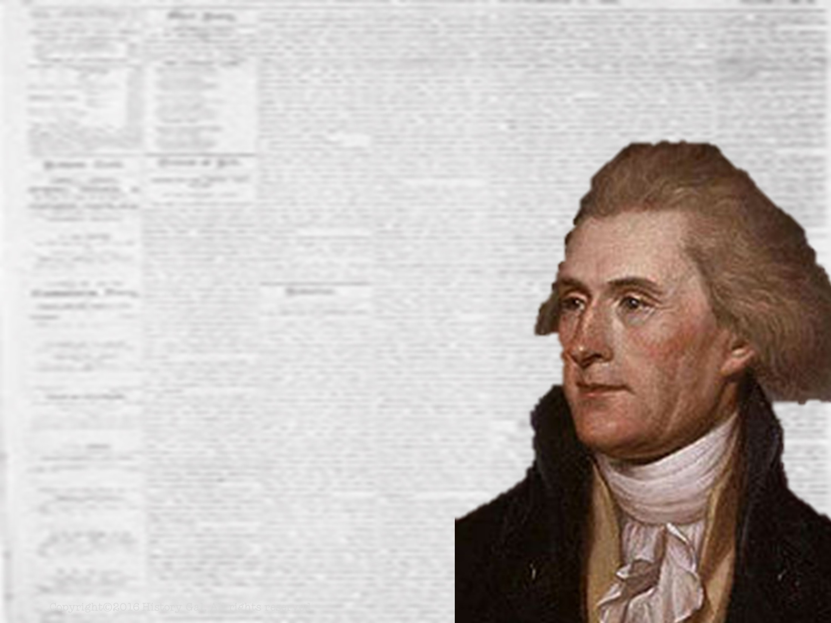
PRESIDENCY OF
THOMAS
JEFFERSON
1801-1809
Thomas Jefferson in 60 Seconds

Slide 41
JEFFERSON’S PRESIDENCY
maintained Hamilton’s national bank and debt repayment plan
stayed out of foreign affairs
repealed the excise taxes (including those on whiskey)
lowered the national debt
repealed the Alien and Sedition Acts
Copyright©2016 History Gal. All rights reserved.

Slide 42
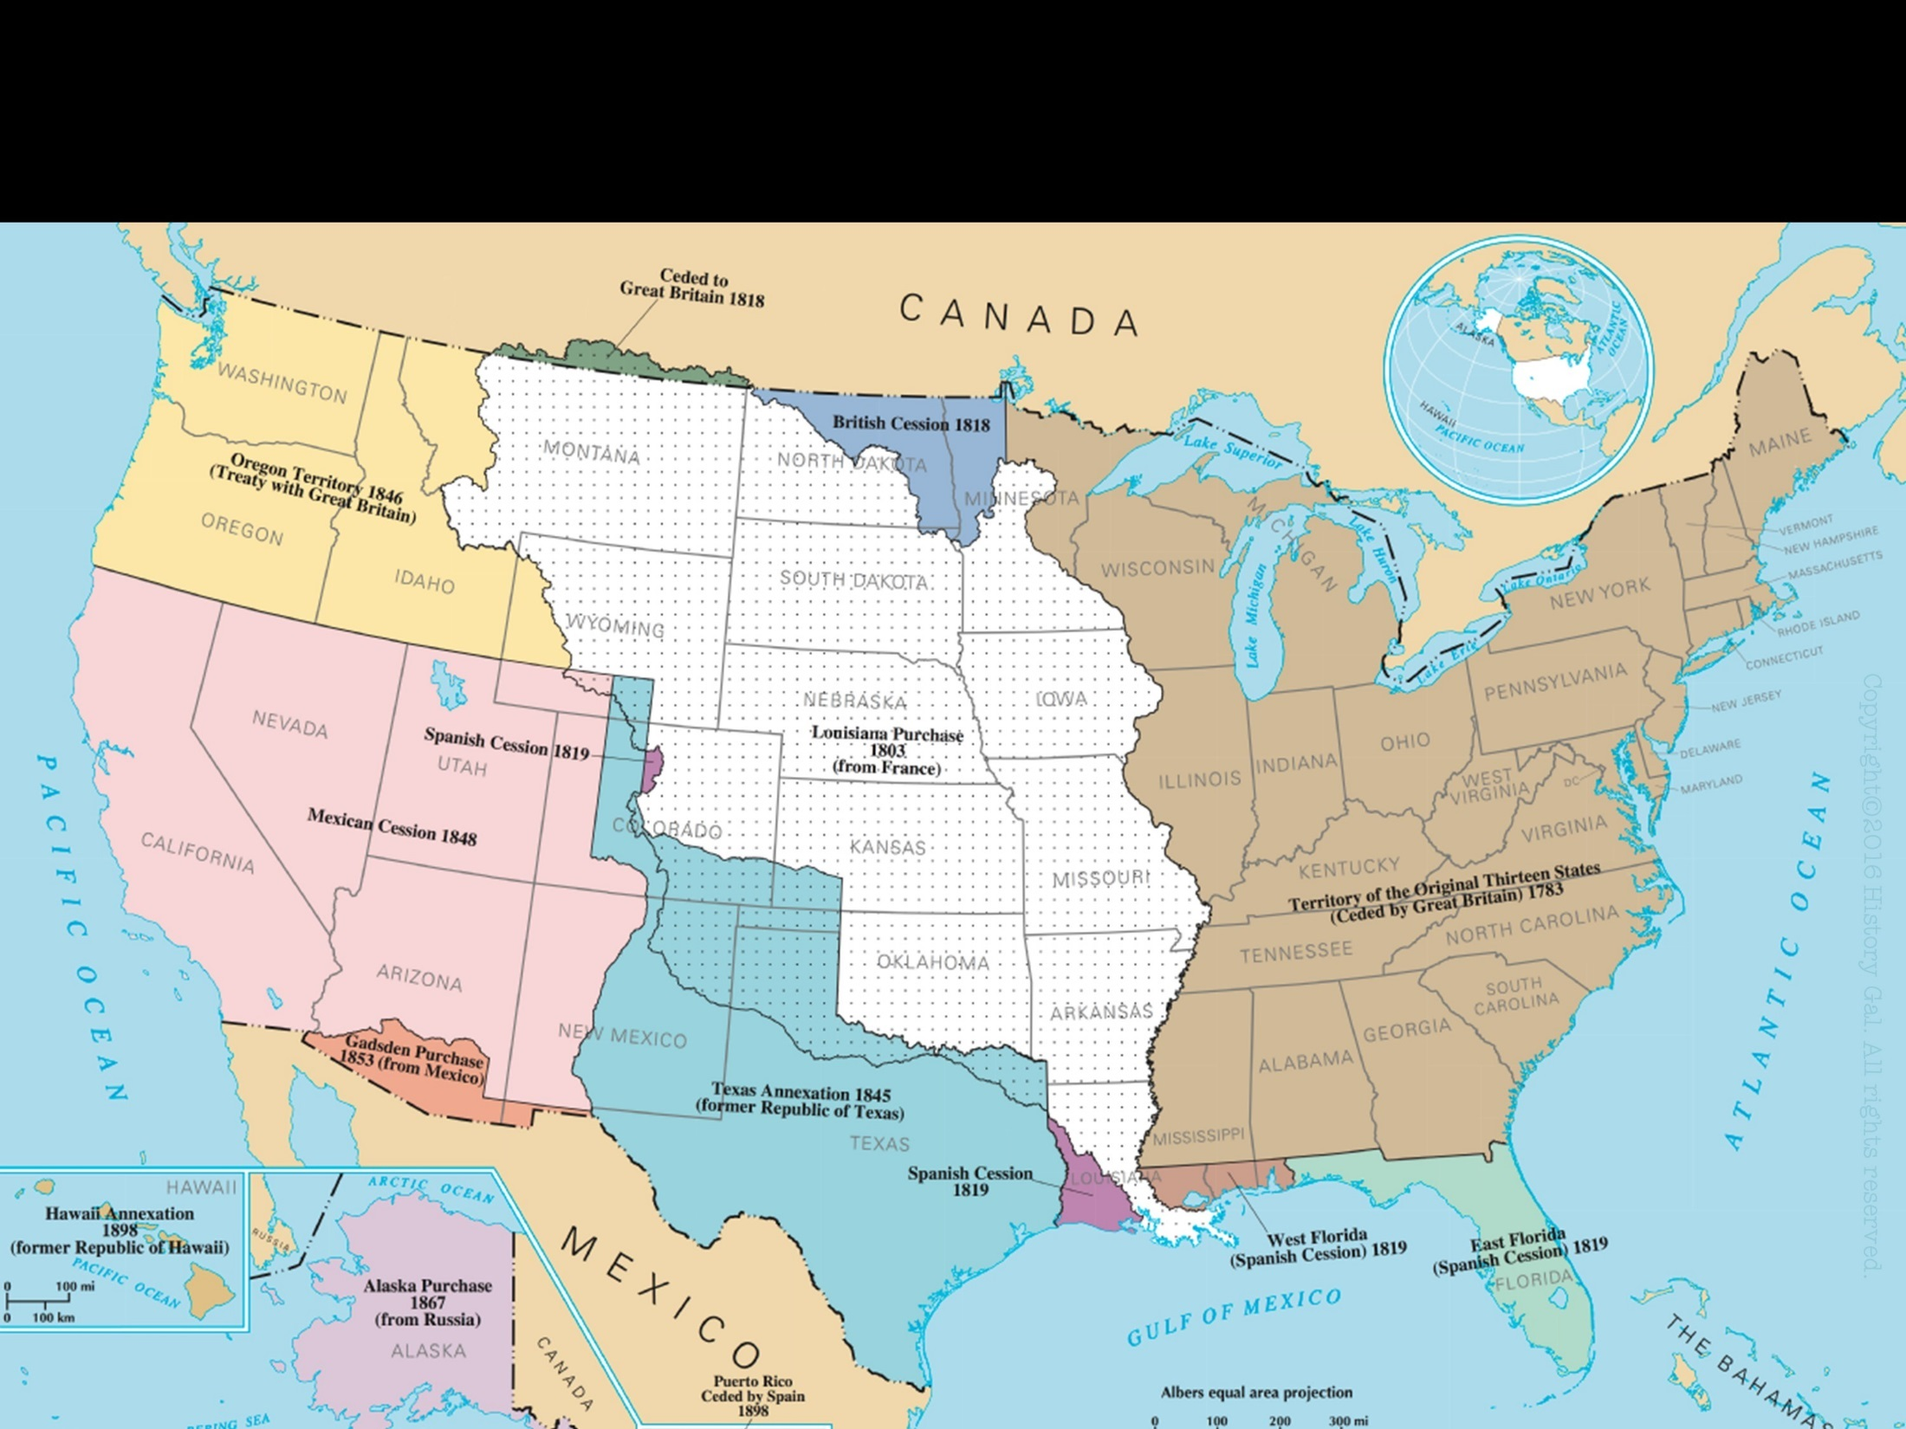
LOUISIANA PURCHASE
LOUISIANA – land where Mississippi and Missouri Rivers flowed, including the Port of New Orleans

Slide 43
LOUISIANA PURCHASE
Why was the U.S. interested in the Mississippi River?
settlers in Indiana Territory depended on transporting goods on rivers that flowed westward into the Mississippi River and into New Orleans for their economic existence

Slide 44
LOUISIANA PURCHASE
Why was the U.S. interested in the Mississippi River?
1802 – Spanish officials revoked the right of deposit (the tax-free use of the Port of New Orleans) guaranteed in Pinckney Treaty
Belief that if a foreign power controlled New Orleans, the U.S. might get entangled in European affairs
House Hunters: Louisiana Purchase Edition

Slide 45
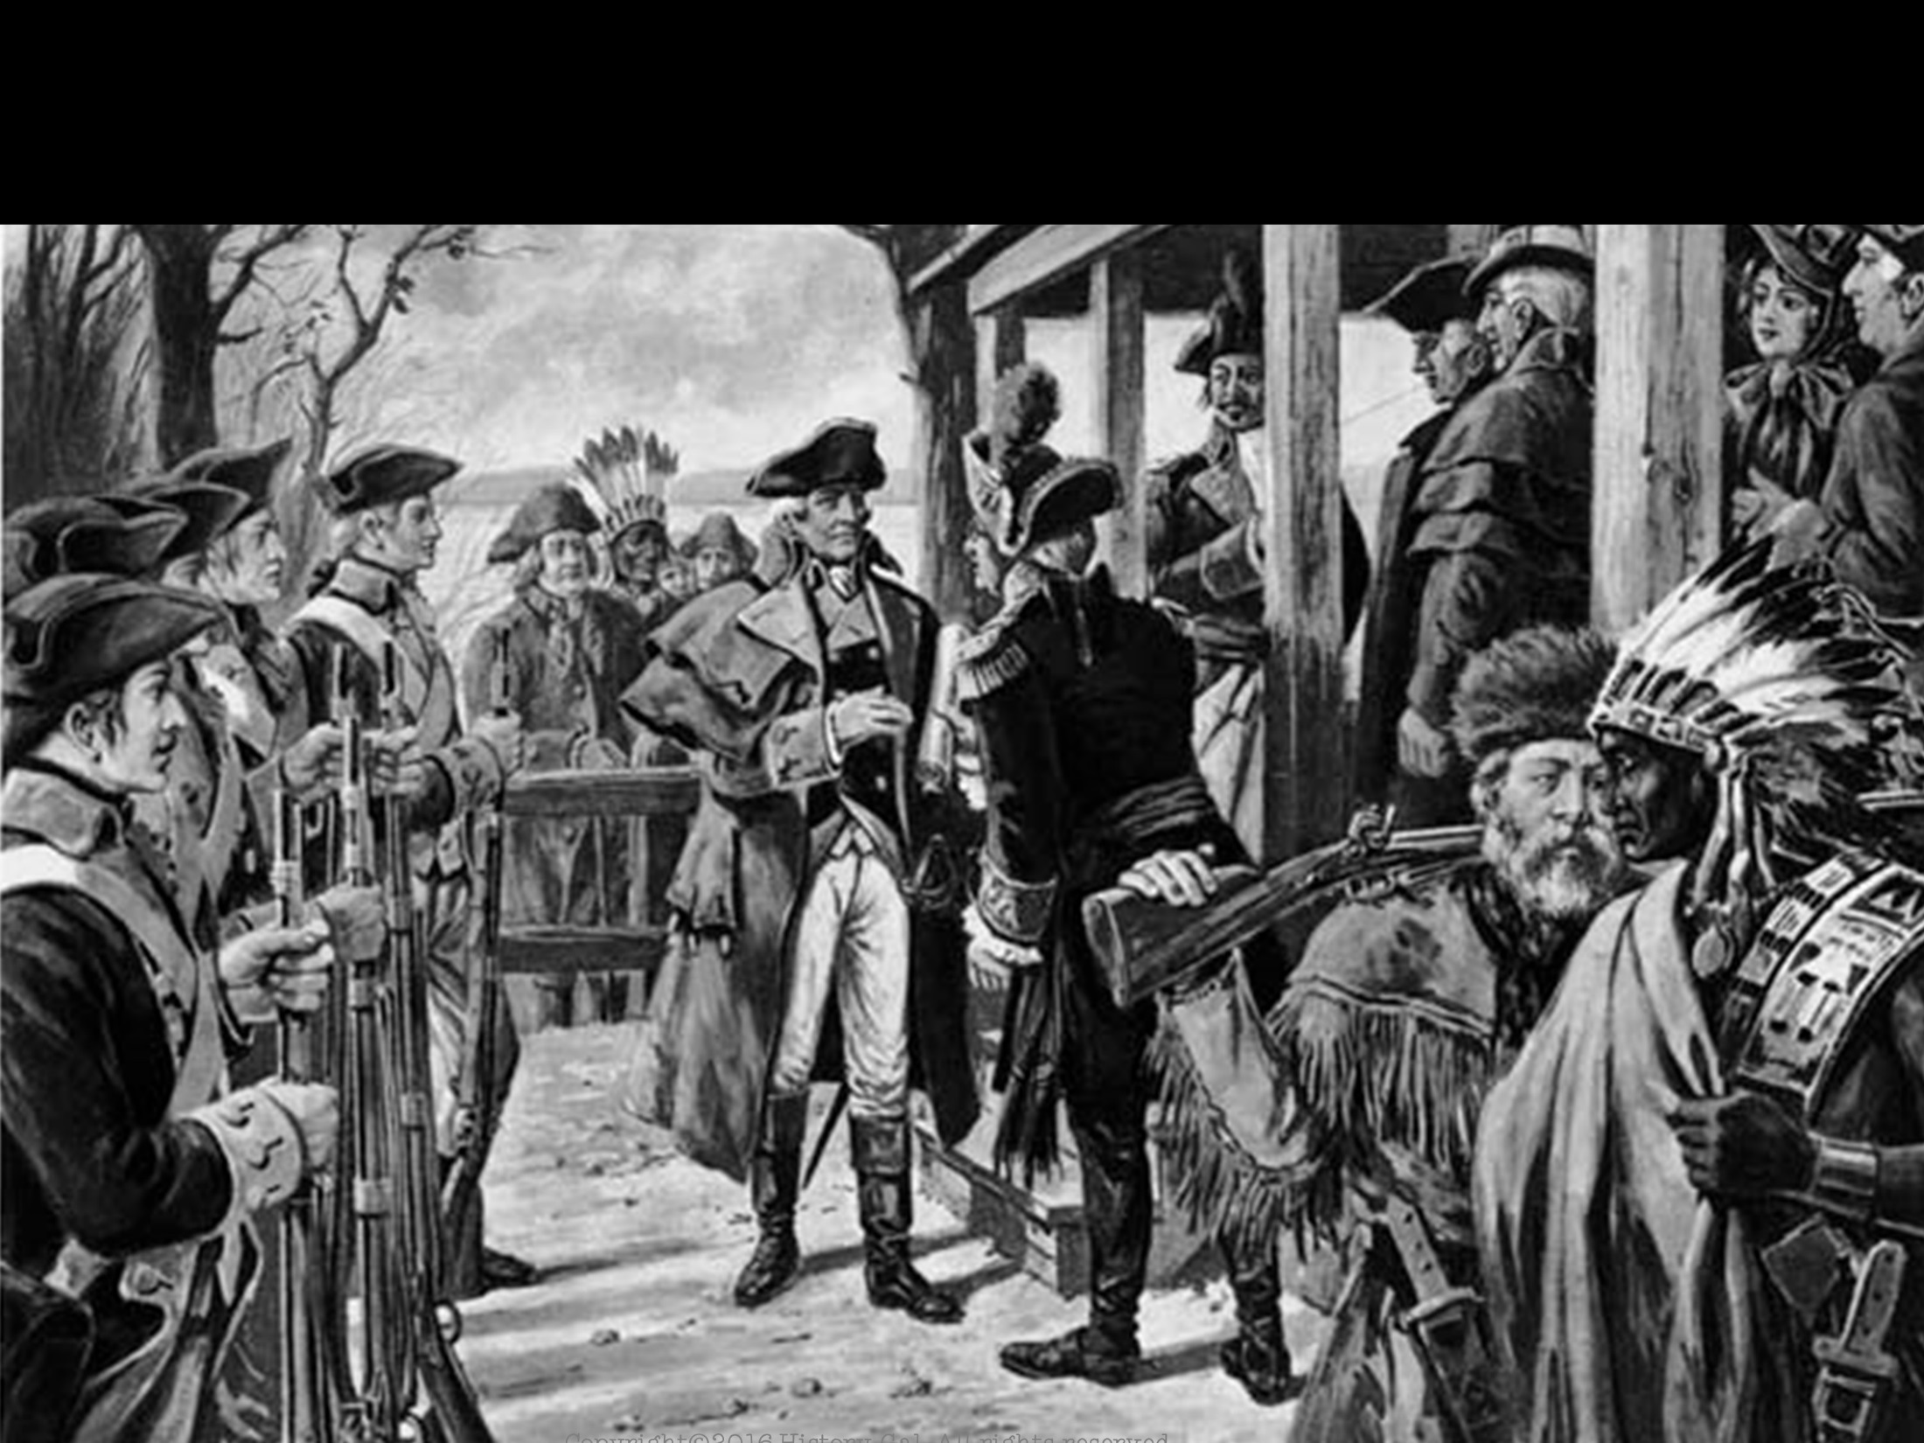
LOUISIANA PURCHASE
NEGOTIATIONS
Jefferson sent ministers to France with instructions to offer up to $10 million for New Orleans and a strip of land from the port eastward to Florida
Napoleon’s ministers offered to sell the entire Louisiana territory for $15 million and the American ministers agreed

Slide 46
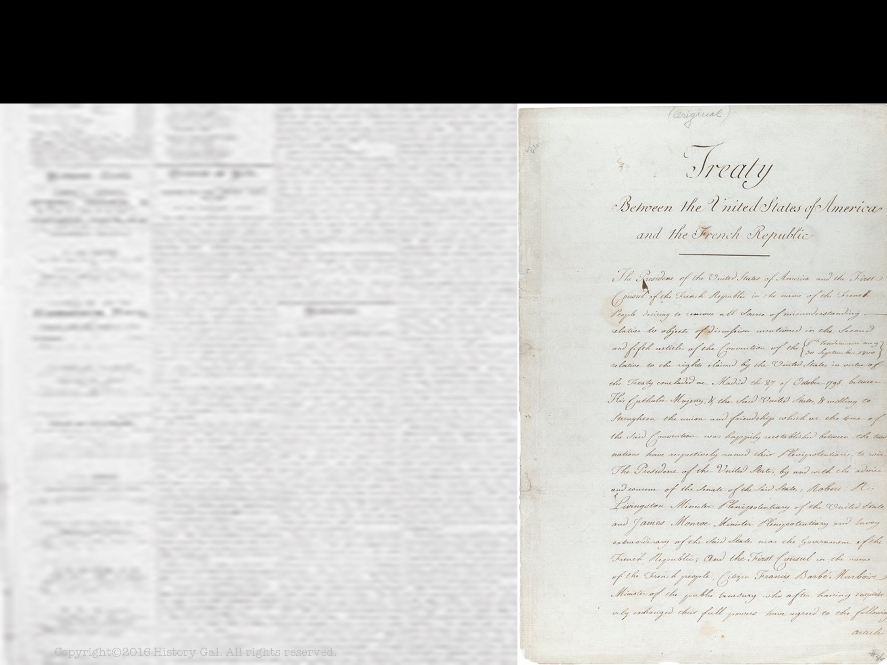
LOUISIANA PURCHASE
CONSTITUTIONAL ISSUE:
Jefferson was committed to a strict interpretation of the Constitution and no clause in the Constitution gave the President power to purchase foreign
land

Slide 47
LOUISIANA PURCHASE
CONSTITUTIONAL ISSUE:
Eventually Jefferson determined it was for the country’s good and submitted the agreement to the Senate, the Senate approved

Slide 48
LOUISIANA PURCHASE
PURCHASE RESULTS:
Doubled the size of the U.S.
Removed a foreign presence from the nation’s borders
Louisiana Purchase

Slide 49
LOUISIANA PURCHASE
PURCHASE RESULTS:
Guaranteed U.S. expansion past the Mississippi River
Increased the popularity of the Democratic-Republican Party
Louisiana Purchase

Slide 50
LEWIS & CLARK EXPEDITION 1804-1806
Lewis and Clark
Captain Meriwether Lewis and Lt. William Clark explored the Louisiana Territory

Slide 51
LEWIS & CLARK EXPEDITION 1804-1806
Animated Map

Slide 52
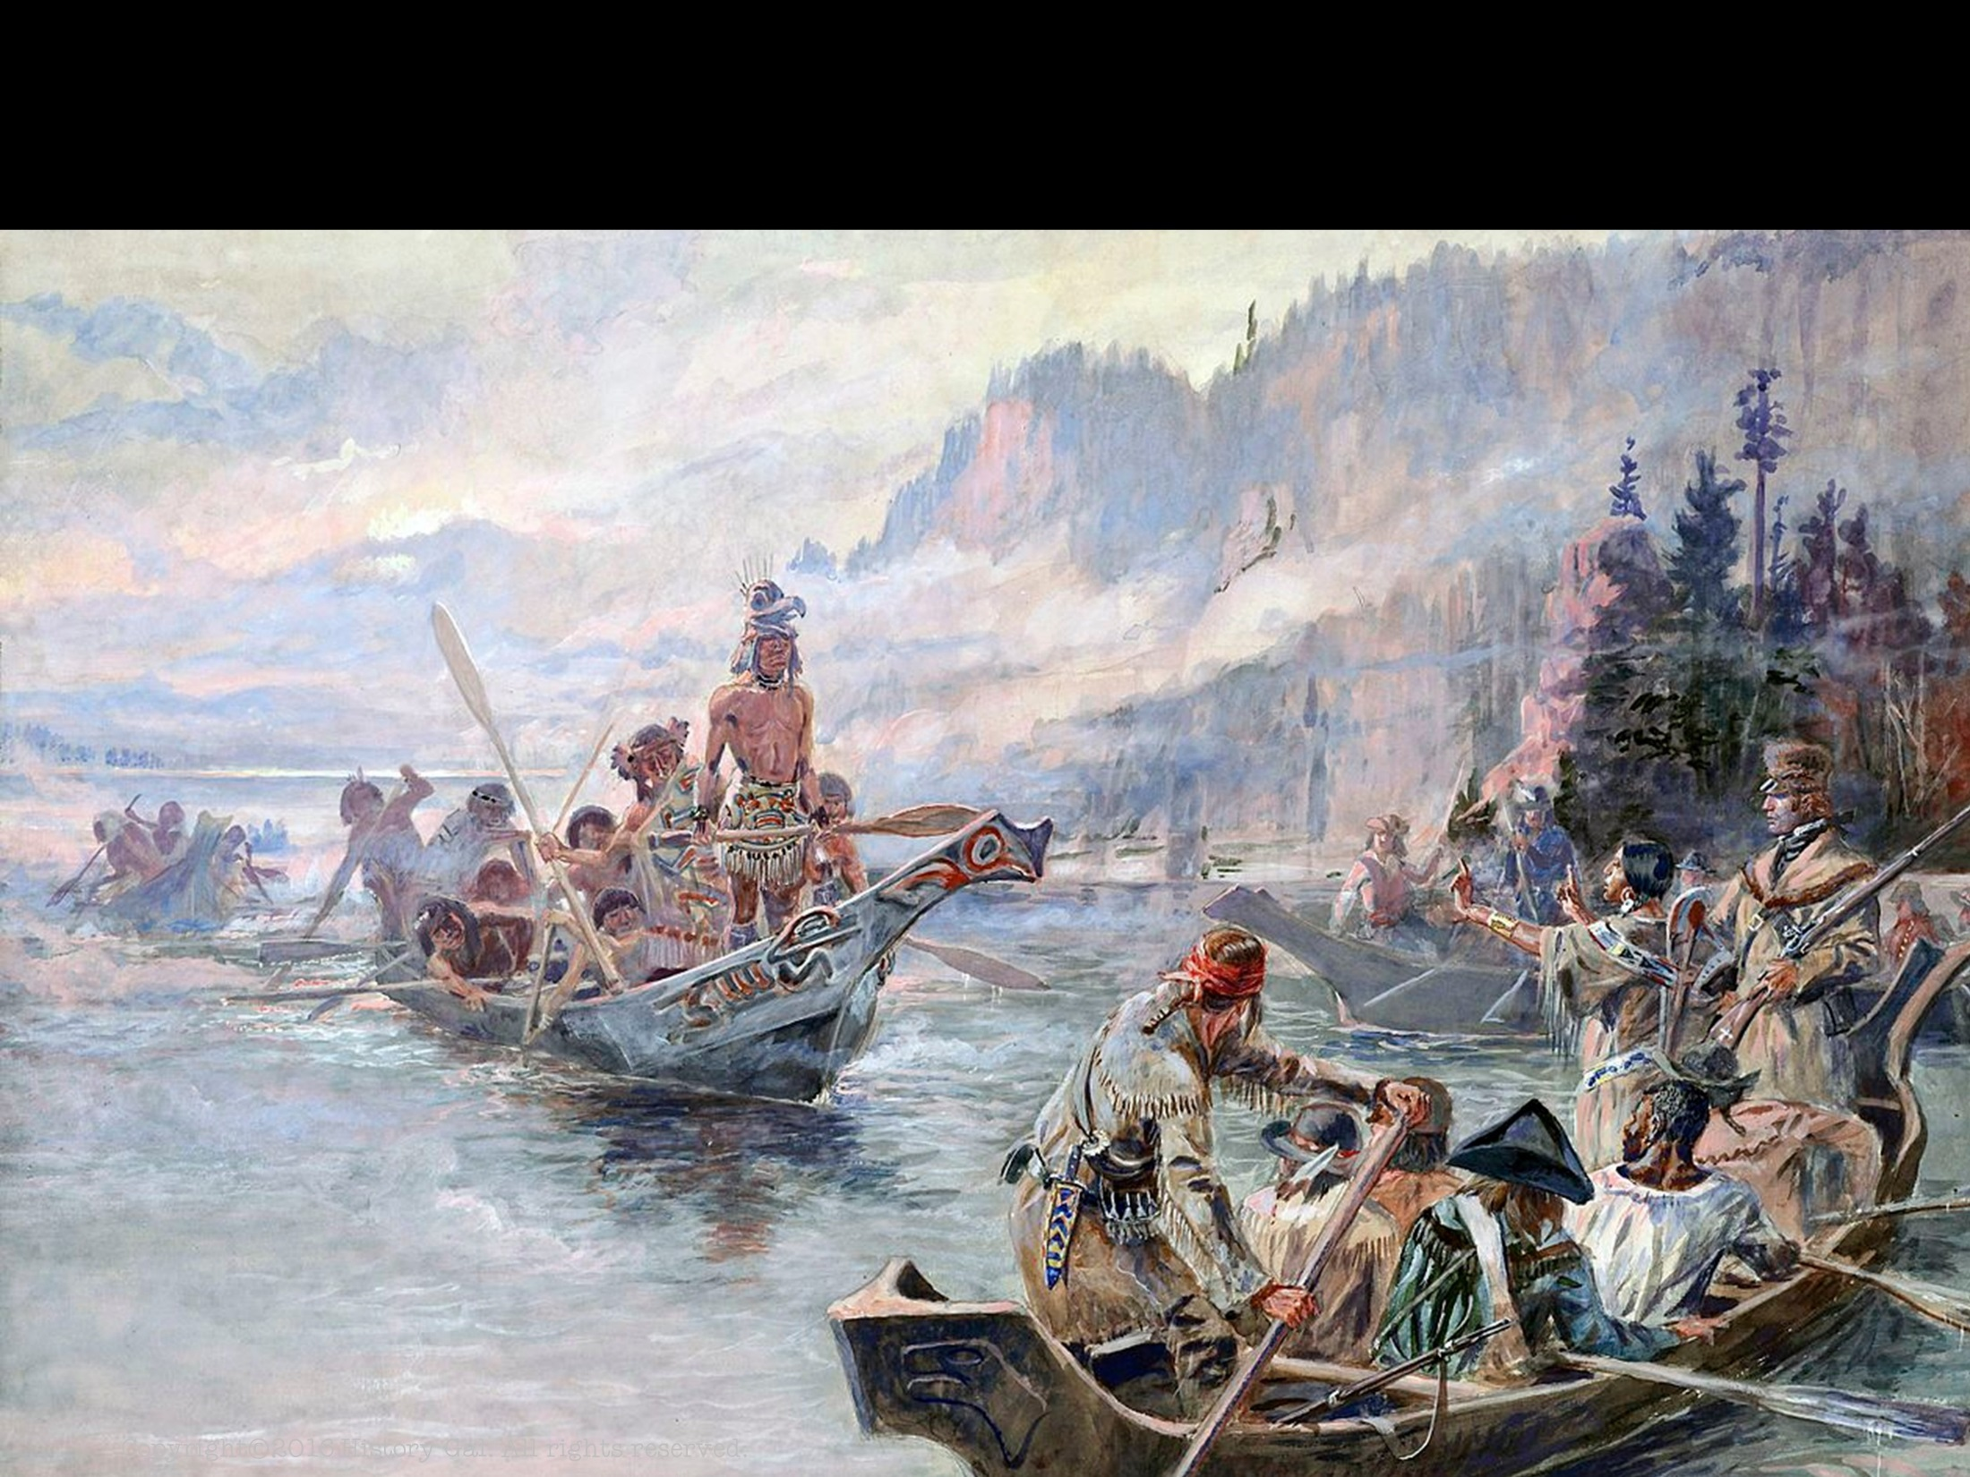
LEWIS & CLARK EXPEDITION 1804-1806
RESULTS
Strengthened claims to the Oregon Territory
Improved relations with Native American tribes
Developed maps and land routes for future travelers

Slide 53
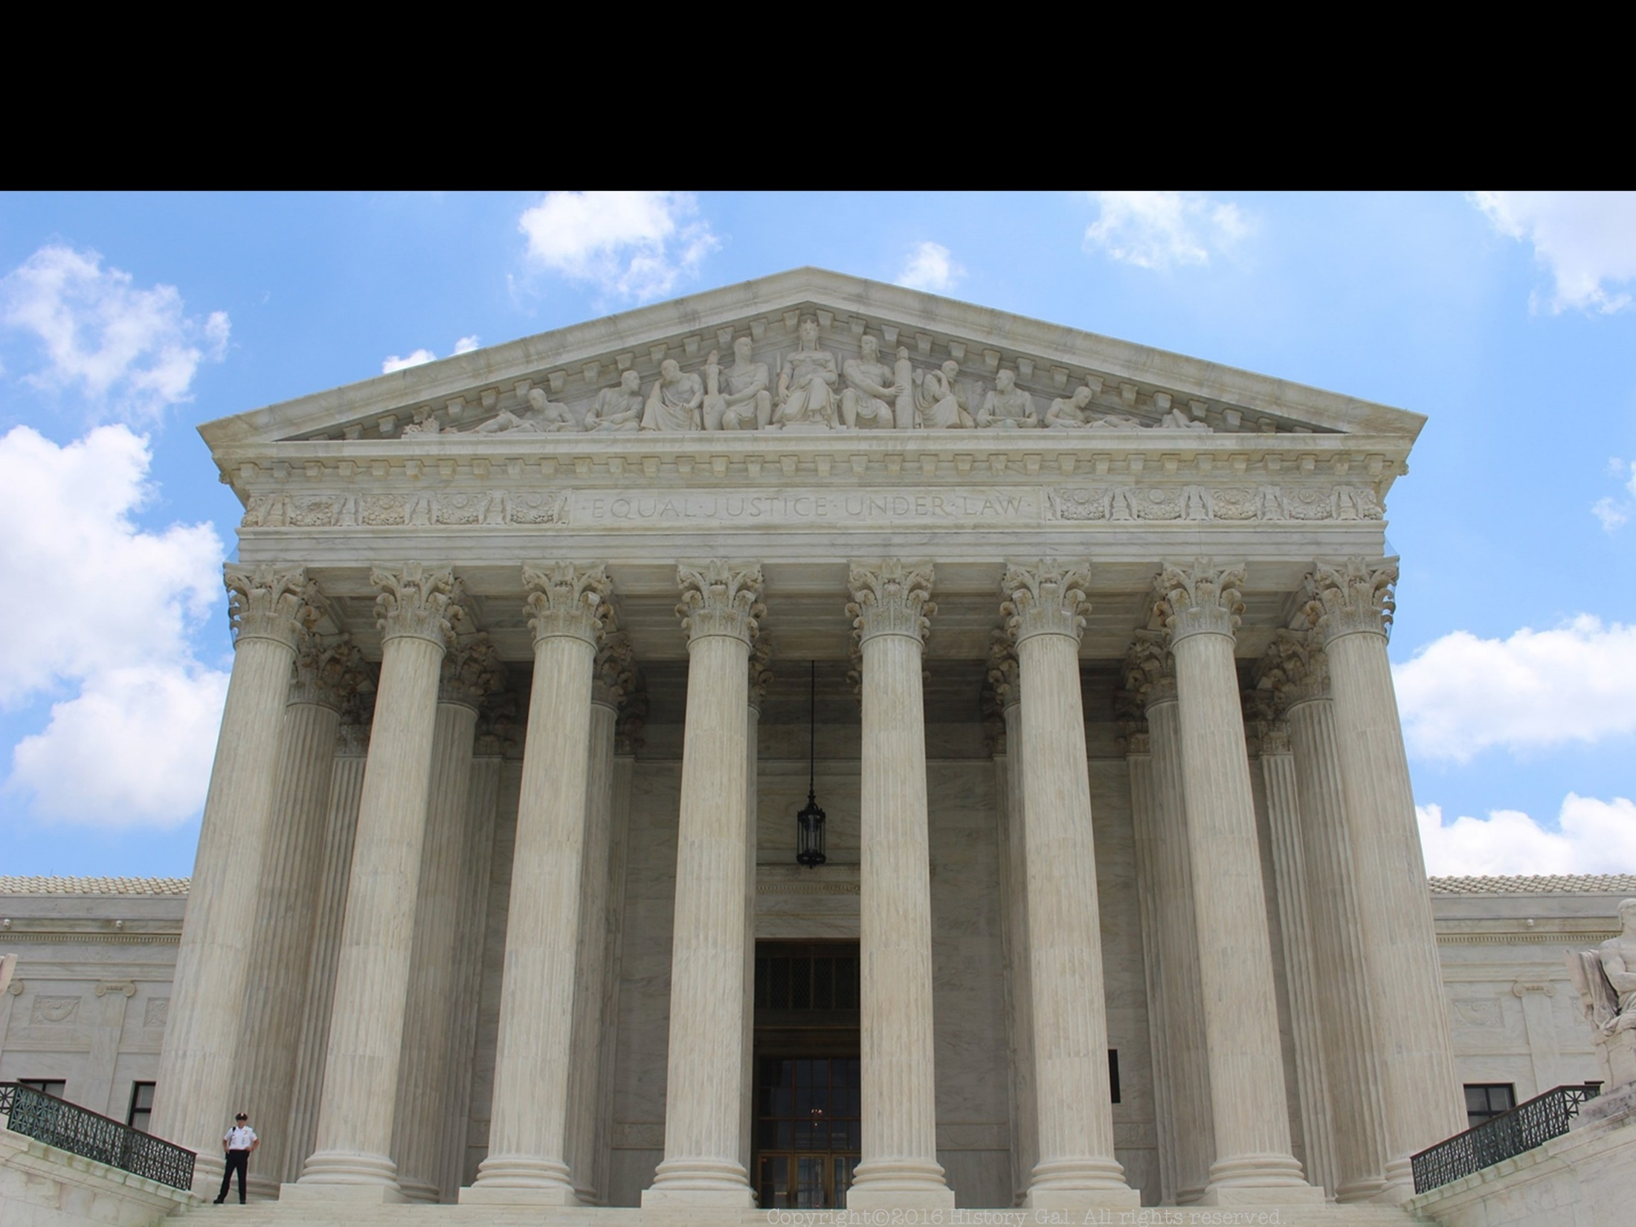
MARBURY V. MADISON 1803
Jefferson wanted to block last minute Federalist appointments made by Adams (Midnight Appointments)
He ordered Secretary of State James Madison not to deliver the commissions to the federal judges that Adams appointed
One of these appointees, William Marbury, sued for his commission and the case went to the Supreme Court
Judicial Review Crash Course

Slide 54
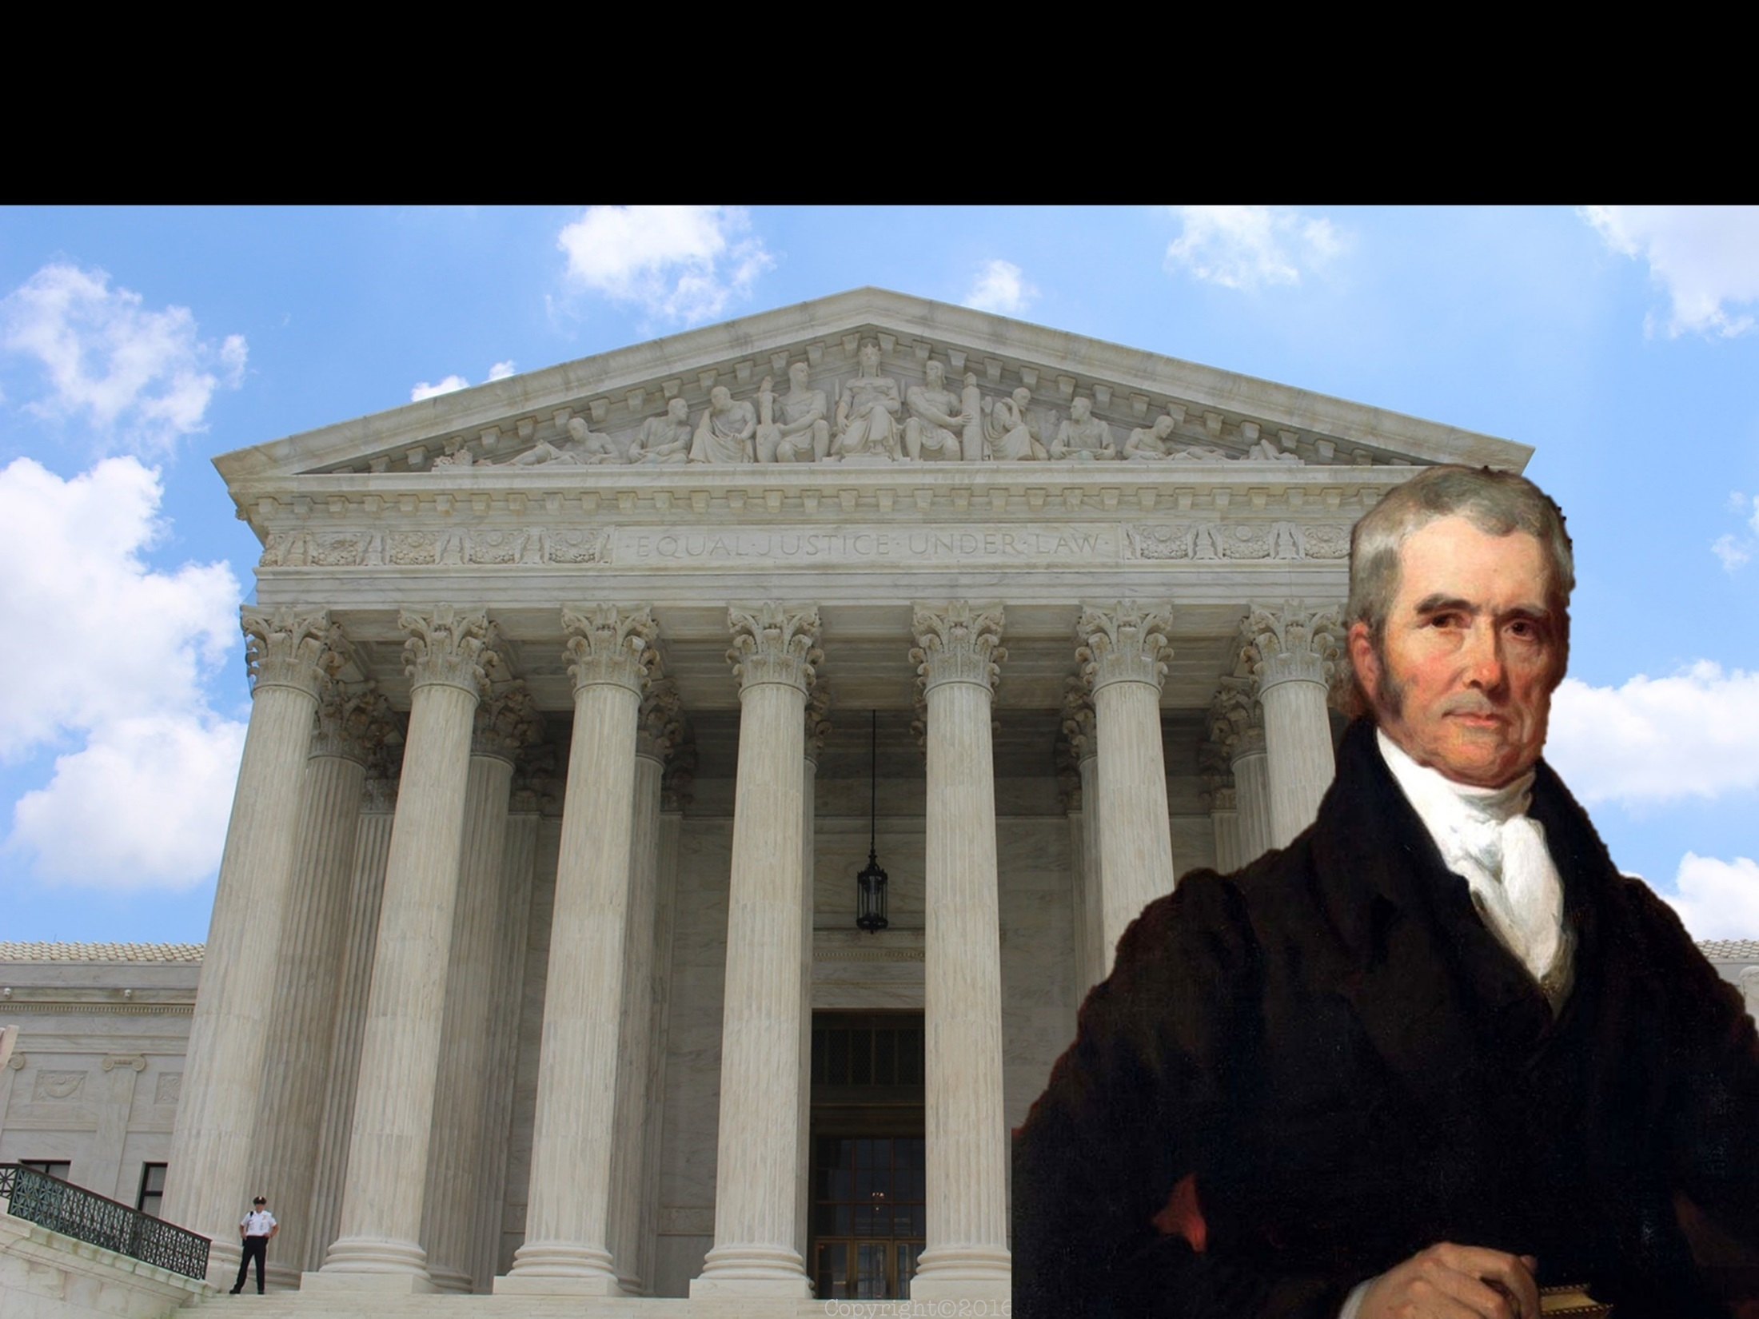
MARBURY V. MADISON 1803
Chief Justice John Marshall ruled that according to the Judiciary Act of 1789, Marbury should get his commission, but the act itself was unconstitutional
John Marshall – Chief Justice of the Supreme Court

Slide 55
MARBURY V. MADISON 1803
IMPORTANCE OF THE CASE:
Established Judicial
Review (Supreme
Court could declare an act of Congress or the President unconstitutional)
John Marshall – Chief Justice of the Supreme Court
Marbury v. Madison Explained

Slide 56
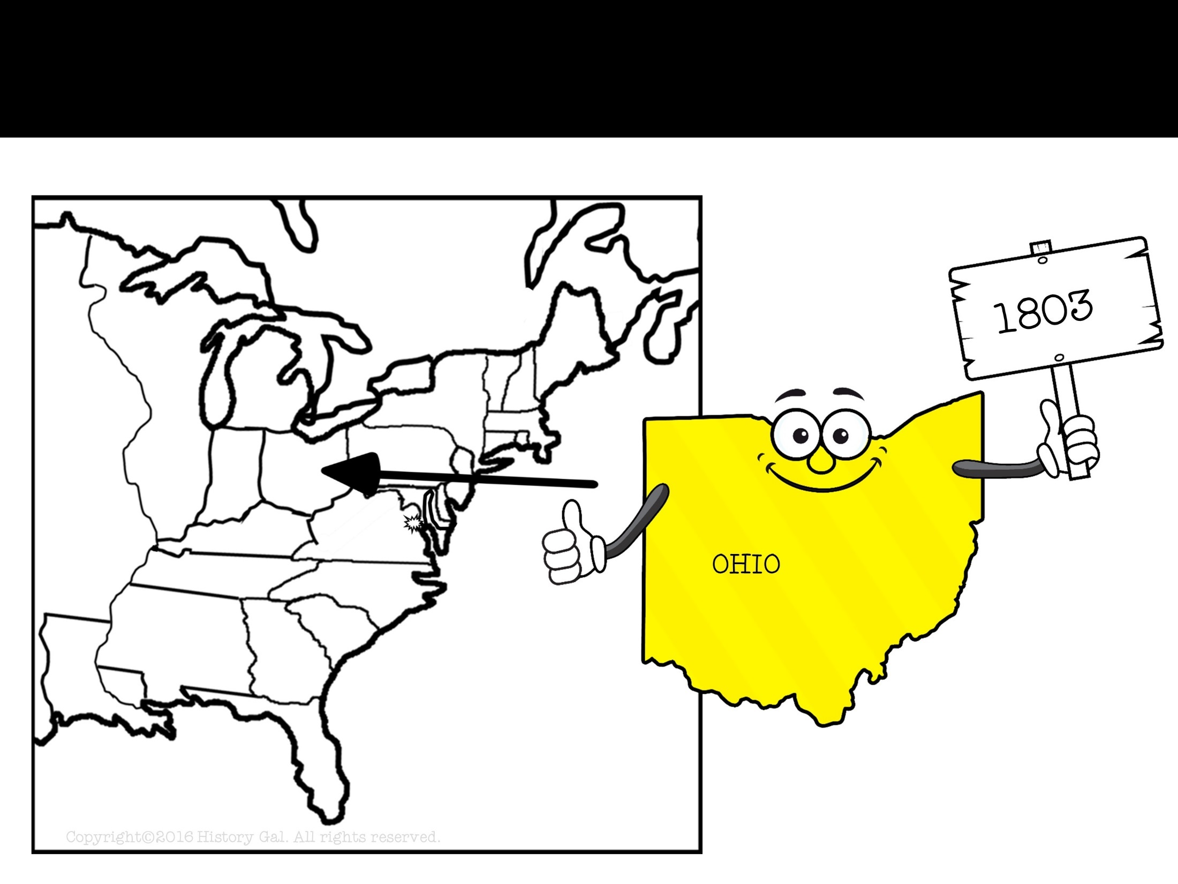
NEW STATE

Slide 57
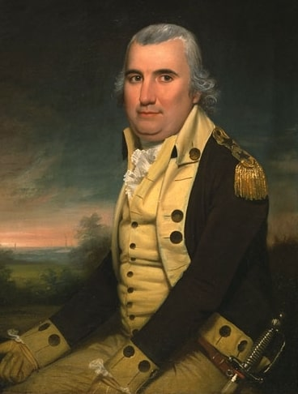
ELECTION OF 1804
Federalist Charles Pinckney
VS.
Democratic-Republican
Thomas Jefferson
WINNER!
Election of 1804 Explained

Slide 58
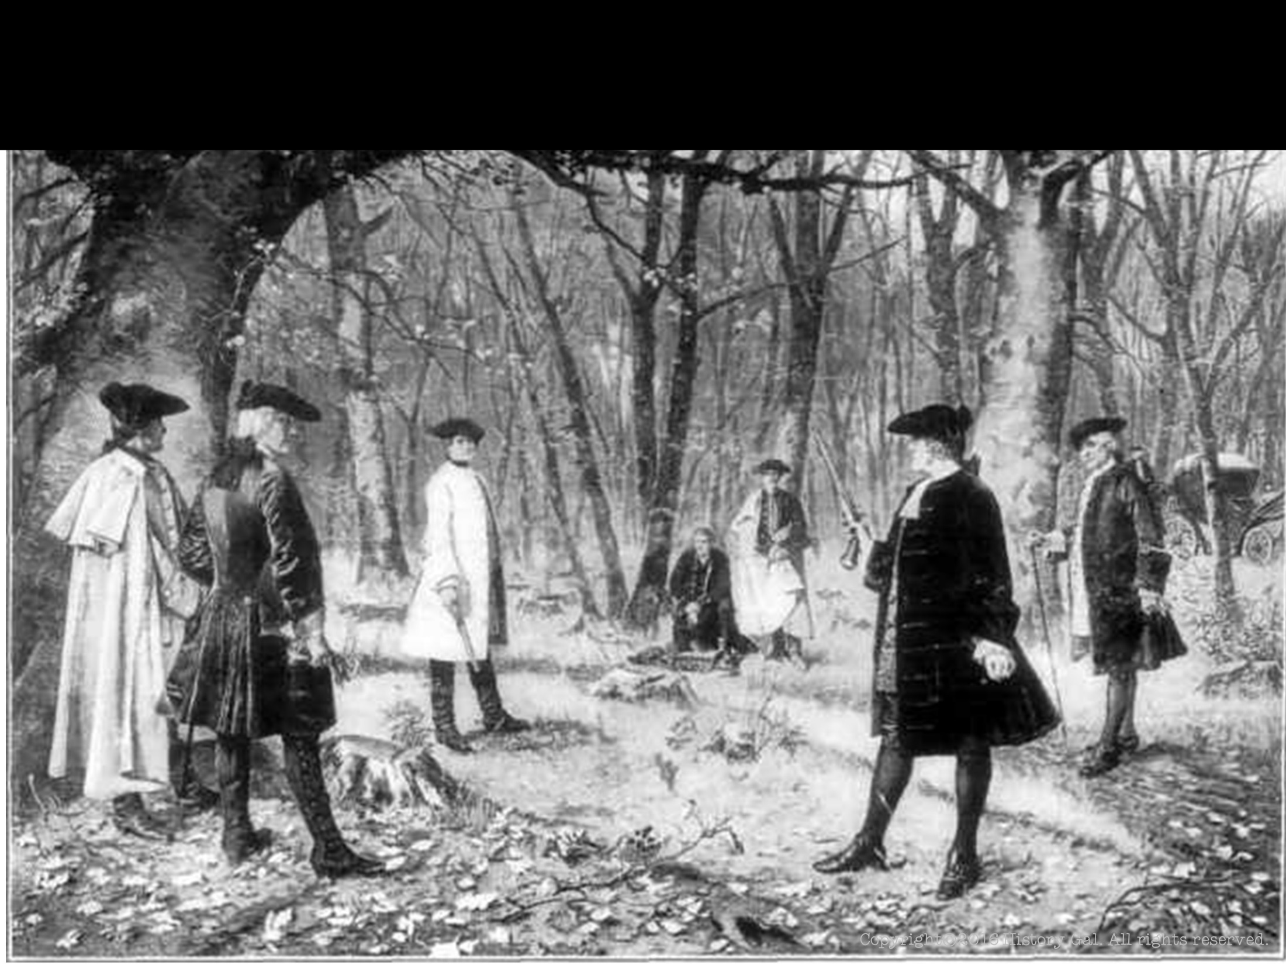
AARON BURR
Not nominated for a 2nd term as Vice President
In 1804, he tried to win the governorship of New York so he could unite New York with the New England states and secede from the union, but he lost the election

Slide 59
AARON BURR
1804 - Burr challenged Alexander Hamilton to a duel because of an insult, Burr killed Hamilton
1806 - Burr tried to take Mexico from Spain and unite Mexico and Louisiana under his rule, Jefferson ordered Burr’s arrest and trial for treason, but Burr was acquitted because of lack of witnesses
Aaron Burr and Alexander Hamilton
Who Shot Alexander Hamilton?

Slide 60
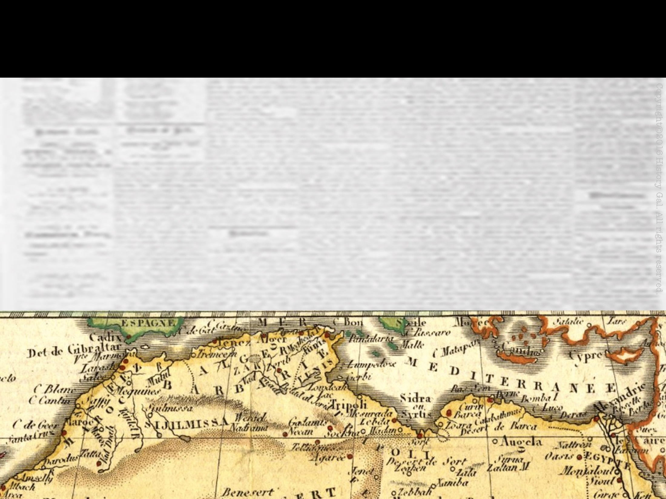
BARBARY PIRATES
Washington and Adams paid a tribute (bribe) to the Barbary governments in North Africa to prevent them from seizing American ships

Slide 61
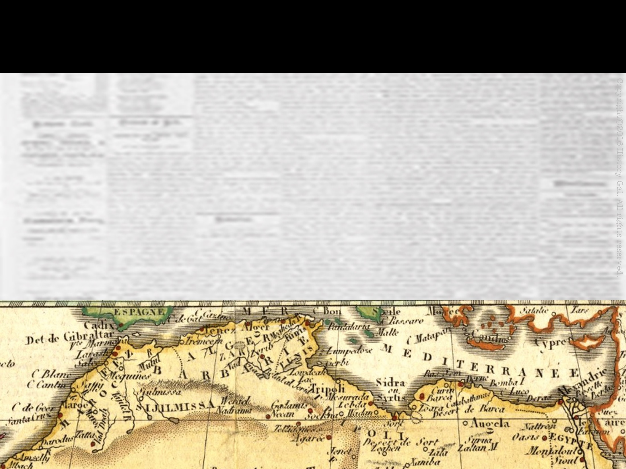
BARBARY PIRATES
Rather than pay, Jefferson sent a small fleet of U.S. naval vessels to the Mediterranean to protect U.S. merchant ships
Fighting between U.S. and pirates lasted until 1805
Jefferson and Barbary Pirates

Slide 62
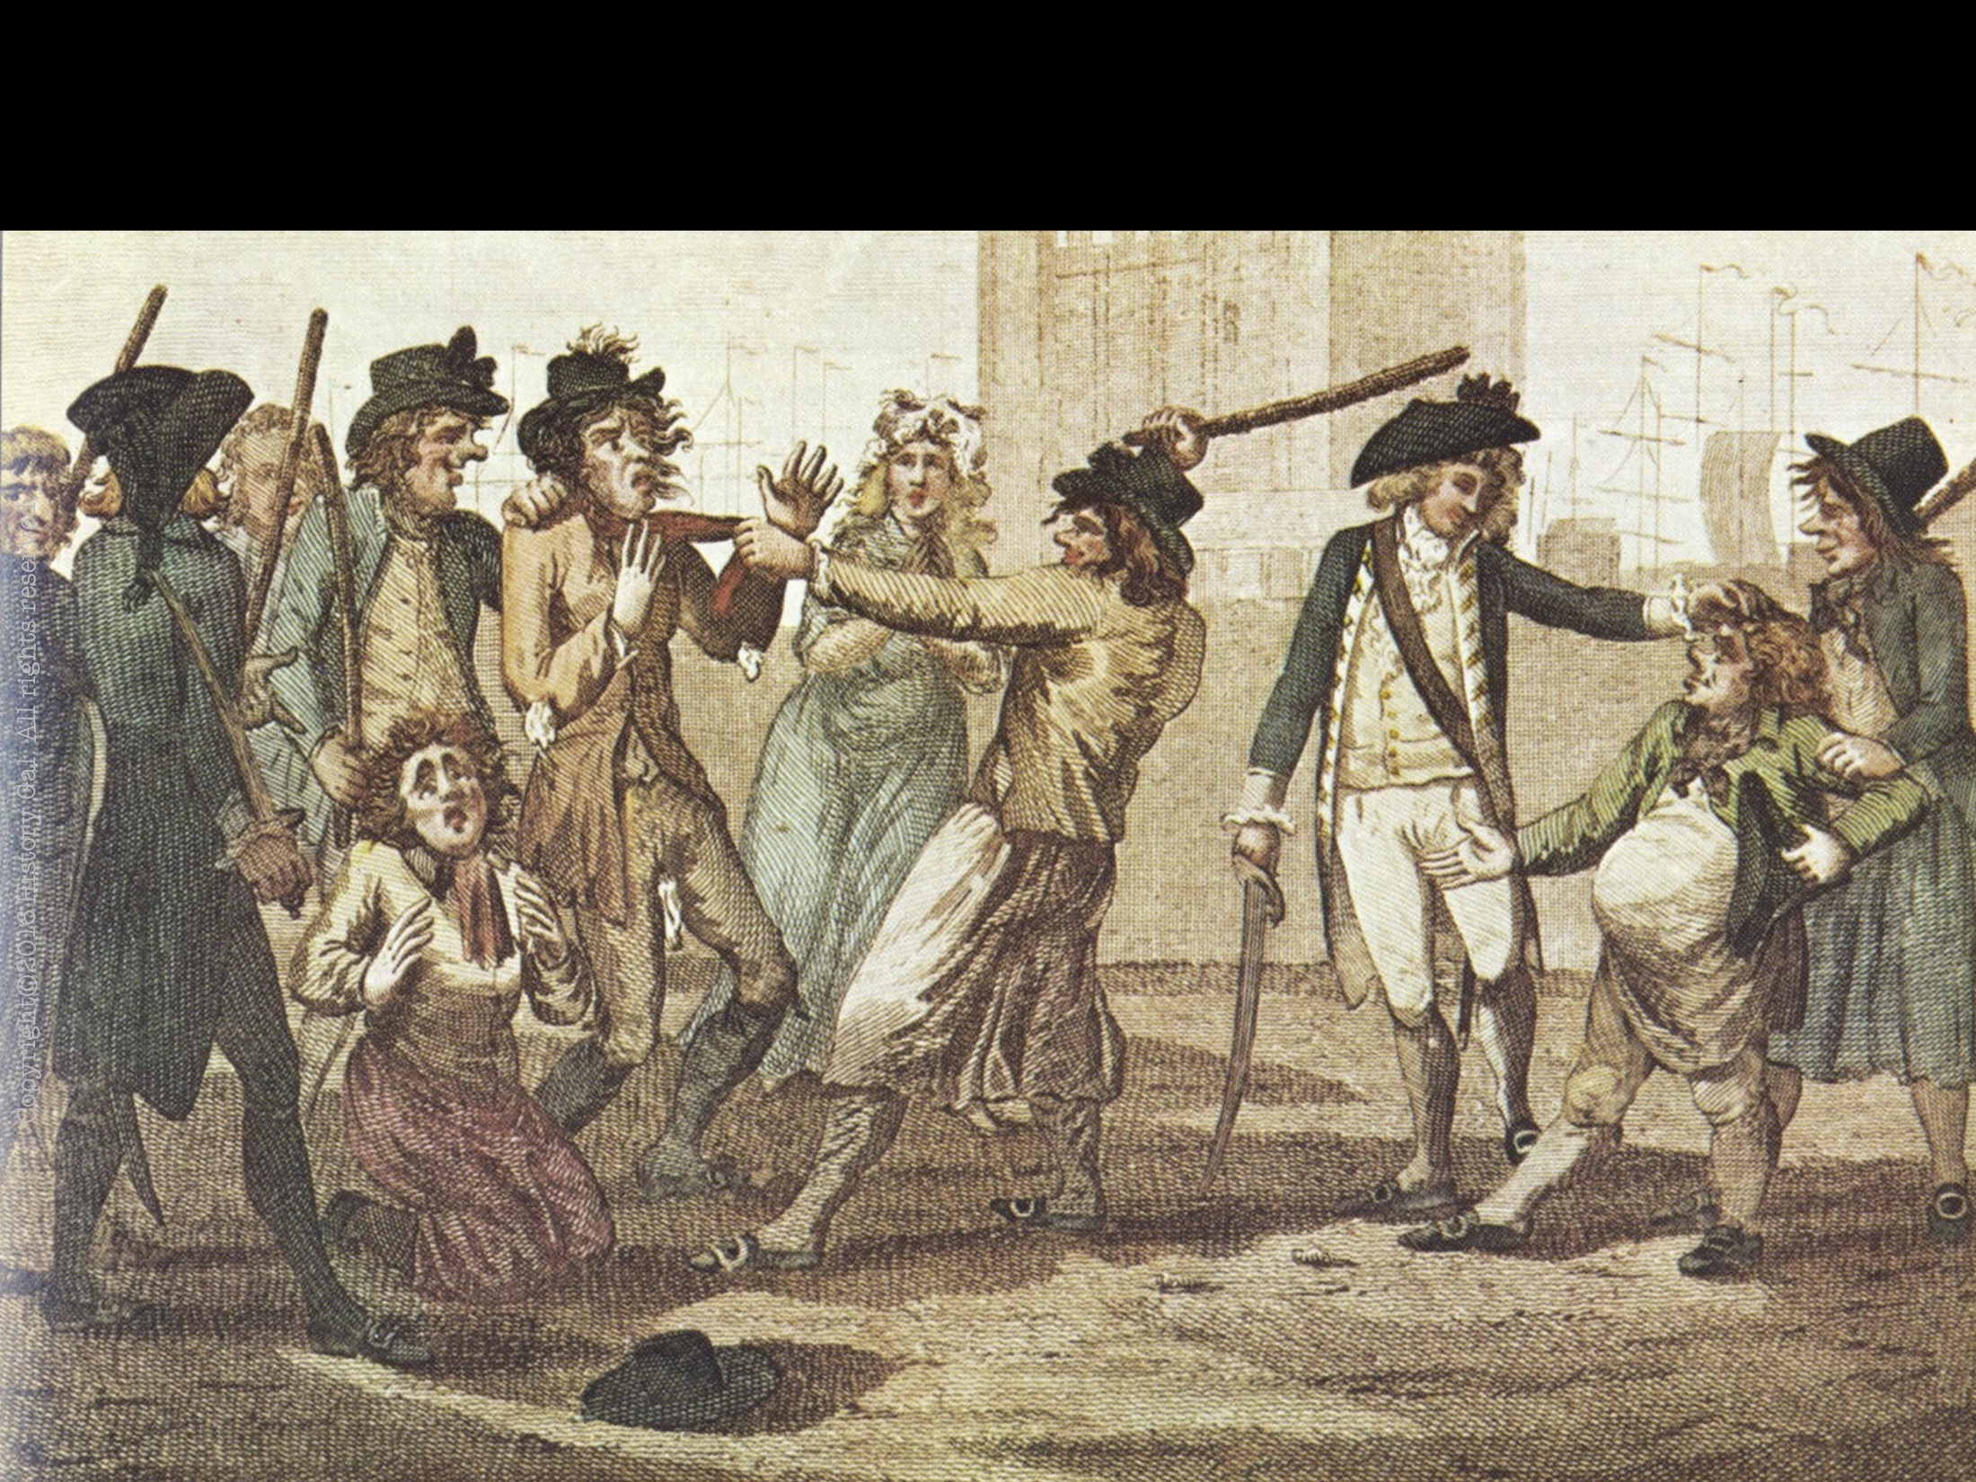
NAPOLEONIC WARS
Great Britain and France were at war with each other AGAIN!
France and Britain continued to seize U.S. merchant ships
Britain was the worst because their navy dominated the Atlantic Ocean and they captured U.S. sailors and forced them to serve in the British navy (IMPRESSMENT)
French Revolution Crash Course (8:15 – end)
Napoleonic Wars in 8 Minutes
Impressment Video

Slide 63
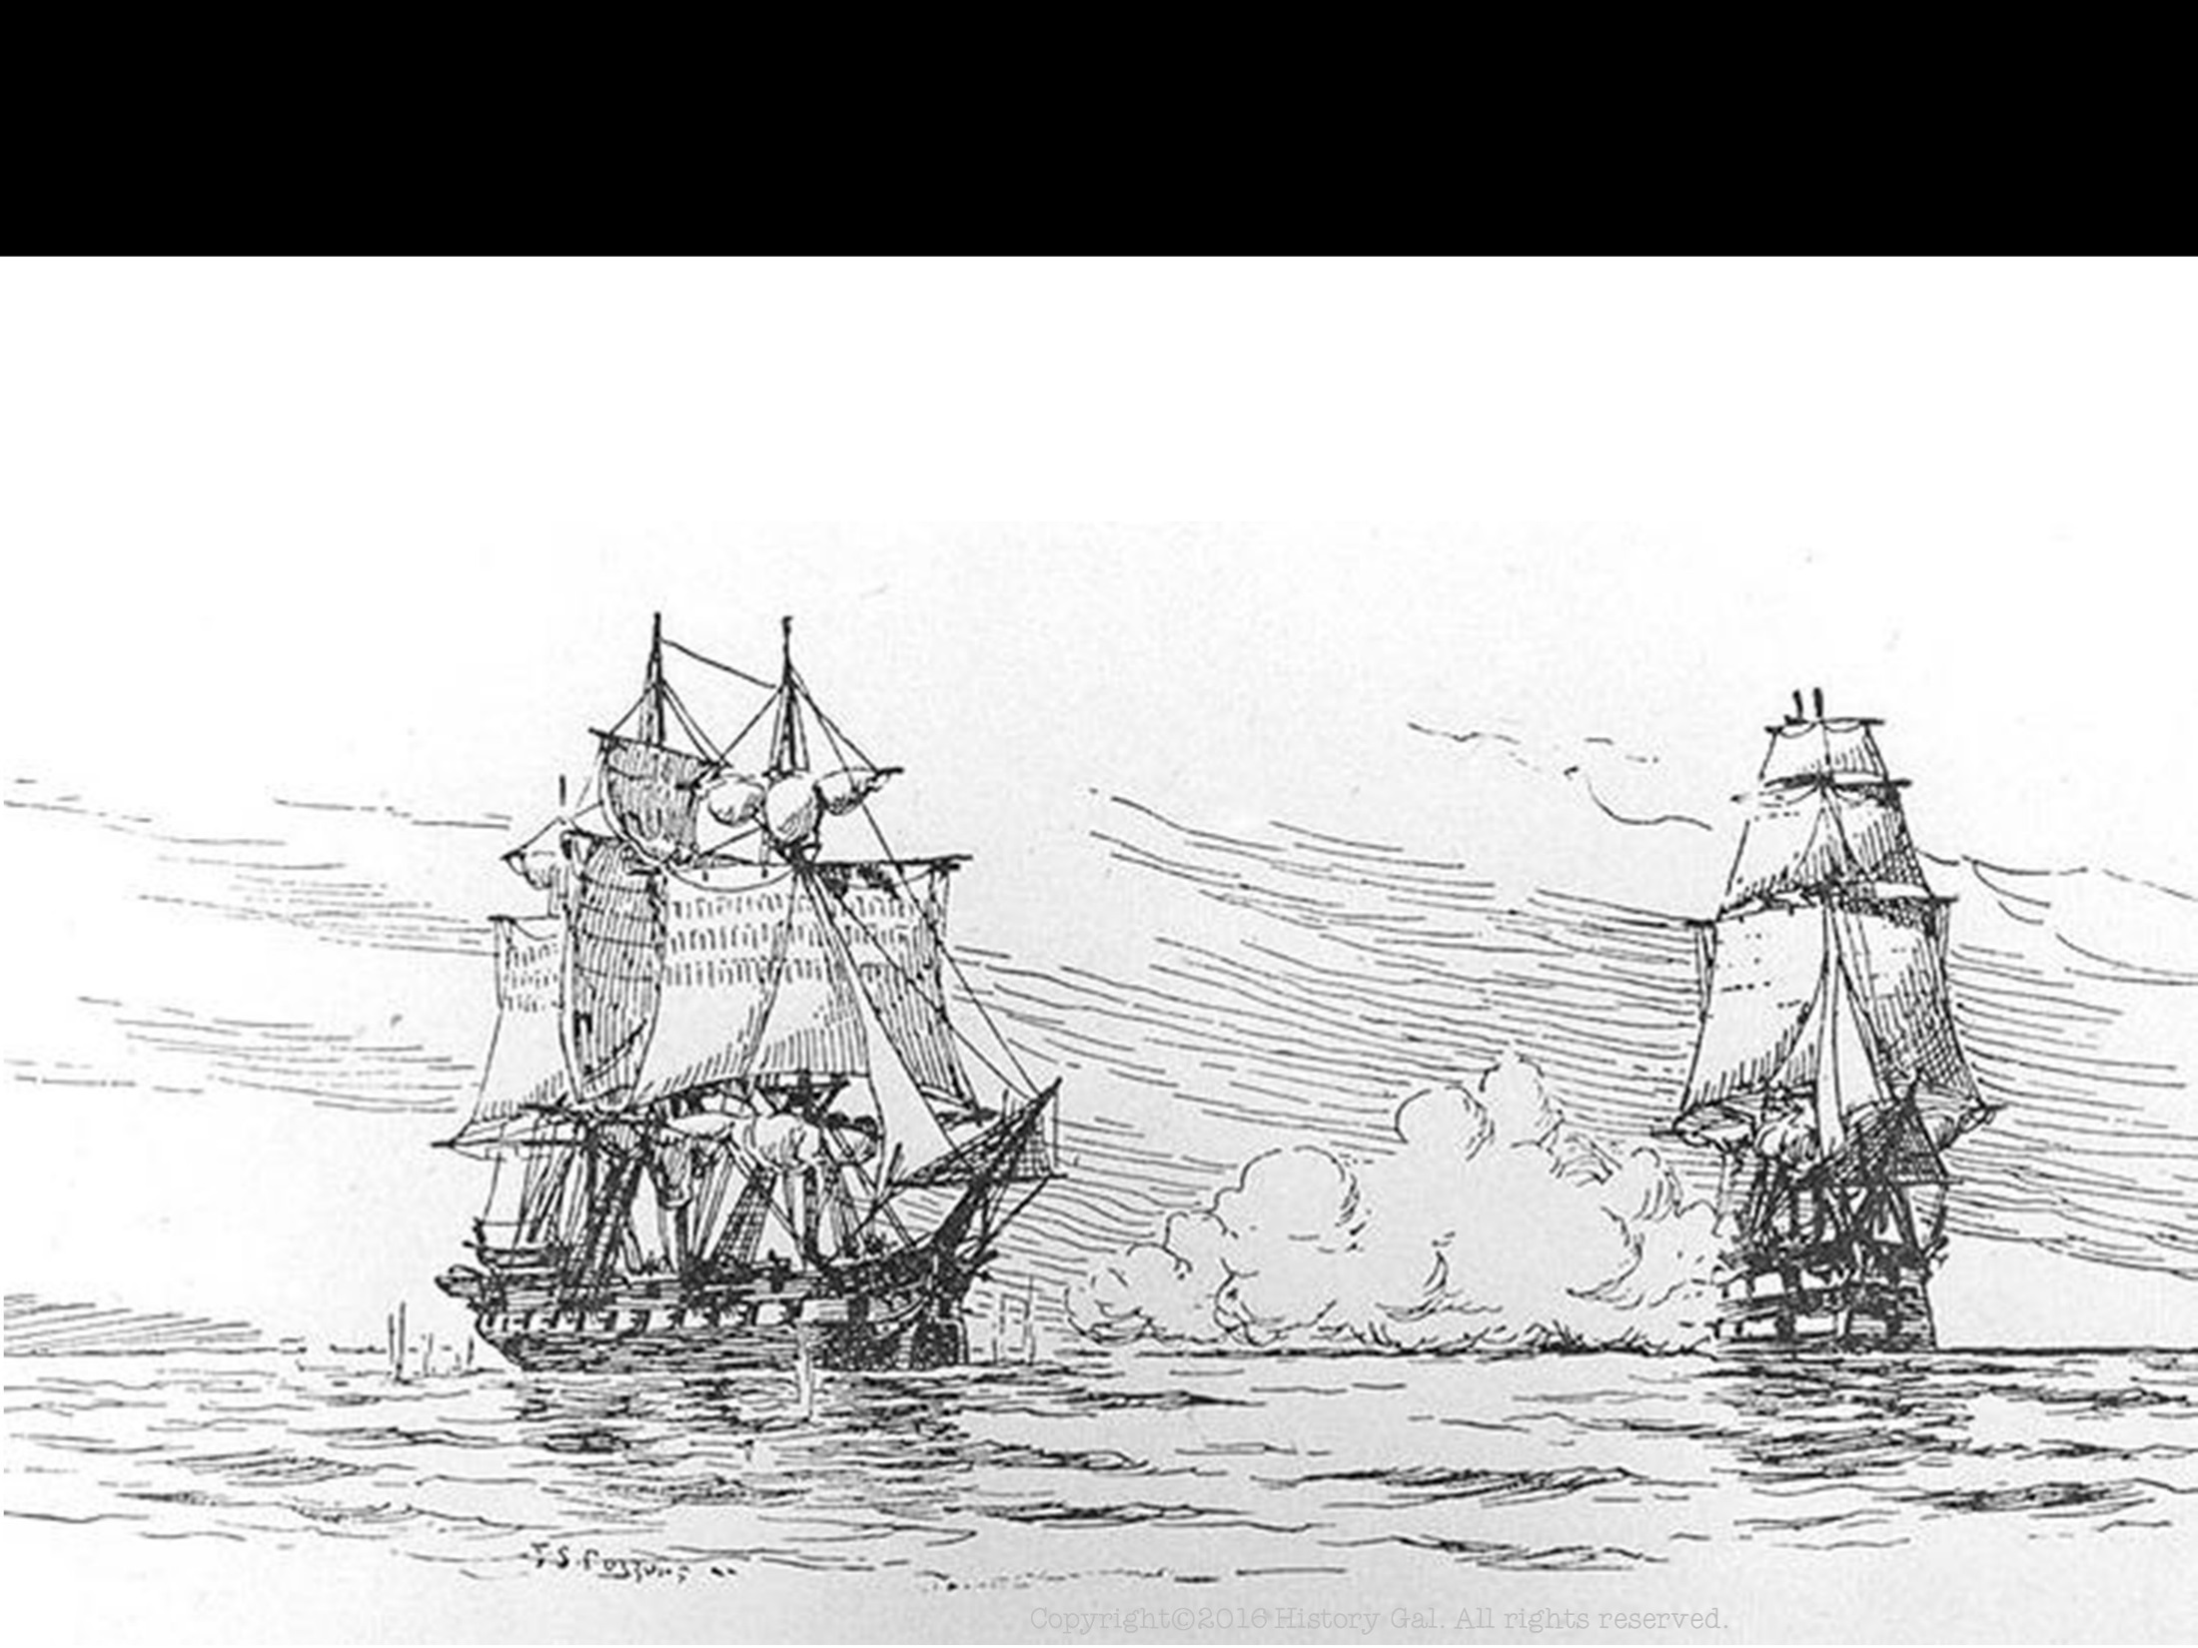
CHESAPEAKE – LEOPARD AFFAIR 1807
A few miles off the Virginia coast, a British warship (Leopard) fired at a U.S. warship (Chesapeake), 3 Americans were killed, 4 were forced into the British navy
Americans wanted war, but Jefferson chose to use diplomacy and economic pressure instead

Slide 64
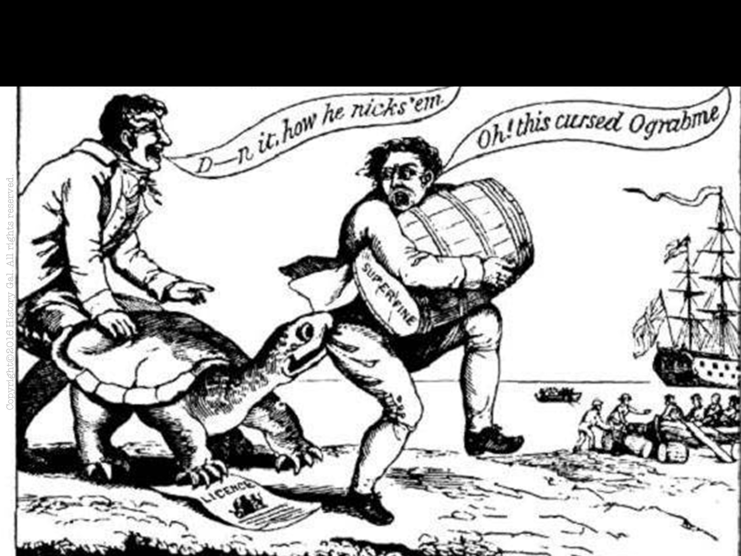
EMBARGO ACT 1807
Prohibited U.S. merchant ships from trading with other countries (hoped it would hurt France and Britain economically)
However, the act hurt the U.S. economy especially those in the North
1809 – the act was repealed, but the U.S. still could not trade with France and Britain
Thomas Jefferson Crash Course
Embargo Act of 1807

Slide 65
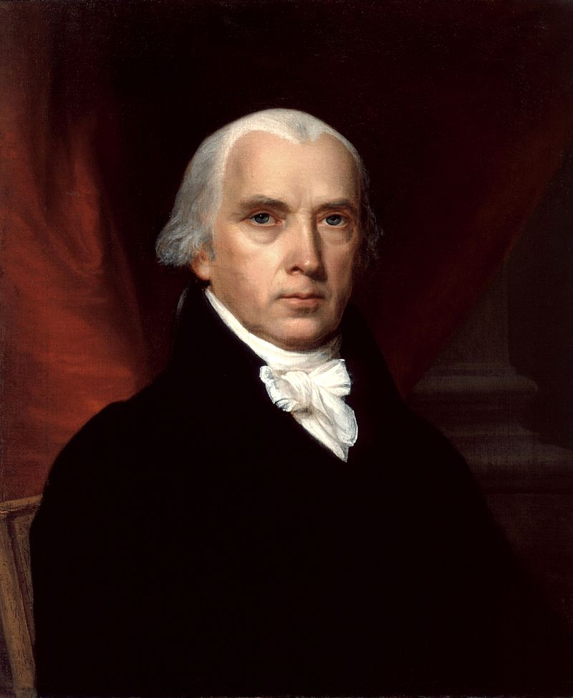
ELECTION OF 1808
Democratic-Republican
James Madison
Federalist Charles Pinckney
VS.
WINNER!
Election of 1808

Slide 66
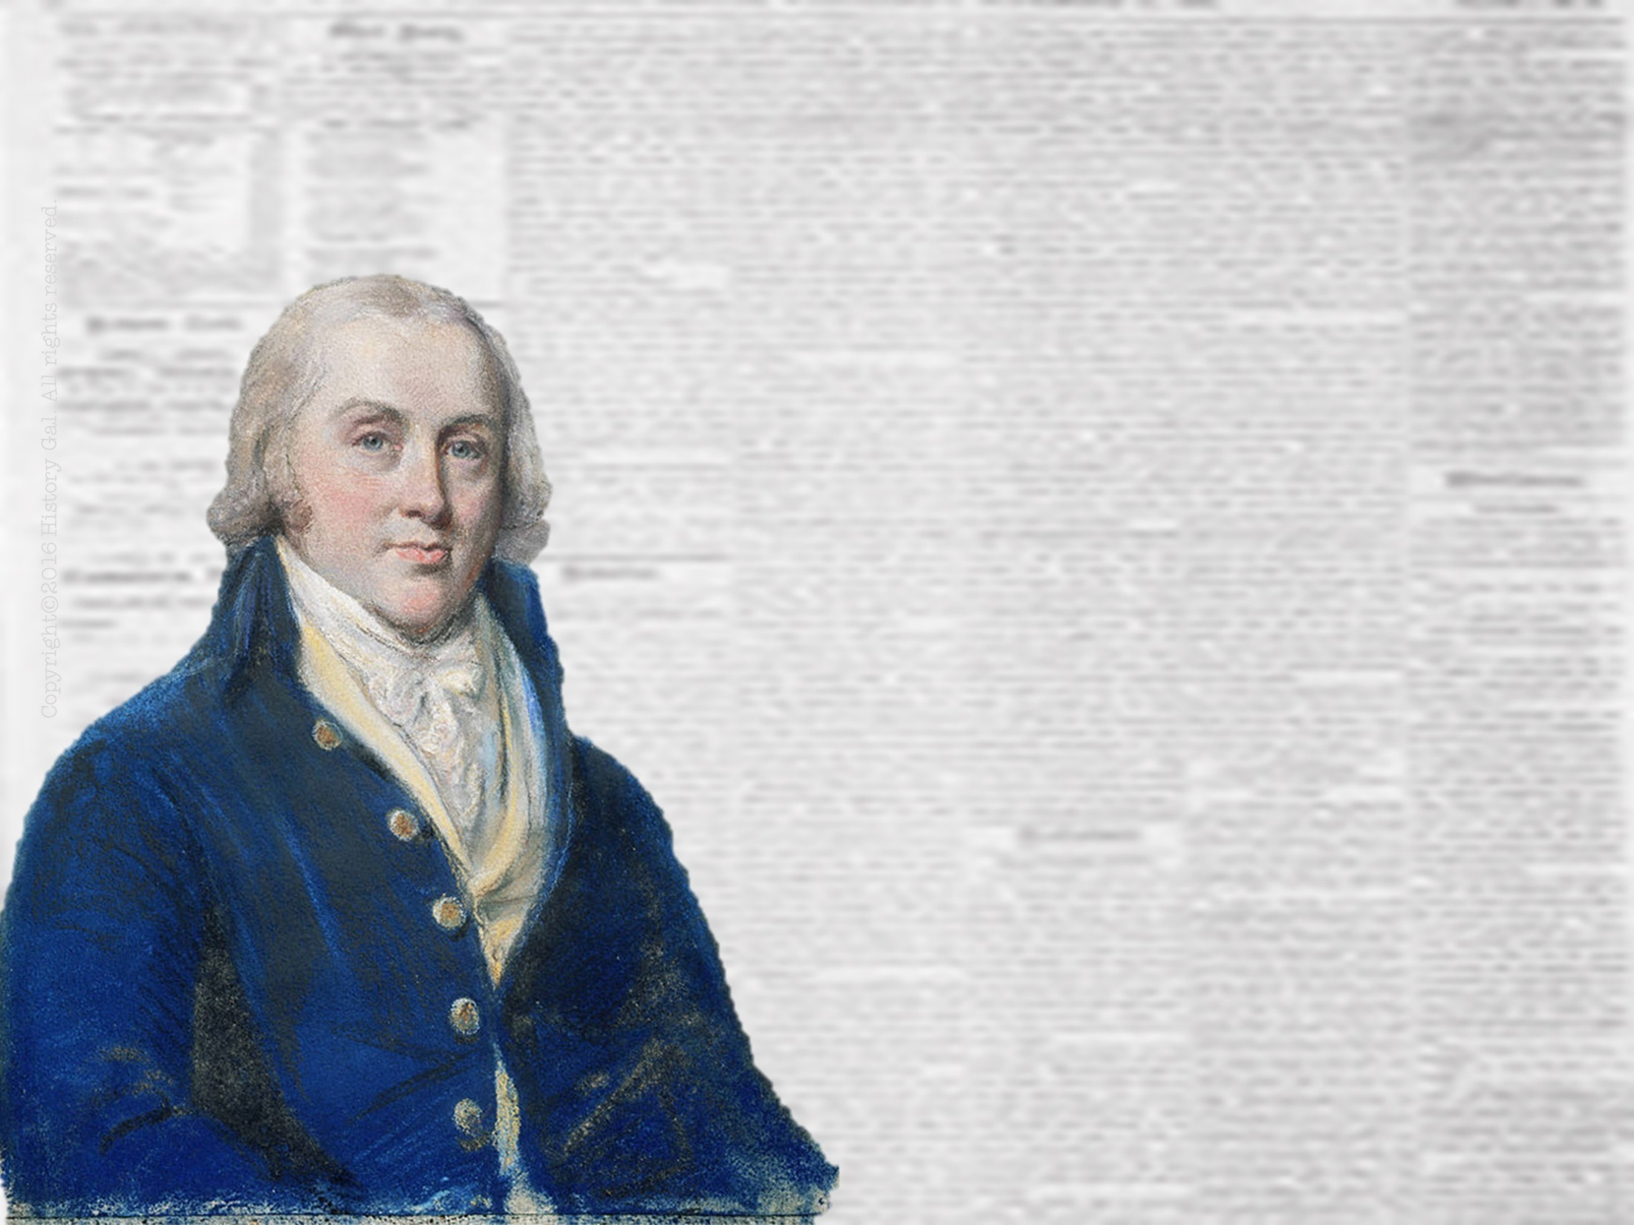
PRESIDENCY OF
JAMES
MADISON
1809-1817
James Madison in 60 Seconds

Slide 67
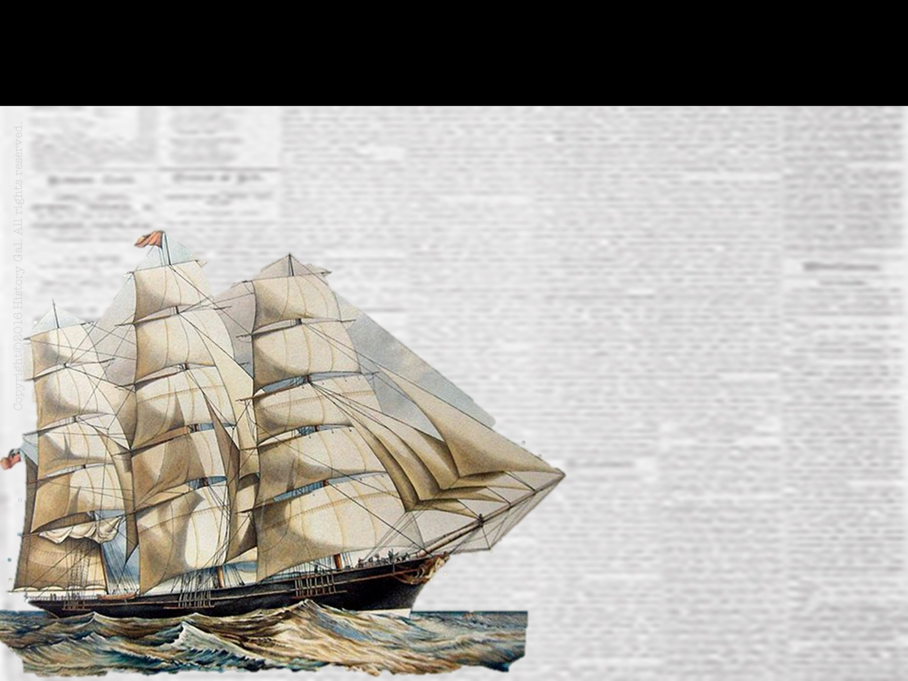
IMPORTANT ACTS
NON-INTERCOURSE ACT OF 1809 – Americans could trade with all nations EXCEPT Britain and France
MACON’S BILL# 2- U.S. would trade with either Britain or France (whichever one agreed to respect U.S. neutrality at sea)
War of 1812 Song

Slide 68
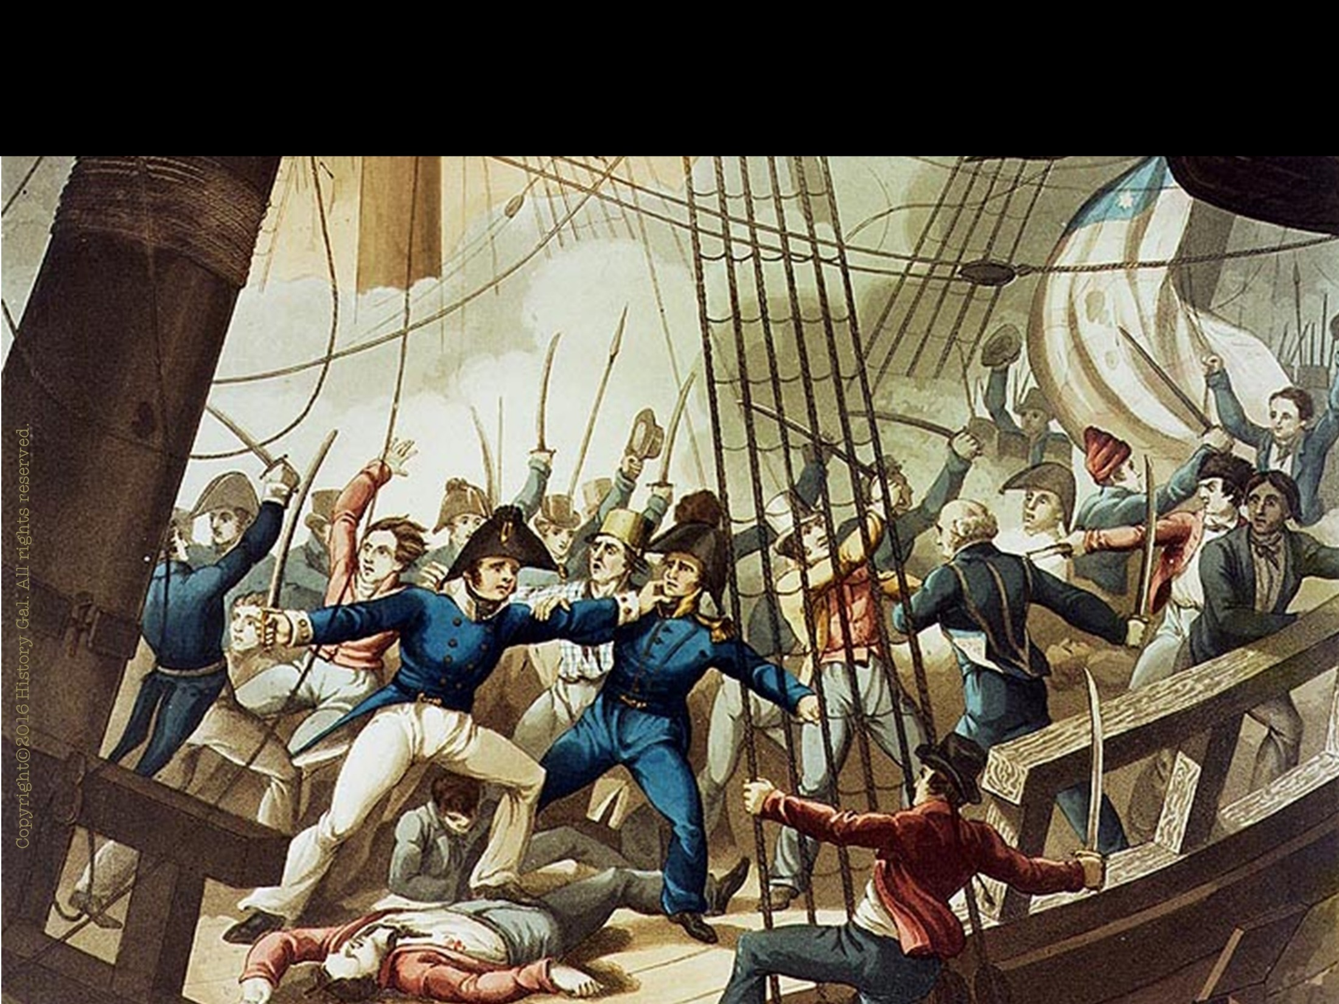
CAUSES OF WAR OF 1812
U.S. wanted its rights as a neutral nation at sea
Americans wanted British Canada and Spanish Florida

Slide 69
CAUSES OF WAR OF 1812
NATIVE AMERICAN PROBLEMS
Shawnee brothers Tecumseh and Prophet attempted to unite all tribes east of
the Mississippi
River to fight
the U.S.

Slide 70
CAUSES OF WAR OF 1812
INDIAN PROBLEMS
General William Henry Harrison destroyed this effort at the Battle of Tippecanoe
The British provided limited aid to Tecumseh so Americans blamed the British for starting the rebellion
Battle of Tippecanoe
William Henry Harrison in 60 Seconds

Slide 71
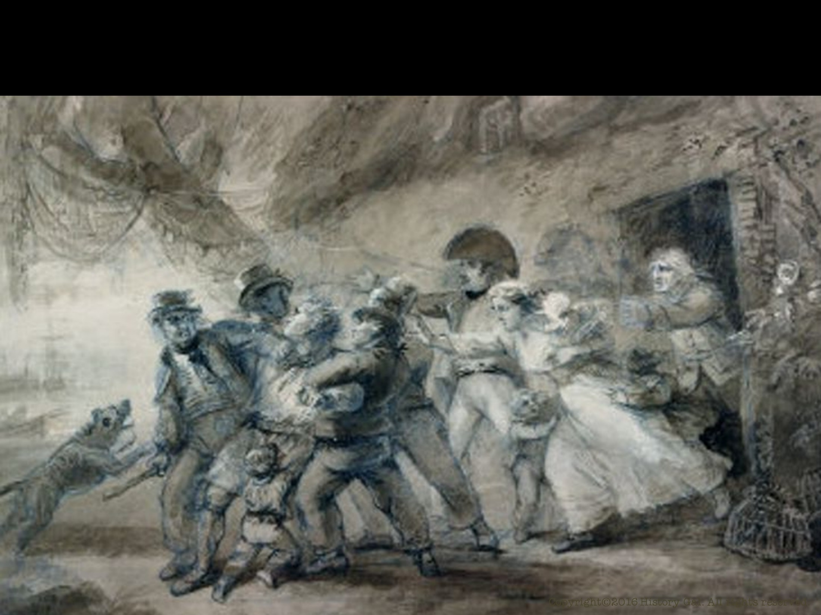
CAUSES OF WAR OF 1812
WAR HAWKS – group of people who wanted to go to war with Britain led by Henry Clay of Kentucky and John C. Calhoun of South Carolina
British delay over meeting U.S. demands over neutrality rights which led Madison to seek a declaration of war against Britain

Slide 72
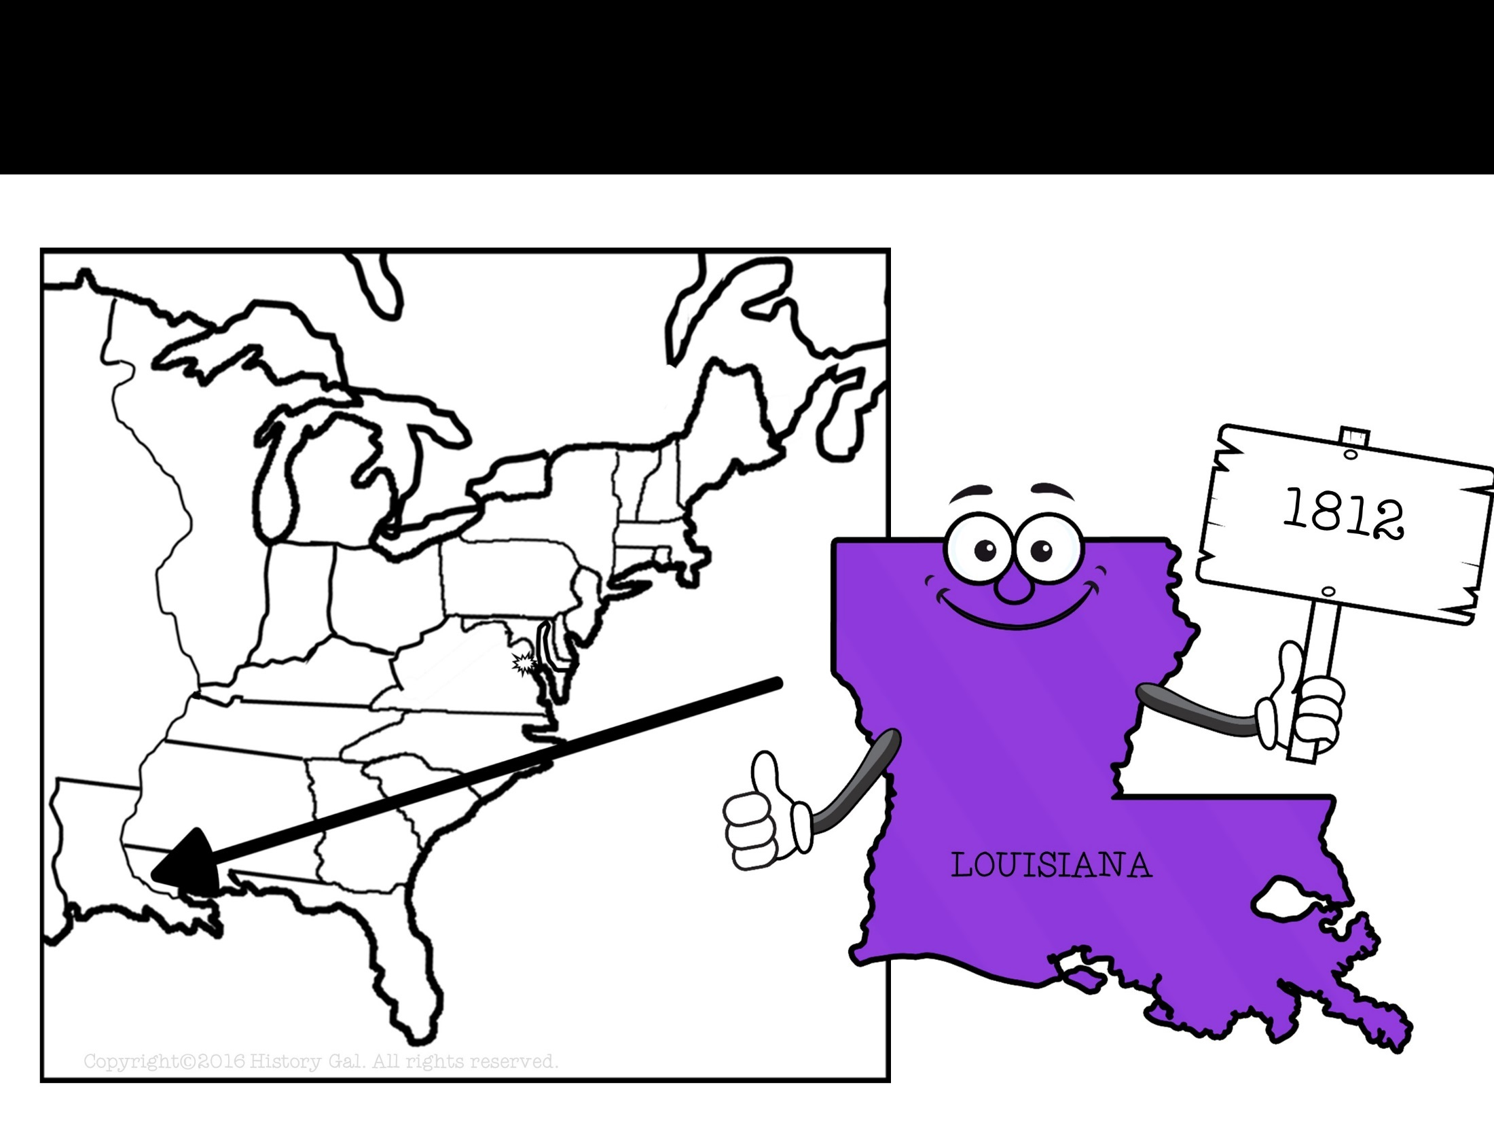
NEW STATE

Slide 73
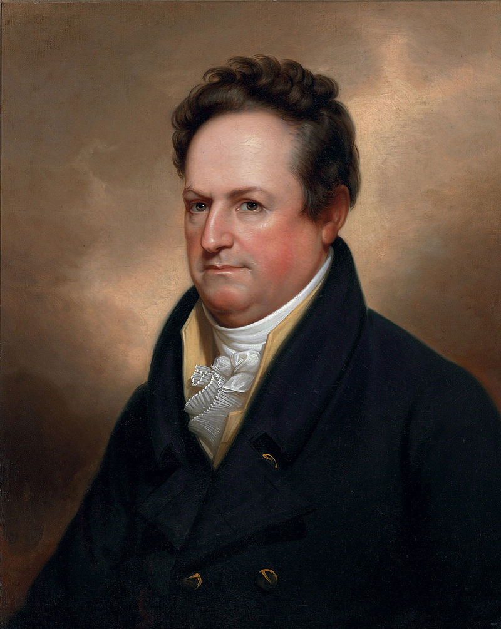
ELECTION OF 1812
Democratic-Republican
James Madison
Democratic-Republican
DeWitt Clinton
VS.
WINNER!
Election of 1812

Slide 74
A DIVIDED NATION
Congress and U.S. citizens were divided over going to war against Great Britain.
GROUPS OPPOSED TO WAR:
New England merchants because they were making profits from the European wars
Federalists

Slide 75
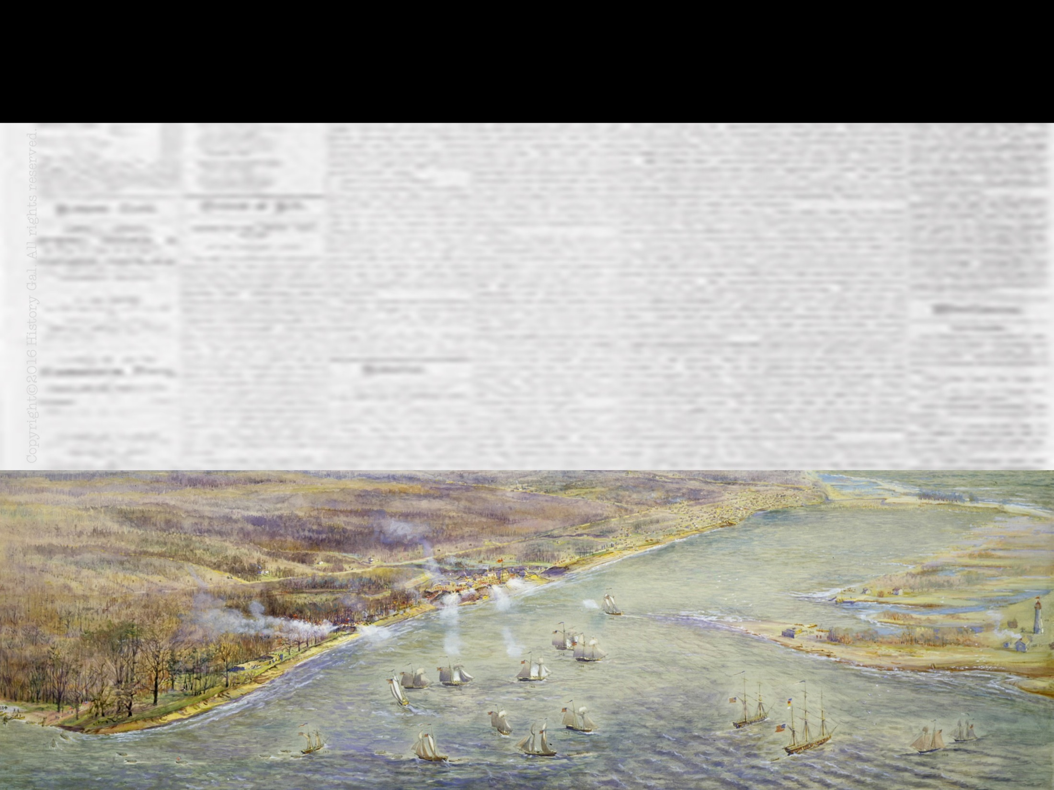
WAR OF 1812 (U.S. v. GREAT BRITAIN)
June 1812, Congress voted to declare war on Great Britain.

Slide 76
WAR OF 1812 (U.S. v. GREAT BRITAIN)
INVASION OF CANADA – 3 part invasion of Canada by U.S. forces (British victory)
Battles Won by the British

Slide 77
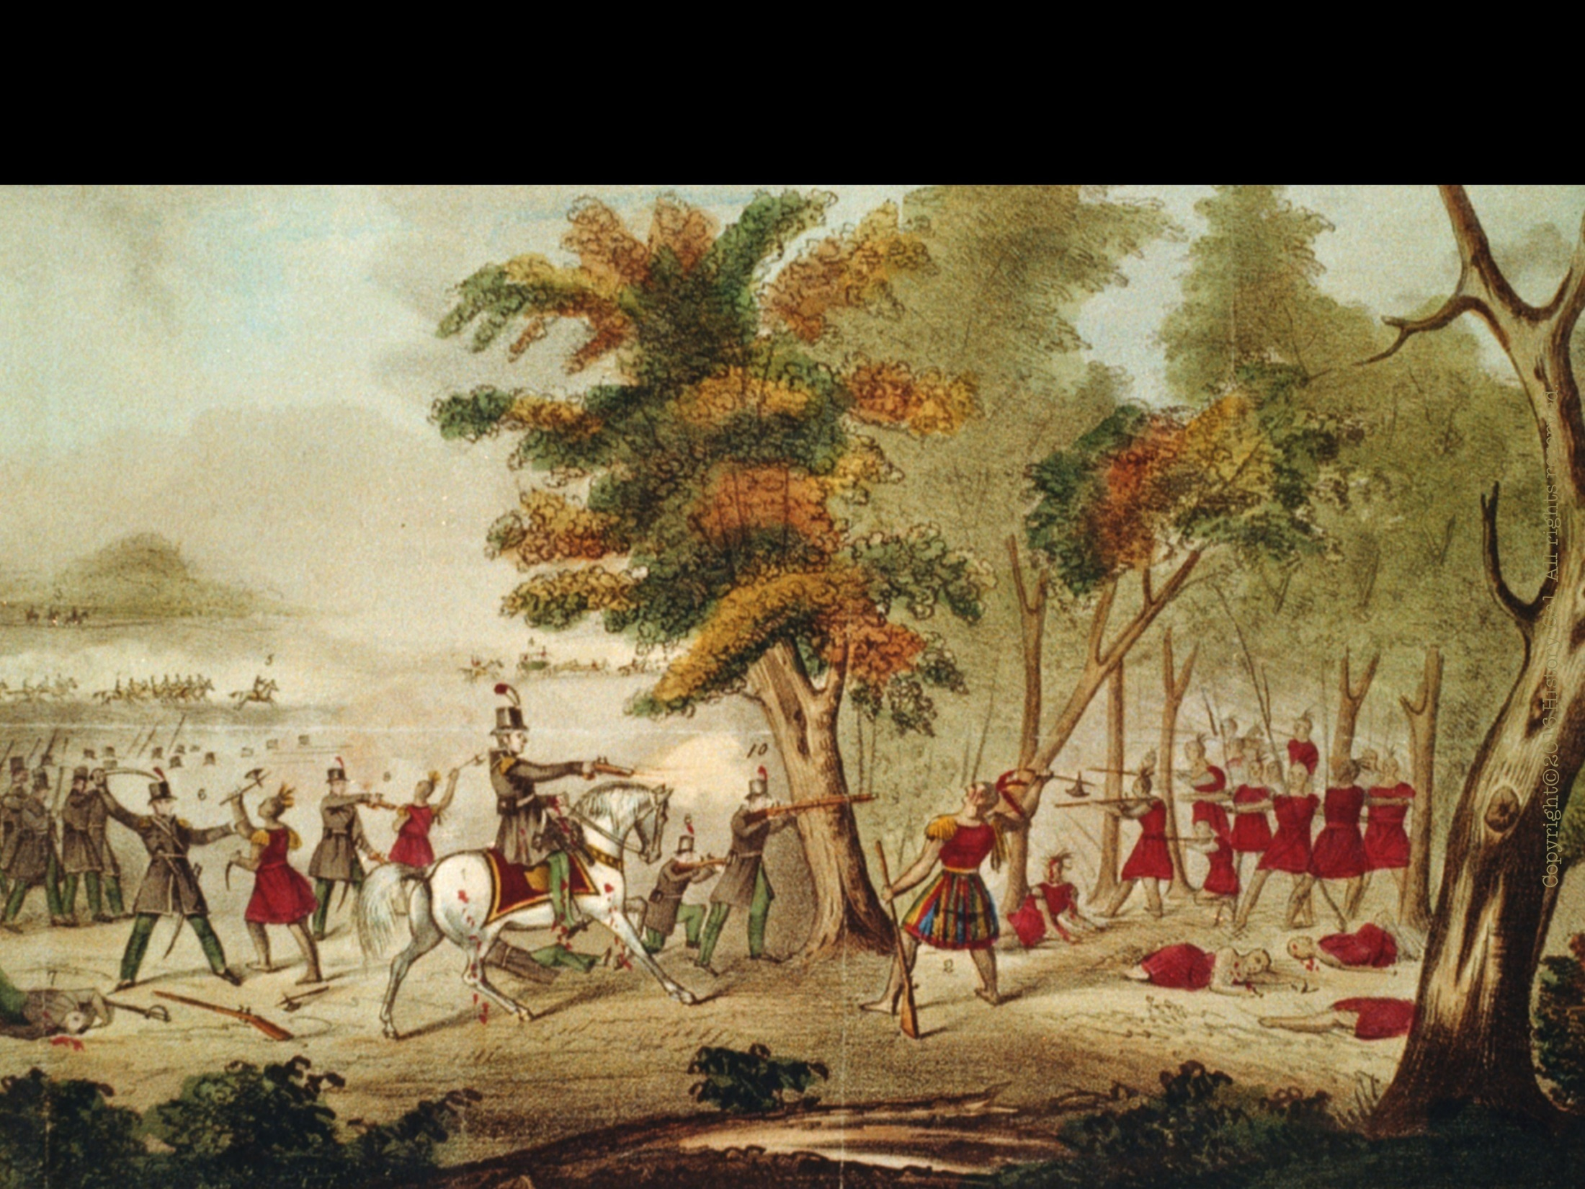
WAR OF 1812 (U.S. v. GREAT BRITAIN)
NORTHERN BATTLES
1812 – Ft. Detroit (British victory)
1813 – Frenchtown and River Raisin Massacre (British victory)
1813 – York/Toronto (U.S. victory)
1813 – Battle of Thames (U.S. victory)
Battle of Ft. Detroit
Battle of York
Battle of the Thames

Slide 78
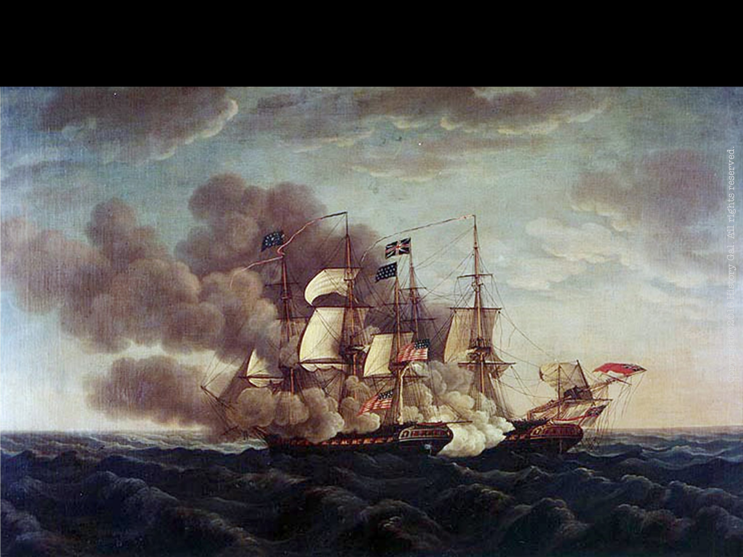
WAR OF 1812 (U.S. v. GREAT BRITAIN)
NAVAL BATTLES
the USS Constitution sunk the British HMS Guerriere off the coast of Nova Scotia (U.S. victory)
U.S. privateers captured numerous British ships
Battle of Lake Erie (U.S. victory)
Battle of Lake Champlain (U.S. victory)
5 Things You Don’t Know About the USS Constitution
Battle of Lake Erie
Battle of Lake Champlain

Slide 79
WAR OF 1812 (U.S. v. GREAT BRITAIN)
CHESAPEAKE CAMPAIGN
1814 – British marched through Washington, D.C., setting fire to the White House, the Capitol, and other U.S. government buildings
British tried to capture Baltimore, but Fort McHenry held out (Francis Scott Key wrote the “Defence of Fort M'Henry”during this bombardment)
Copyright©2016 History Gal. All rights reserved.
The Burning of Washington D.C.
Defense of Ft. McHenry
Battle of Ft. McHenry Through Francis Scott Key’s Eyes
CBS Video – Burning of Washington D.C.
Battle of Baltimore

Slide 80
WAR OF 1812 (U.S. v. GREAT BRITAIN)
SOUTHERN CAMPAIGN
U.S. forces commanded by General Andrew Jackson
1814 – U.S. defeated the Creek Nation (British ally) at the Battle of Horseshoe Bend
January 1815 – Battle of New Orleans – U.S. defeated the British (after the treaty ending the war had been signed in Europe)
Mail Call 1812 Part 2
200th Anniversary of Battle of New Orleans
Battle of Horseshoe Bend
Andrew Jackson in 60 Seconds
Johnny Cash Version of Song
Song: Battle of New Orleans

Slide 81
WAR OF 1812 (U.S. v. GREAT BRITAIN)
HARTFORD CONVENTION
(Dec. 15, 1814 - Jan. 5, 1815)
New England Federalist party members met at the Hartford Convention to discuss war grievances and the possibility of secession.
Copyright©2016 History Gal. All rights reserved.
Hartford Convention

Slide 82
WAR OF 1812 (U.S. v. GREAT BRITAIN)
TREATY OF GHENT (1815): ended the War of 1812
Stopped the fighting
Returned all conquered territory to whoever had claimed it before the war
Recognized the pre-war boundary between the U.S. and British Canada
Said nothing about the grievances that led to the war (neutral rights at sea, etc.)
Treaty of Ghent

Slide 83
LEGACIES OF WAR OF 1812
U.S. gained respect
U.S. accepted Canada as a neighbor
Federalist Party disappeared because it had been against the war and its talk about secession of New England
The Canadian Perspective
Military Medicine During the War of 1812
Blacks During the War of 1812

Slide 84
LEGACIES OF WAR OF 1812
Native Americans were forced to surrender large tracts of land
More U.S. factories were built since European goods were not available during the war

Slide 85
LEGACIES OF WAR OF 1812
War heroes like Andrew Jackson and William Henry Harrison will be a new generation of
political leaders
Strong feelings
of American
nationalism
ushered in the Era
of Good Feelings

